Slide 1
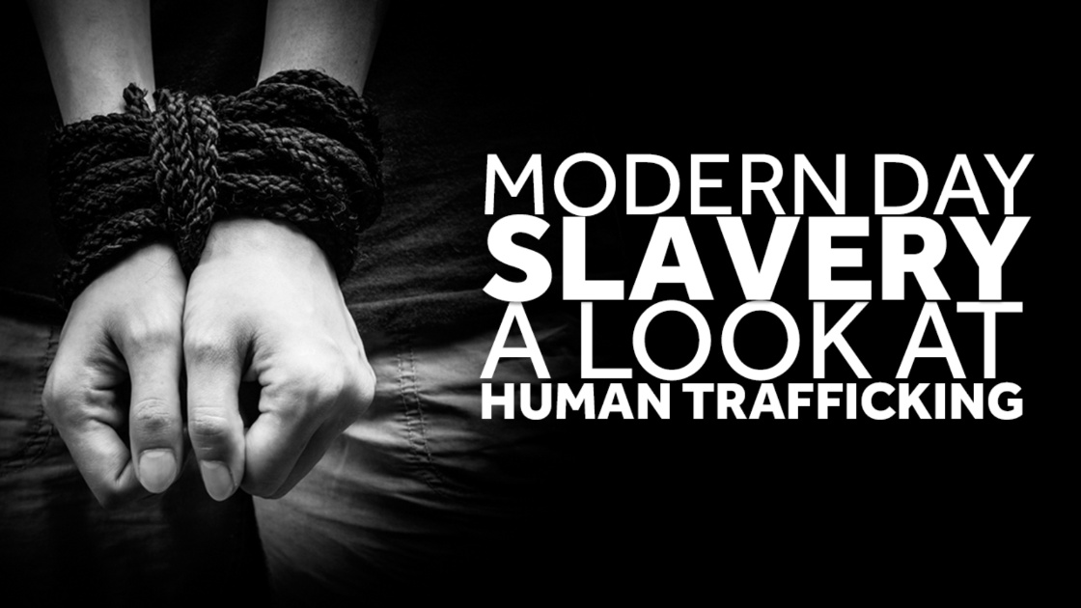
Erin E. Tracy, M.D., M.P.H. (class of ‘88)
University of Scranton Medical Alumni Symposium
Saturday, March 30, 2019

Slide 2
Learning Objectives
Overview of trafficking
Identify patients at risk/screening
Be aware of resources to help survivors
I have no disclosures to make

Slide 3
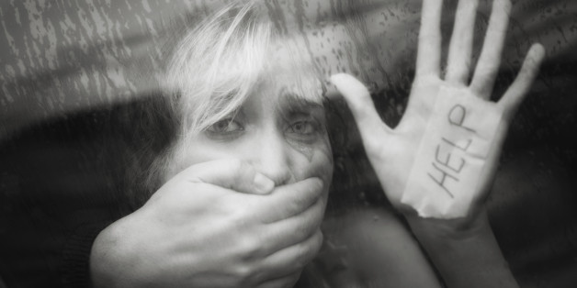
How many of you have ever had a pt who was a victim of human trafficking?

Slide 4
https://human trafficking video
https://www.youtube.com/watch?v=VZTN0TbsRYA&t=9s

Slide 5
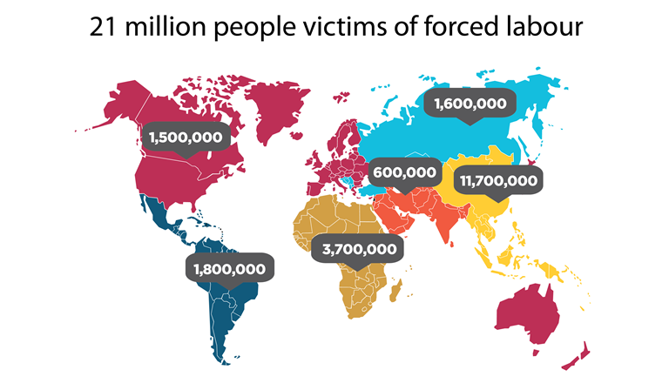
http://www.ilo.org/global/topics/forced-labour/policy-areas/statistics/lang--en/index.htm (2012 ILO statistics)

Slide 6
At any given time in 2016, an estimated 40.3 million people are in modern slavery, including 24.9 in forced labour and 15.4 million in forced marriage.
It means there are 5.4 victims of modern slavery for every 1,000 people in the world.
1 in 4 victims of modern slavery are children.
Out of the 24.9 million people trapped in forced labour, 16 million people are exploited in the private sector such as domestic work, construction or agriculture; 4.8 million persons in forced sexual exploitation, and 4 million persons in forced labour imposed by state authorities.
Women and girls are disproportionately affected by forced labour, accounting for 99% of victims in the commercial sex industry, and 58% in other sectors
Source: Global Estimates of Modern Slavery: Forced Labour and Forced Marriage

Slide 7
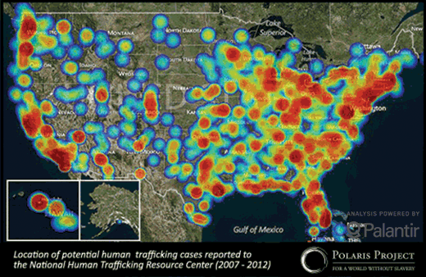

Slide 8
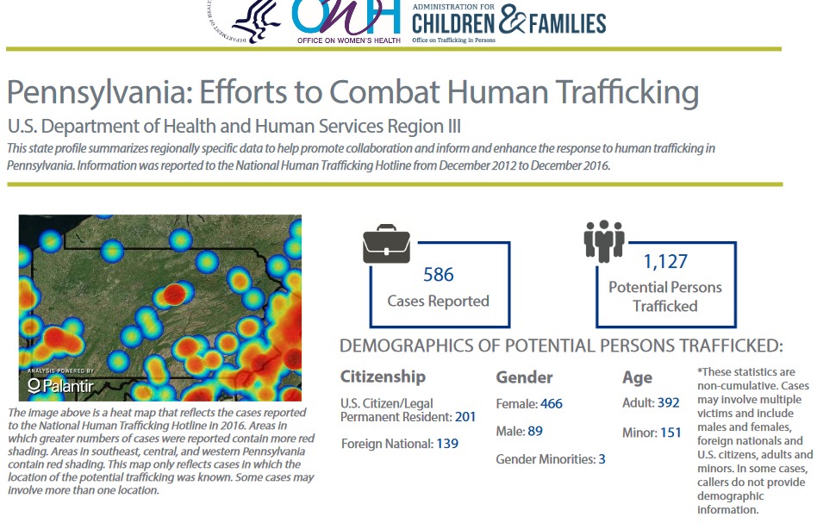

Slide 9
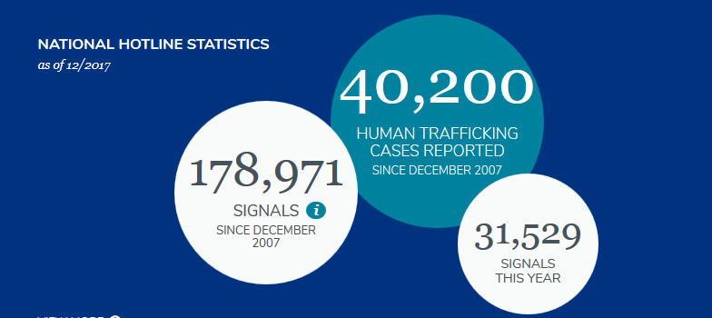
https://humantraffickinghotline.org/

Slide 10
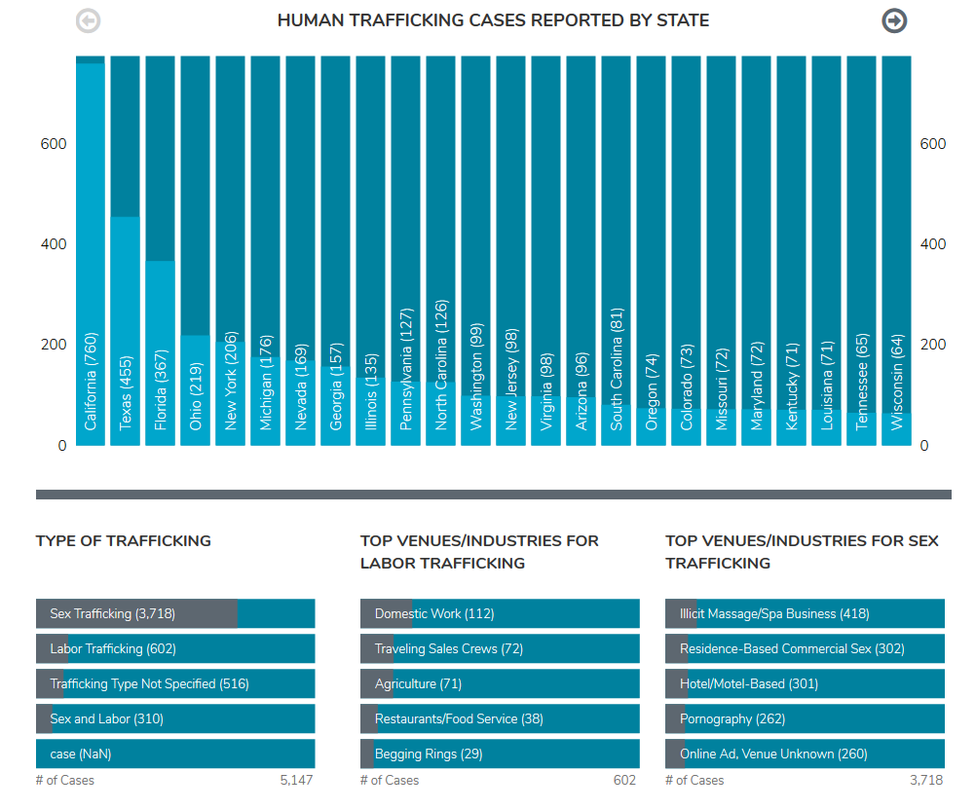

Slide 11
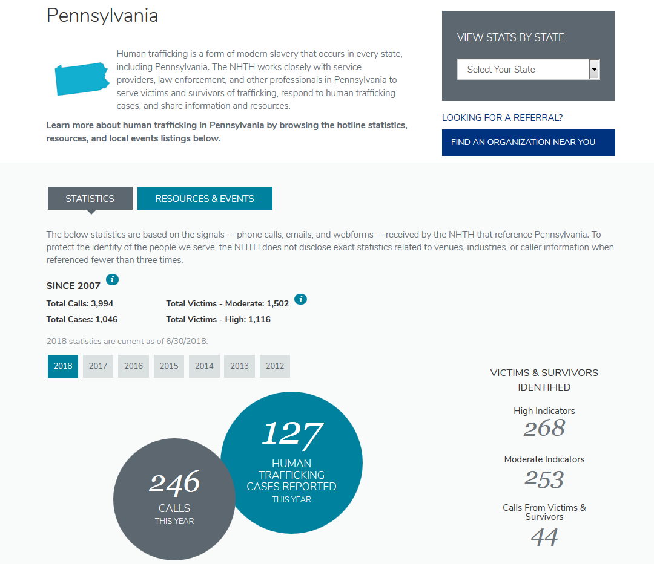

Slide 12
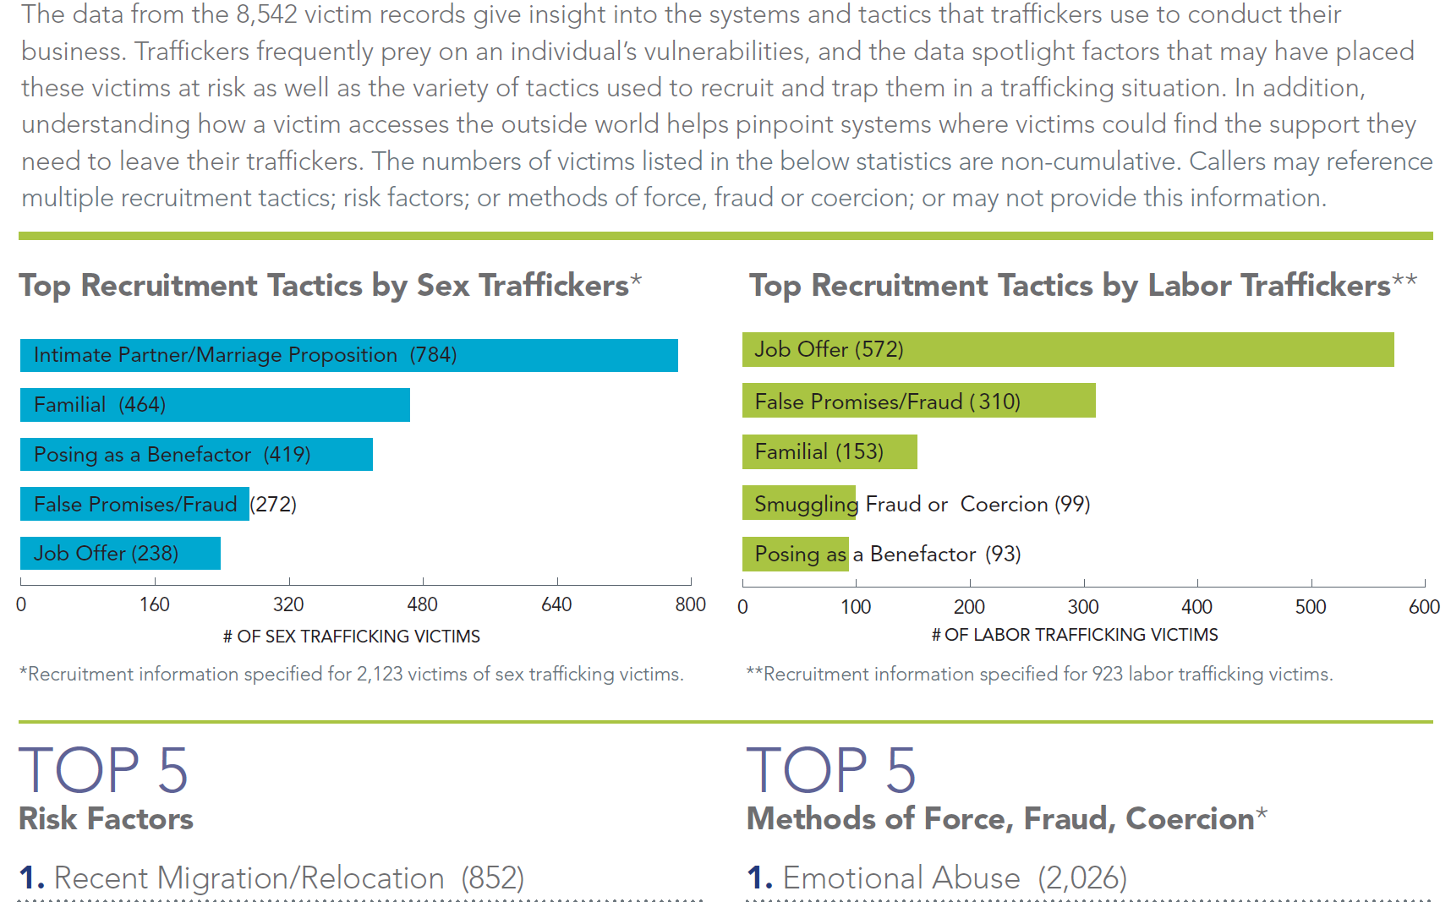

Slide 13
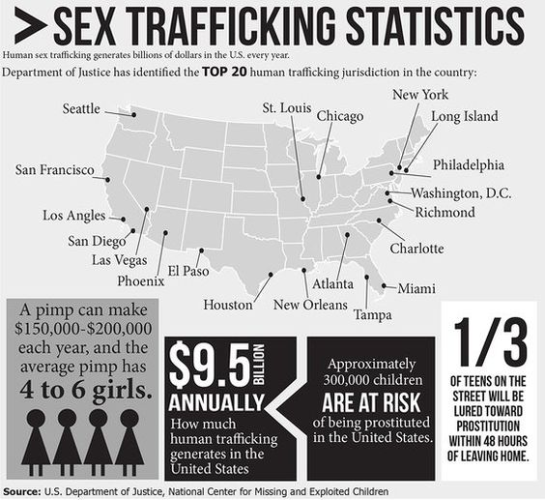

Slide 14


Slide 15
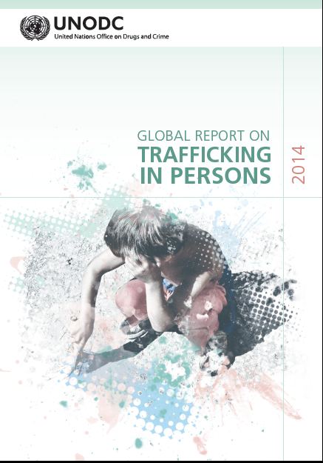

Slide 16
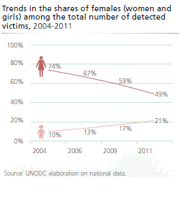

Slide 17
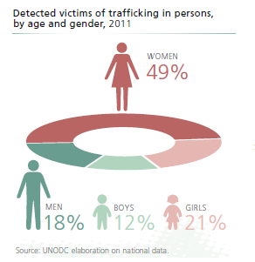

Slide 18
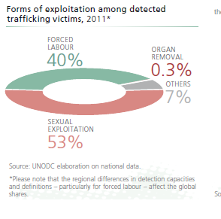

Slide 19
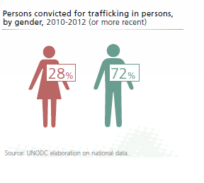

Slide 21
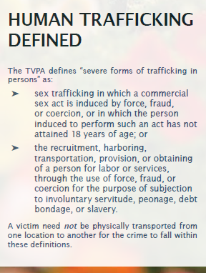
http://www.state.gov/documents/organization/258876.pdf, accessed 10/25/16

Slide 22
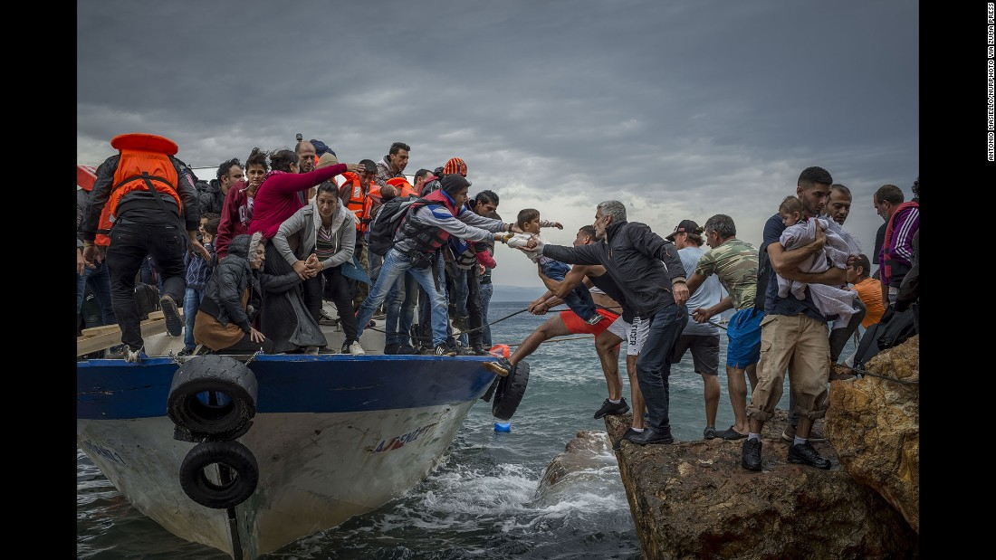
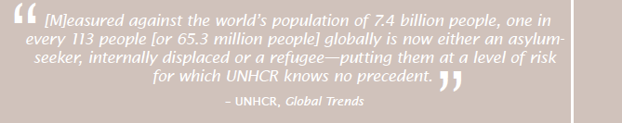

Slide 23

September 2011
Human Trafficking (14-15,000 in US)

Slide 24
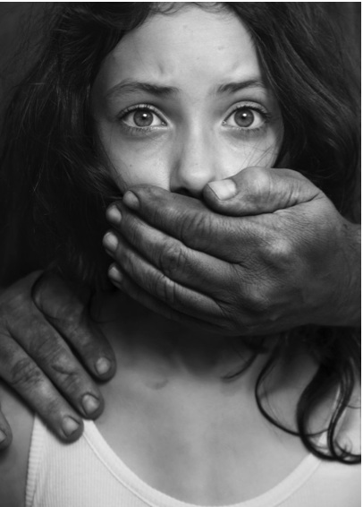
Missed Opportunities
50% of trafficking survivors had been seen by a health care provider at least once during captivity
Baldwin SB et al. Health & Human Rights 2011

Slide 25


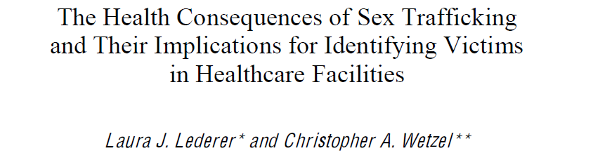
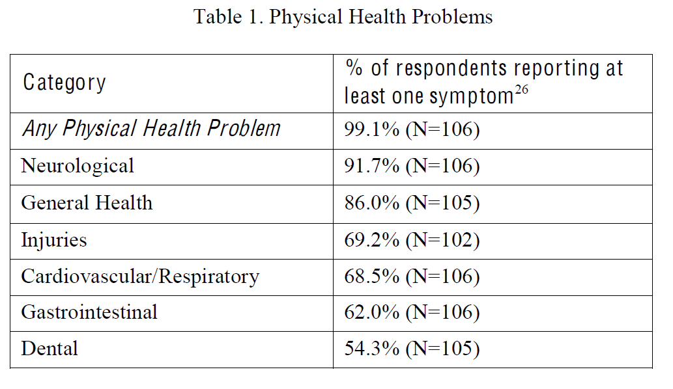
11 focus groups
US cities
N=107
2012, multiple surveys

Slide 26
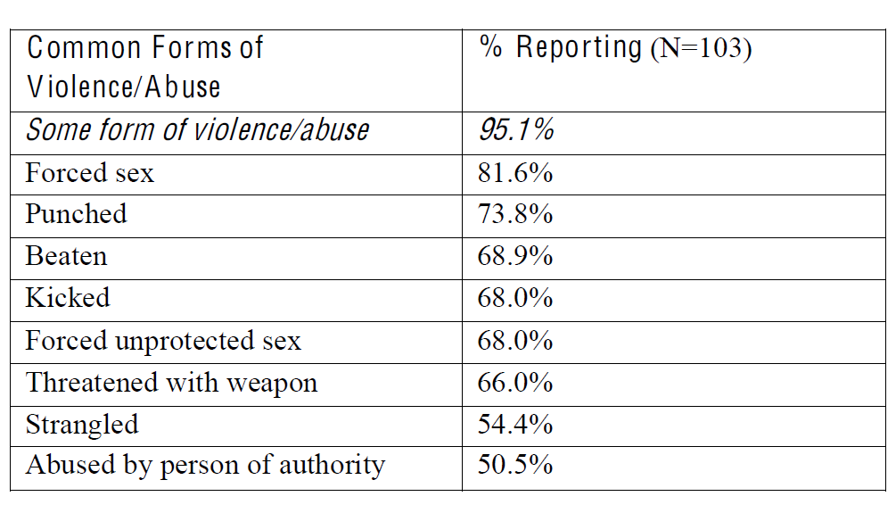
Table 3. Violence and Abuse in Sex Trafficking

Slide 27
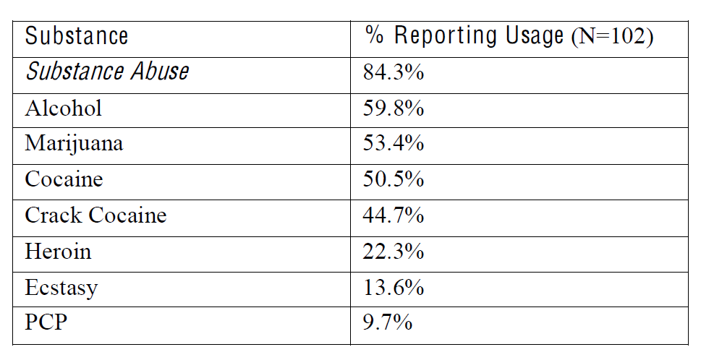
Table 5. Substance Abuse in Sex Trafficking

Slide 28
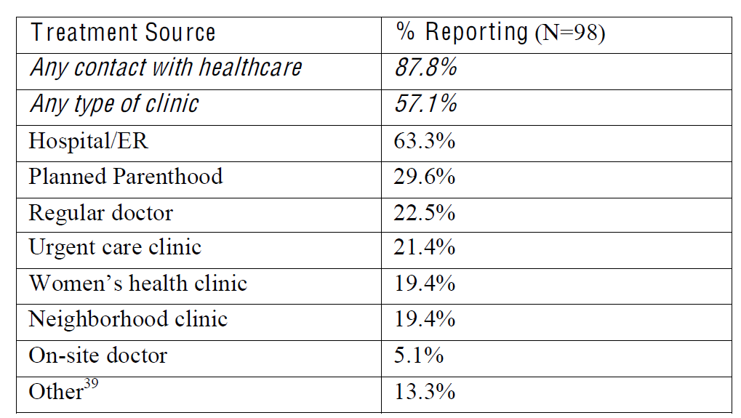

Table 6. Victim Contact with Health Care Provider

Slide 29

Child sex trafficking in the emergency department: opportunities and challenges.
Miller CL DOI: 10.1016/j.jen.2013.06.004

Slide 30
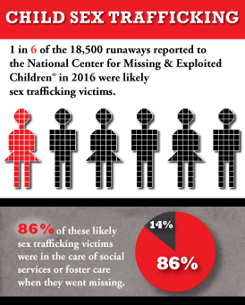
http://www.missingkids.com/Home

Slide 31
Risk Factors
Age (especially 12-16, immature prefrontal cortex, puberty)
Runaway and homeless
History of sexual or physical abuse or neglect
Dysfunctional families (substance abuse, criminality, violence)
Interactions with Child Protective Services of Juvenile Justice System
Lesbian/gay/bisexual/transgender or questioning
Substance abuse, behavioral or mental health issues
Learning disabilities
Living in high crime areas, poverty, transient male populations
Living in countries with political or social unrest or corruption
Living in societies with gender bias and discrimination/ glorification of pimp culture

Slide 32
Presentations
STDs
Unsafe ETPs
Chronic pelvic pain
Injuries
Poor oral health
Anxiety
Depression
PTSD
SI
HIV
Tracy E, Konstantonopoulos W Obstet Gynecol 2012

Slide 33
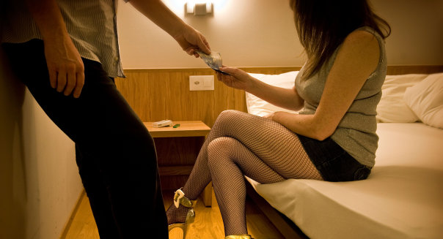
More $$$ for unprotected sex
Tsutsumi A et al. Soc Sci Med 2008

Slide 34

Zimmerman C, Yun K, Watts C, Shvab I, Trapppolin et al. The health risks and consequences of trafficking in women and adolescents: Findings from a European study. London School of Hygiene & Tropical Medicine 2003
25% at least one unintended pregnancy> ETP
10-50 clients/ night
27% forced to have unprotected anal coitus

Slide 35
“virginity seekers”
Belief HIV cured via sex w/ a virgin
Female virgins $400-800 first encounter
  $1000 for one week
  After that price can be $15/ visit
  “resale virginity”
  stitch vaginal tears or hymen
  Peters K. The growing business of human trafficking and the power of emergency nurses to stop it. J Emergency Nursing 2013:39:280-88

Slide 36
Silverman J, Decker M, Gypta J, Maheshwari A, Patel V, Raj A. HIV prevalence and predictors among rescued sex-trafficked women and girls in Mumbai, India. J Acquir Immune Defic Syndr 2006;43:588-93.
Study of 175 survivors/ HT in India
22.9% HIV +
(also risks of other communicable diseases bc/ overcrowding)

Slide 37

Suspect if girls
With older nonrelative
Have unexpected material things
Overly familiar with sex
Tattoo reluctant to discuss

Slide 38
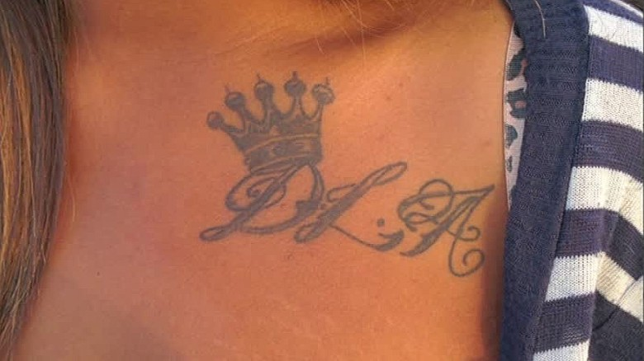
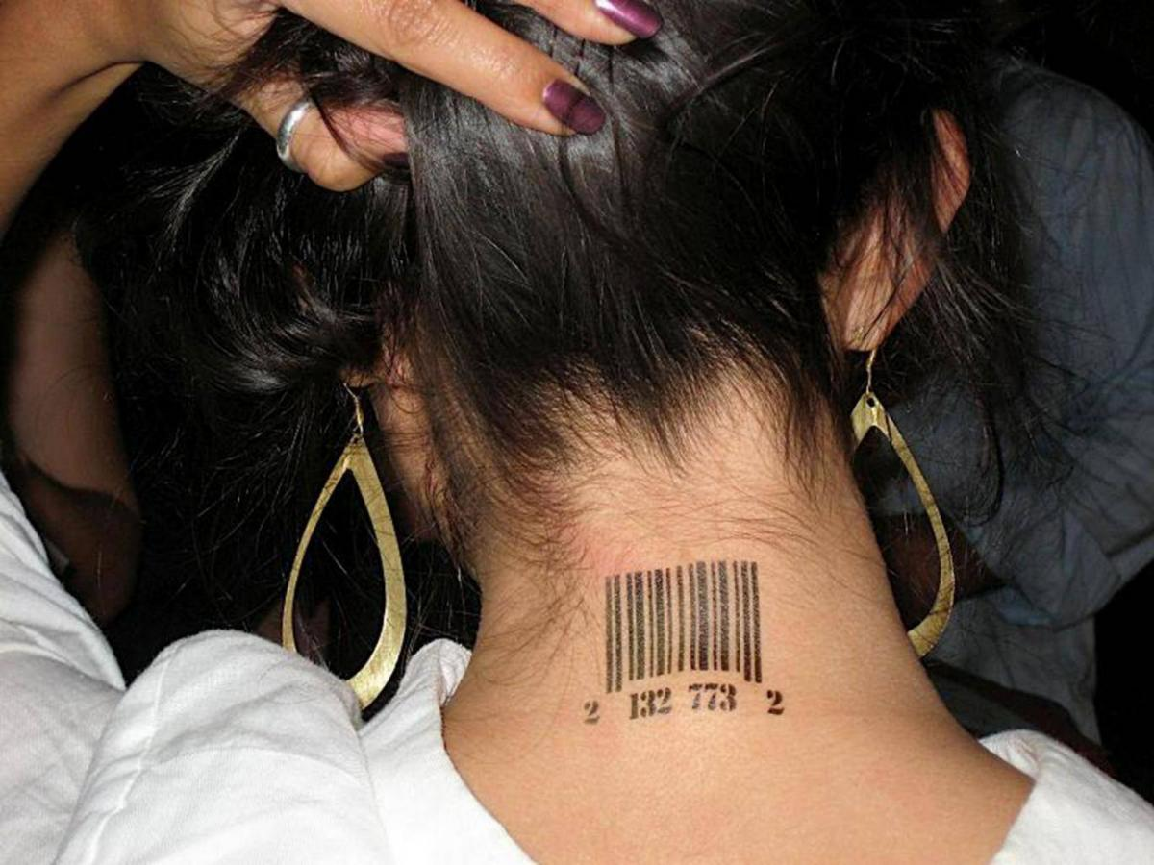
https://www.napnappartners.org/tattoos-human-trafficking-victims

Slide 39
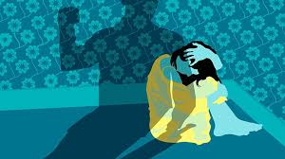
Similar to IPV
Wounds in various stages of healing
  Esp lower back
Injuries don’t match Hx
Looks anxious/ afraid
Someone else answers her questions/ won’t leave
    ***Professional interpreters***

Slide 40
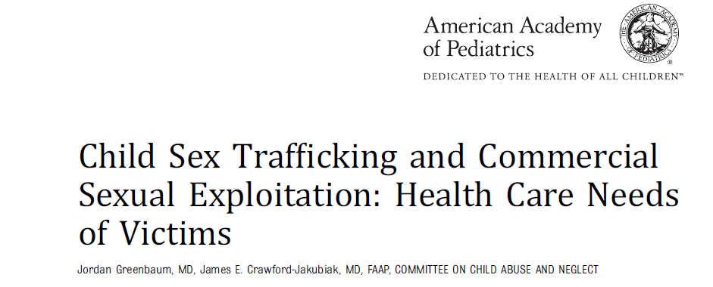
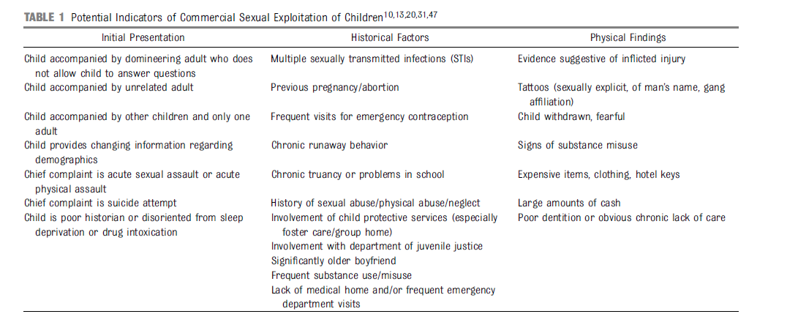

Slide 41

Medical Sequelae

Slide 42
Zimmerman C,et al. Am J Public Health 2008;98:55-9

Slide 43

Myriad of mental health issues
Depression
Anxiety
PTSD
Suicidal ideation
Tracy E, Macias-Konstantopoulos, W. Obstet Gynecol 2017;130:443-53.

Slide 44
12% of 387 survivors had attempted to harm or kill themselves within the past month
Kiss L, Yun K, Pocock N, Zimmerman C. JAMA Pediatrics 2015;169:e152278.

Slide 45
Substance Use
“it was much more difficult to work sober because I was dealing with emotions or the pain that I was feeling during intercourse, because when you have sex with people 8,9,10 times a day, even more than that, it starts to hurt a lot. And being high made it easier to deal with that and also it made it easier for me to get away from my body while it was happening, place my brain somewhere else.”
Ravi A, Pfeiffer M, Rosner Z, Shea J. Trafficking and trauma: Insight and advice for the healthcare system from sex-trafficked women incarcerated on Rikers Island. Medical Care 2017;55:1017-22

Slide 46
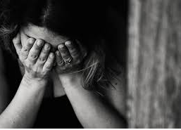
Importance of trauma-informed questions
Potentially triggering
Potentially retraumatizing

Slide 47
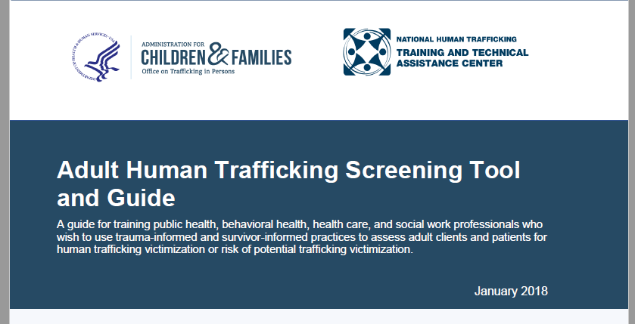

Slide 48

Recognize effects of violence on patient
Ensure appropriate services
Identify and manage concomitant problems
Ensure services culturally and linguistically appropriate
Minimize possibility of re-traumatizing
Emphasize education, choice and resilience

Slide 49

Patient may appear
Withdrawn
Distrustful
Intoxicated
Drug-seeking
Detached

Slide 50
Don’t:
Immediately address psych Sx during screening
  Could increase agitation
  Could interfere w/ ability to screen
Criticize or condemn trafficker
  Could distress patient
  Patient could become defensive
It is best to maintain a verbally neutral stance towards the trafficker

Slide 51
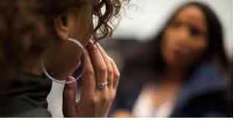

Important
Professional interpreters
See patients alone

Slide 52
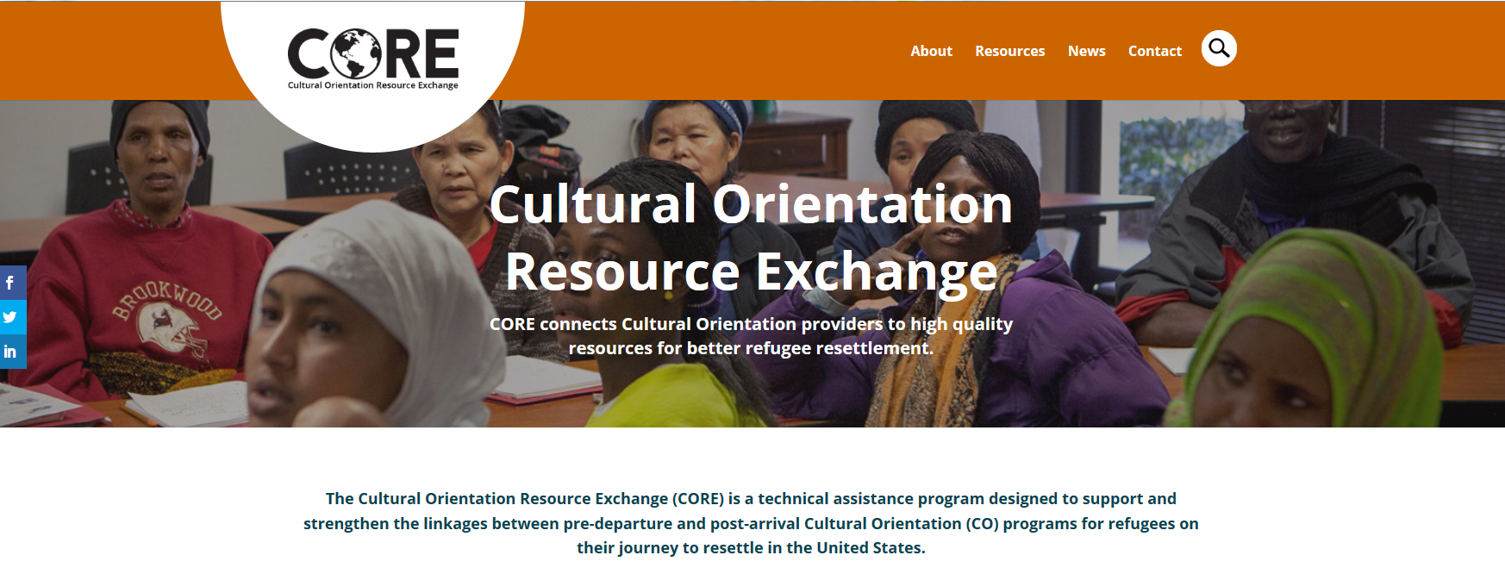

Slide 53
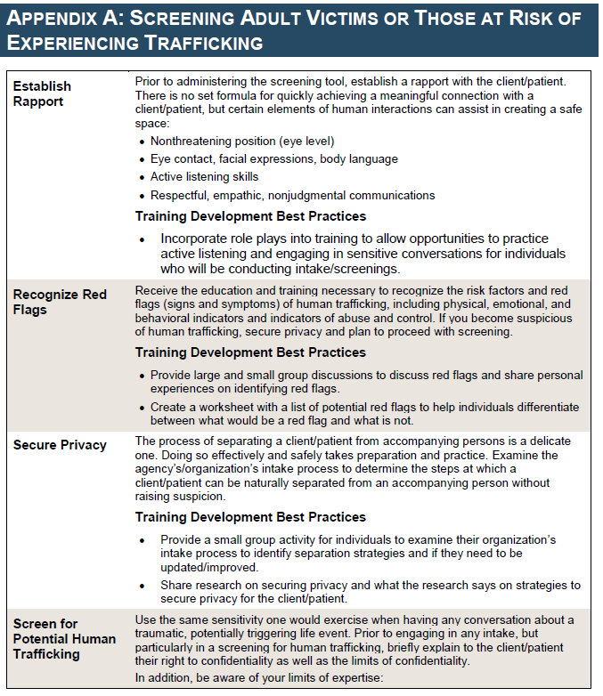

Slide 54
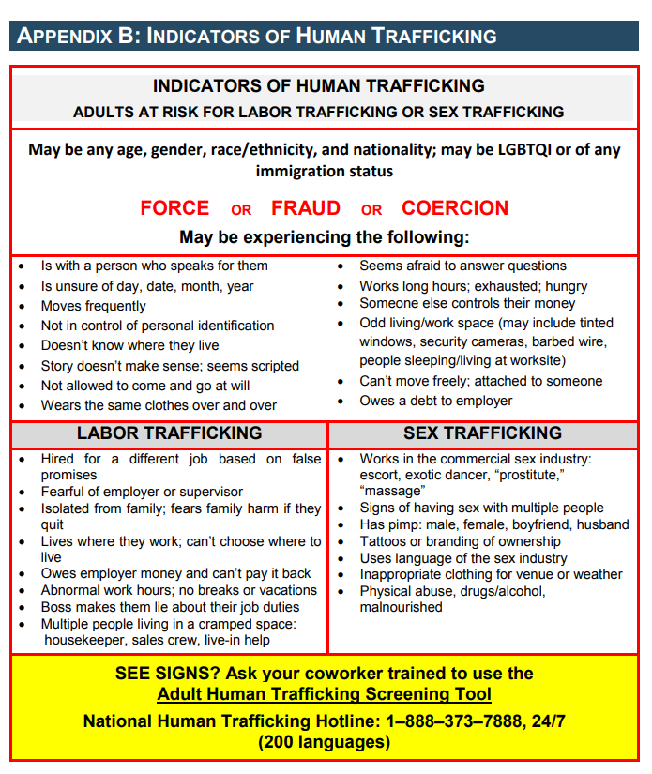
https://www.acf.hhs.gov/sites/default/files/otip/adult_human_trafficking_screening_tool_and_guide.pdf (U.S. HHS Jan 2018)

Slide 55
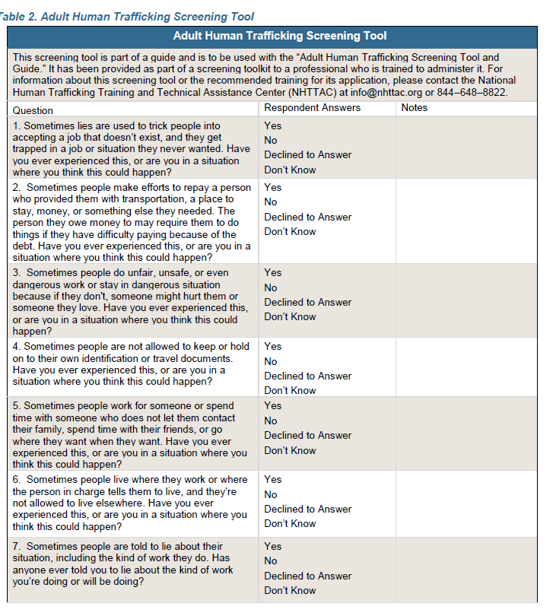
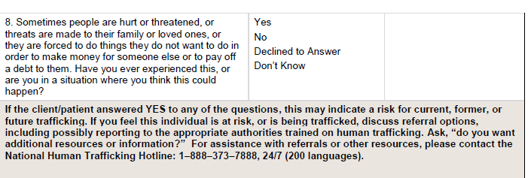

Slide 56
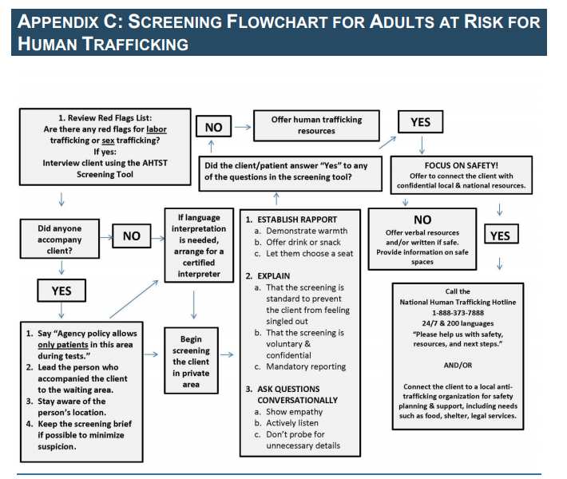

Slide 57
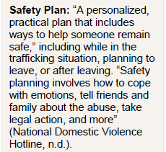
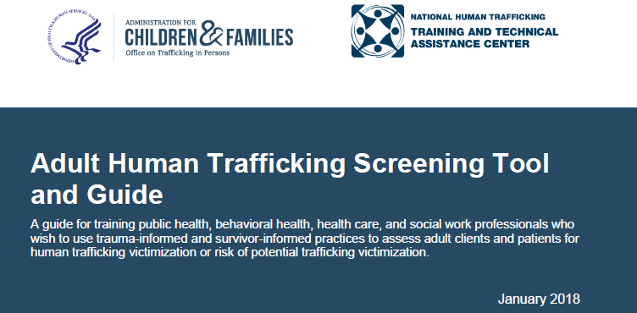

Slide 58
Minimize risk
If patient unaware of location: encourage look for surroundings, building addresses, landmarks
Avoid dangerous rooms (I.e. where weapons stored)
Important documents/meds in safe place
Escape route:
  Plan/ memorize
  Practice (if safe)
  Have back up plan

Slide 59
Work up/ Tx
Routine labs
Consider:
  Tox screen
  Empiric Abi for STIs
  Post-exposure HIV prophylaxis
Emergency contraception
Stoklosa H, MacGibbon M. Human trafficking, mental illness, and addiction: Avoiding diagnostic overshadowing. AMA J Ethics 2017;19:23-34
Chung R, English A. Commercial sexual exploitation and sex trafficking of adolescents. Curr Opin Pediatr 2015;27:428-33.

Slide 60
Document accurate/ unbiased for
Clinical/ other services (esp diff providers)
Evidence
Record only information regarding your role
Confidentiality
Secure access
Consult management and legal before responding

Slide 61

http://www.polarisproject.org/state-map

Slide 62
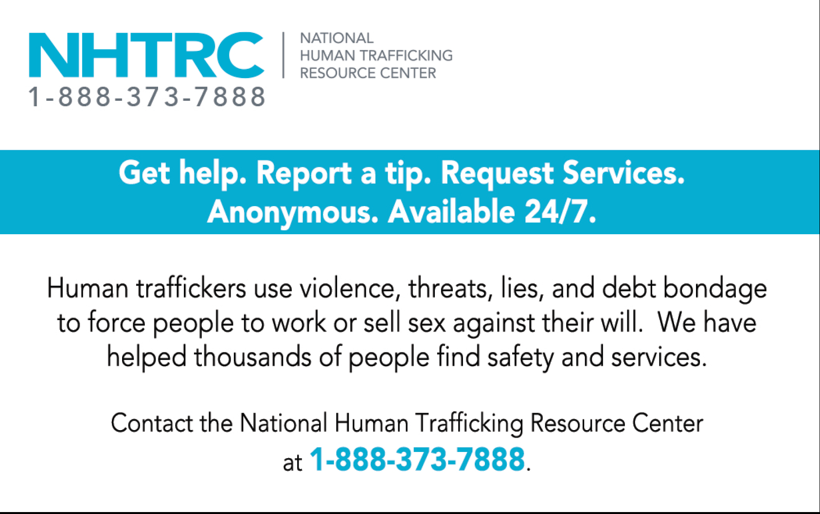
Sex Trafficking Victim Outreach Card

Slide 63
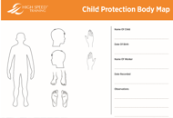
Documentation
Oral statements, using quotes
Body maps
Forensic photography
Avoid “alleged/ patient claims”
Use “suspected” or “reported human trafficking”
Goodman J. Lawyer’s manual on human trafficking: Pursuing justice for victims. http://www.nycourts.gov/ip/womeninthecourts/pdfs/LMHT.pdf.
Leidholdt D. Human trafficking and domestic violence a primer for judges. The Judge’s Journal 2013

Slide 64
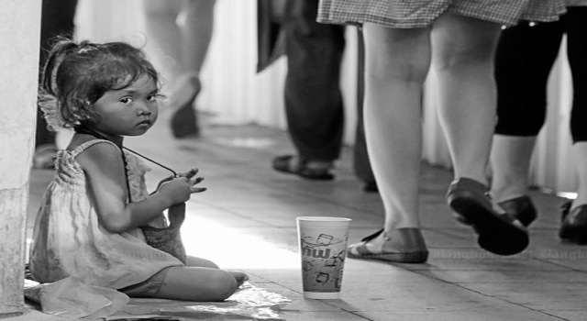
Mandatory reporting
all U.S. states have statutes mandating the report of suspected child maltreatment including sexual abuse and neglect,
21 states include sex trafficking in their legal definitions of sexual abuse.
Child Welfare Information Gateway. Mandatory Reporters of Child Abuse and Neglect. Washington, DC: U.S. Department of Health and Human Services, Children’s Bureau; 2016 (PA is one per http://keepkidssafe.pa.gov/cs/groups/webcontent/documents/document/c_137646.pdf )

Slide 65
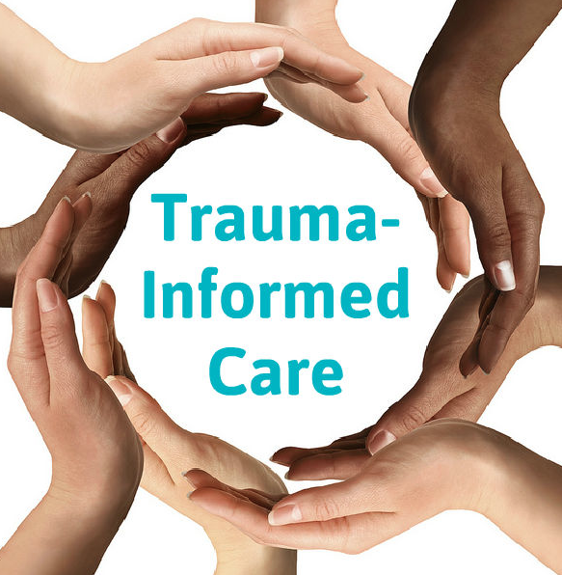

Slide 66
Trauma Informed Care
“every part of service is assessed and potentially modified to include a basic understanding of how trauma impacts the life of an individual seeking services”
Raja et al. Fam Comm Health 2015

Slide 67
Universal trauma precautions vs trauma specific strategies
  Lack of control in medical settings/ anxiety, lack of trust
  Bodies exposed/ powerless
  Fear of being touch/ something inserted into body

Slide 68

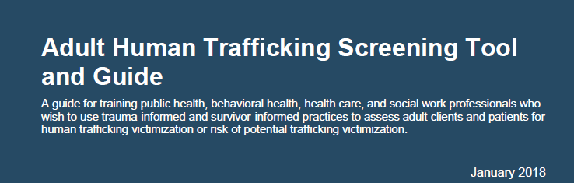
In fact, screening can unintentionally result in decision making on behalf of the person perceived to be vulnerable, without regard for their own sense of the dangers behind those decisions.

Slide 69
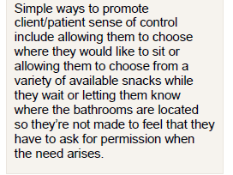

Slide 70
Ask patient how to be more comfortable
Shift clothes away instead of gown
Chair vs exam table
Mirror
Distress signal
Door ajar or support person

Slide 71
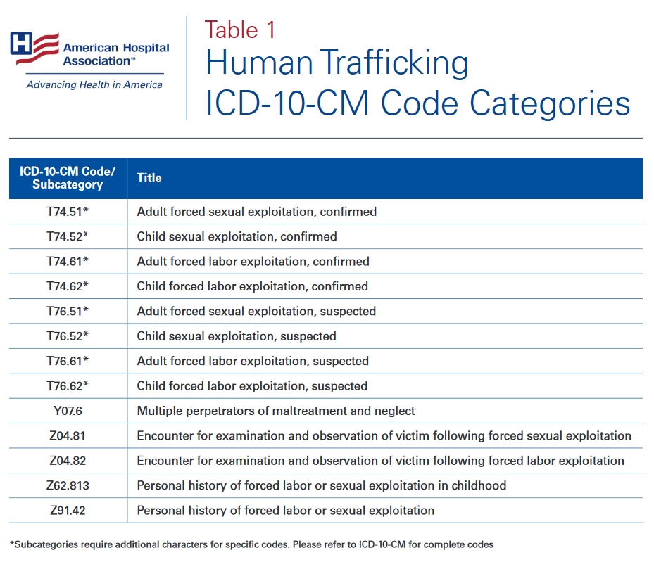

Slide 72


Slide 73
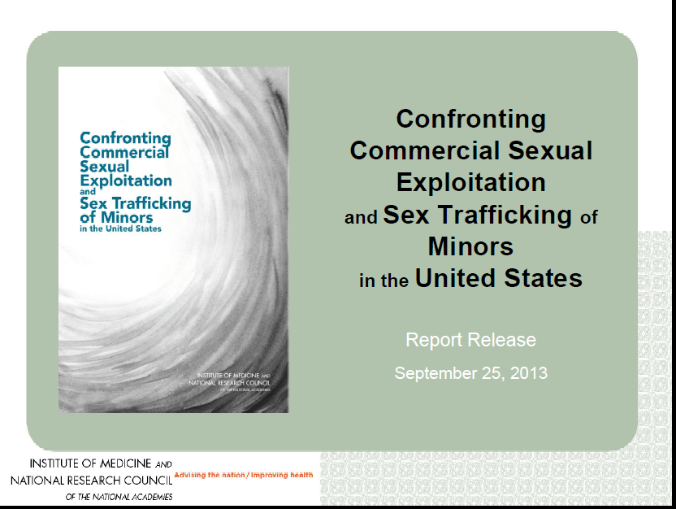

Slide 74



Slide 75



Victims of Trafficking and Violence Prevention Act signed 2000 (reauthorized 4x, last 2013)

Slide 76
TVPA
legal foundation in US vs trafficking
authorized federal funds anti-trafficking programs to support to victims and survivors.
passed in 2000
The Justice for Victims of Trafficking Act of 2015

Slide 77

Act 130, known as the Safe Harbor law, ensures child victims of human trafficking won’t be prosecuted for prostitution or other crimes.
Shea Rhodes, who directs the Institute to Address Commercial Sexual Exploitation at Villanova University, …said since Pennsylvania passed a comprehensive human trafficking law in 2014, it has been used to convict 26 people, with another 20 or so convictions pending.
https://whyy.org/articles/pa-safe-harbor-law-fines-helping-human-trafficking-victims/

Slide 78

(March 21, 2018) –U.S. Senate Stop Enabling Sex Traffickers Act (SESTA). The legislation was spearheaded by Sens. Rob Portman (R-OH) and Richard Blumenthal (D-CT), with a version passing the House by 388 to 25 in late February. SESTA provides a much-needed update to the Communications Decency Act (CDA) to help hold websites like Backpage accountable when they knowingly facilitate sex trafficking.

Slide 79


Slide 80

Polaris Project State Ratings: 2014
http://polarisproject.org/sites/default/files/2014-State-Ratings.pdf

Slide 81


Slide 82


Slide 83


Slide 84


Slide 85


Massachusetts General Hospital Freedom clinic
2013, the National Human Trafficking Resource Center Hotline received 385 calls from Massachusetts (17th in US)
grant, awarded by the

Slide 86
CARE in MA
Hope Through Health in Texas
The Pacific Survivor Center in Hawaii
Geynisman-Tan J, Taylor J, Edersheim T, Taubel D. All the darkness we don’t see.
Amer J Obstet Gynecol 2017;135-38.

Slide 87


Slide 88

National Human
Trafficking Referral Directory

Slide 89


Slide 90


Increased Awareness

Slide 91

And YET…..
IPV screening studies ~10% providers routinely screen

Slide 92




We are NOT

Slide 93

Supply chain

Slide 94


Slide 95
“our survivors told us that more than fear or pain, the feelings that sat with them most often were worthlessness and invisibility. We can do better as physicians, and as educators to expose this epidemic and care for its victims.”
Geynisman-Tan J, Taylor J, Edersheim T, Taubel D. All the darkness we don’t see.
Amer J Obstet Gynecol 2017;135-38.

Slide 96

Wendy Macias-Konstantopoulos, MD, MPH. , Director of the Human Trafficking Initiative in the Emergency Department’s Division of Global Health and Human Rights

Slide 97


With Gratitude to
Holly Gibbs
Connie Rose

Slide 98


Slide 99


Slide 100
Hidden among us
https://www.youtube.com/watch?v=yKQSXv5Efvg

Slide 101

Thank you…..

