Slide 1
Colon Cancer Screening Guidelines
What’s New?
Thomas M. Loughney, M.D., FACP, FACG
Associate Professor of Medicine
Director of Endoscopy
MedStar Georgetown University Hospital
Presenter:

Slide 2
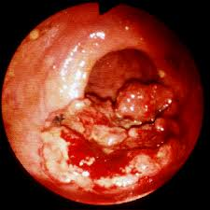
Colorectal Cancer
135,430 cases per year
50,260 deaths per year
Second leading cause of cancer death in U.S.
In many cases preventable
Occurring more commonly in patients less than 40
CA Cancer J Clin. 2017;67(1):7.
endoatlas.com

Slide 3
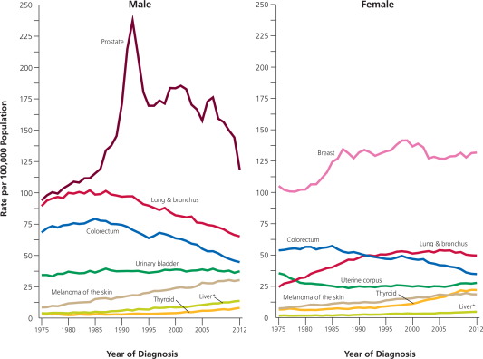
Declining Risk of Death from Colon Cancer
CA Cancer J Clin 2016;7–30

Slide 4
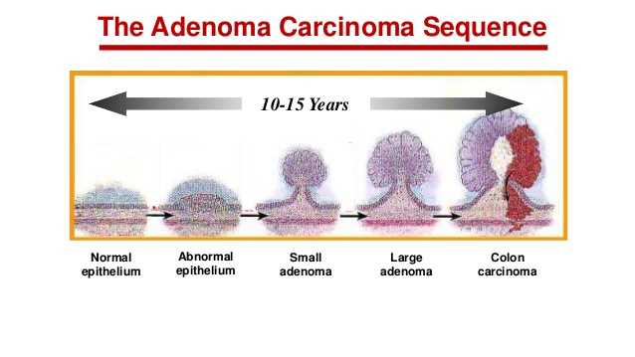

Slide 5
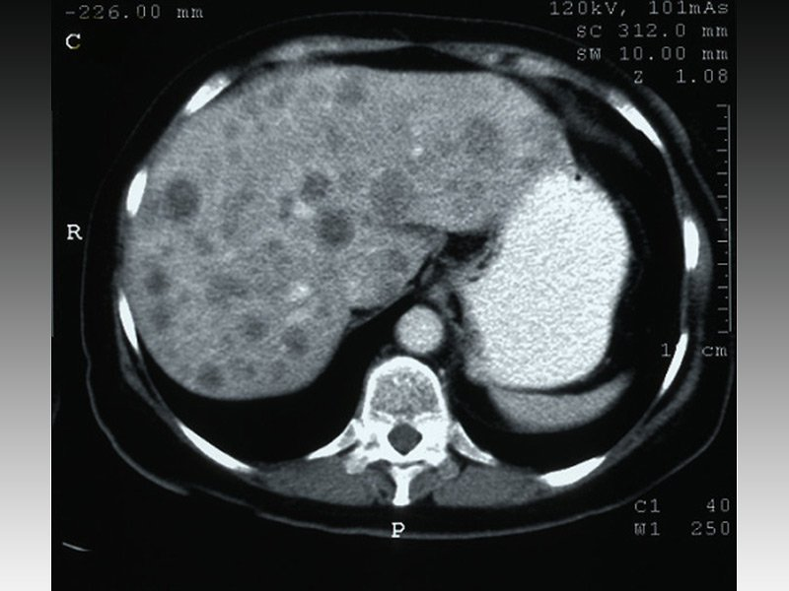
Natural History of Colon Cancer
Two Years From Invasive Cancer to Distant Metastases
Two Years From
Metastases to Death

Slide 6
What is Screening?
Who Do We Screen?
Age 50-76
No symptoms of colonic disease
No family history of colon cancer
No prior history of polyps
No history of inflammatory bowel disease

Slide 7
How Do We Screen/Survey?
Stool Assessment
Anatomic Assessment
Colonoscopy
Sigmoidoscopy
CT colonography
Capsule colonography
Fecal Immunochemical Testing (FIT)
Stool DNA analysis

Slide 8
Fecal Immunochemical Testing
Direct measure of human hemoglobin in stool
Superior to occult blood testing-peroxidase activity
Cost $29
Performed Annually
 | Sensitivity | Specificity
Colorectal Cancer | 74% | 95%
Advanced Adenoma | 24% | 95%
Imperiale et. al. NEJM 2014;370:1287

Slide 9
Stool DNA Analysis
Abnormal DNA from neoplastic cells shed by polyps and tumors
-Methylated BMP3
-NDRG4 promotor regions
-Mutant K-ras
-B-actin
Fecal immunochemical test
Covered by Medicare
Cost $599
Performed every 3 years
 | Sensitivity | Specificity
Colorectal cancer | 92% | 87%
Advanced Adenoma | 42%
Imperiale et. al. NEJM 2014;370:1287

Slide 10
Implications of a Positive Cologuard
Colon cancer 4%
Advanced adenoma 20%
Non-advanced adenoma 31%
No polyp 45%
Imperiale et.al NEJM 2014;370:1286

Slide 11
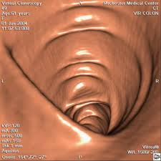
CT Colonography
(Virtual colonoscopy)
Multidimensional CT
Avoids sedation and most risks of colonoscopy
Not covered by Medicare
Cost $575
90% sensitive, 86% specific for polyps greater than 1 cm
Extra-colonic findings common
Radiation dose
Performed every 5 years
rochestermedicalcenter.org

Slide 12
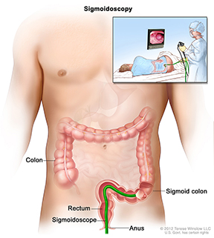
Flexible Sigmoidoscopy
Formerly the primary screening modality
Has been shown to decrease mortality from colon cancer
Usually does not require sedation
Examines only the distal ¼ to 1/3 of the colon
Cancer more commonly occurring in the proximal colon
May be uncomfortable
niddk.nih.gov

Slide 13
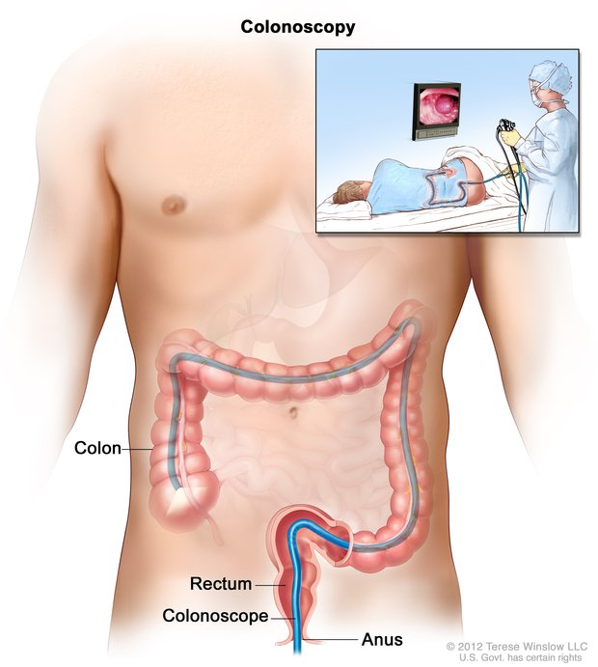
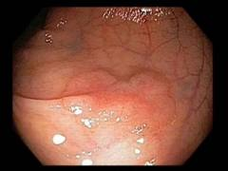
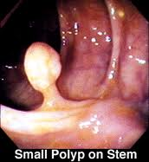
Colonoscopy
nih.niddk.gov

Slide 14
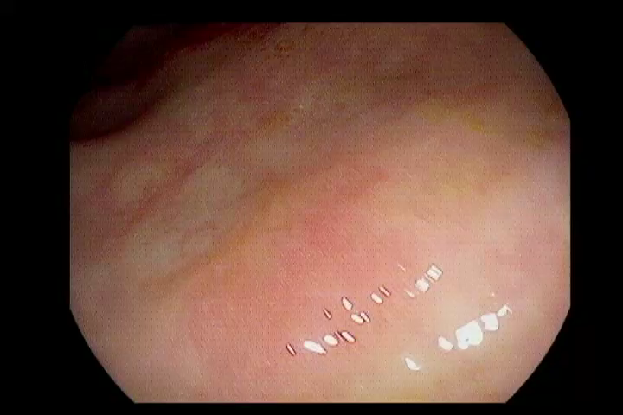
Therapeutic Colonoscopy

Slide 15
2017 Multi Society Task Force Guidelines
Tier 1
-Colonoscopy every 10 years
-FIT annually
Tier 2
  -Virtual colonoscopy every 5 years
  -Flexible sigmoidoscopy every 5-10 years
  -FIT/Fecal DNA every 3 years
Tier 3
-Capsule colonoscopy every 5 years
Rex et. al Gastroenterology 2017;174:1-17
March 25, 2019

Slide 16
Recommended Surveillance
Findings
Surveillance Interval
No polyps
<10 mm hyperplastic polyps in sig/rectum
1-2 < 10 mm tubular adenomas
3-10 tubular adenomas
>10 tubular adenomas
Tubular adenoma ≥ 10 mm
Villous adenoma
Adenoma with high grade dysplasia
10 years
10 years
5-10 years
3 years
< 3 years
3 years
3 Years
3 years

Slide 17
Family History of Colon Cancer
Family History
Recommendations
Colorectal cancer or advanced adenoma in 1st degree relative < 60 years old or 2 or more 1st degree relatives at any age
Colorectal cancer or advanced adenoma in 1st degree relative at any age
Colonoscopy at age 40 or 10 years younger than relative was at diagnosis and every 5 years
Average risk screening options starting at age 40

Slide 18
Colonoscopy Quality Measures
“No Polyp Left Behind”
Adenoma detection rate
-30% in male patients
-20% in female patients
Cecal intubation rate-95%
Colonoscope withdrawal time
-At least 6 minutes
-Ideally 10 minutes
Prep Quality

Slide 19
Adenoma Detection Rates
1 January 2014-28 February 2019
Physician | Total Procedures | Male Procedure | Male Adenomas | ADR Male Patients | Female Procedure | Female Adenomas | ADR Female Patients | ADR All Patients
A | 106 | 43 | 12 | 28% | 63 | 15 | 24% | 25%
C | 921 | 454 | 177 | 39% | 467 | 150 | 32% | 36%
D | 493 | 256 | 79 | 31% | 237 | 59 | 25% | 28%
E | 166 | 62 | 21 | 34% | 104 | 23 | 22% | 27%
F | 314 | 163 | 51 | 31% | 151 | 39 | 26% | 29%
G | 484 | 170 | 65 | 38% | 314 | 80 | 25% | 30%
H | 18 | 8 | 5 | 63% | 10 | 2 | 20% | 39%
I | 535 | 246 | 78 | 32% | 289 | 69 | 24% | 27%
J | 944 | 440 | 165 | 38% | 504 | 124 | 25% | 31%
K | 452 | 238 | 66 | 28% | 214 | 45 | 21% | 25%
M | 22 | 9 | 6 | 67% | 13 | 2 | 15% | 36%
N | 208 | 102 | 54 | 53% | 106 | 39 | 37% | 45%
Dept | 4663 | 2191 | 779 | 36% | 2435 | 647 | 26% | 31%

Slide 20
Results in order of Total ADR
Physician | Physician Gender | Total patients | Total Females | Total Males | %Female | %Males | ADR-Female Patients | ADR Male Patients | ADR All Patients
A | Male | 33 | 19 | 14 | 58% | 42% | 21% | 14% | 18%
F | Male | 171 | 80 | 91 | 47% | 53% | 19% | 21% | 21%
E | Female | 83 | 50 | 33 | 60% | 40% | 19% | 27% | 22%
K | Male | 280 | 128 | 152 | 46% | 54% | 19% | 26% | 23%
H | Female | 211 | 134 | 77 | 64% | 36% | 24% | 25% | 24%
B | Female | 280 | 201 | 79 | 72% | 28% | 22% | 34% | 25%
D | Male | 288 | 141 | 147 | 49% | 51% | 22% | 29% | 25%
I | Male | 394 | 213 | 181 | 54% | 46% | 25% | 33% | 29%
J | Male | 590 | 304 | 286 | 52% | 48% | 22% | 36% | 29%
G | Female | 306 | 187 | 119 | 61% | 39% | 25% | 42% | 31%
C | Male | 521 | 257 | 264 | 49% | 51% | 27% | 37% | 32%
N | Male | 134 | 67 | 67 | 50% | 50% | 24% | 51% | 43%

Slide 21
Physician | Physician Gender | %Female Patients | %Male Patients
K | Male | 46% | 54%
F | Male | 47% | 53%
C | Male | 49% | 51%
D | Male | 49% | 51%
N | Male | 50% | 50%
J | Male | 52% | 48%
I | Male | 54% | 46%
A | Male | 58% | 42%
E | Female | 60% | 40%
G | Female | 61% | 39%
H | Female | 64% | 36%
B | Female | 72% | 28%

Slide 22
Results in order of ADR in Female Patients
Physician | Physician Gender | Total patients | Total Females | Total Males | %Female | %Males | ADR-Female %
K | Male | 280 | 128 | 152 | 46% | 54% | 19%
E | Female | 83 | 50 | 33 | 60% | 40% | 19%
F | Male | 171 | 80 | 91 | 47% | 53% | 19%
A | Male | 33 | 19 | 14 | 58% | 42% | 21%
J | Male | 590 | 304 | 286 | 52% | 48% | 22%
B | Female | 280 | 201 | 79 | 72% | 28% | 22%
D | Male | 288 | 141 | 147 | 49% | 51% | 22%
N | Male | 134 | 67 | 67 | 50% | 50% | 24%
H | Female | 211 | 134 | 77 | 64% | 36% | 24%
I | Male | 394 | 213 | 181 | 54% | 46% | 25%
G | Female | 306 | 187 | 119 | 61% | 39% | 25%
C | Male | 521 | 257 | 264 | 49% | 51% | 27%

Slide 23
Results in order of ADR in Male Patients
Physician | Physician Gender | Total patients | Total Females | Total Males | %Female | %Males | ADR-Male %
A | Male | 33 | 19 | 14 | 58% | 42% | 21%
F | Male | 171 | 80 | 91 | 47% | 53% | 23%
H | Female | 211 | 134 | 77 | 64% | 36% | 25%
K | Male | 280 | 128 | 152 | 46% | 54% | 26%
E | Female | 83 | 50 | 33 | 60% | 40% | 27%
D | Male | 288 | 141 | 147 | 49% | 51% | 29%
I | Male | 394 | 213 | 181 | 54% | 46% | 33%
B | Female | 280 | 201 | 79 | 72% | 28% | 34%
J | Male | 590 | 304 | 286 | 52% | 48% | 36%
C | Male | 521 | 257 | 264 | 49% | 51% | 37%
G | Female | 306 | 187 | 119 | 61% | 39% | 42%
N | Male | 134 | 67 | 67 | 50% | 50% | 51%

Slide 24
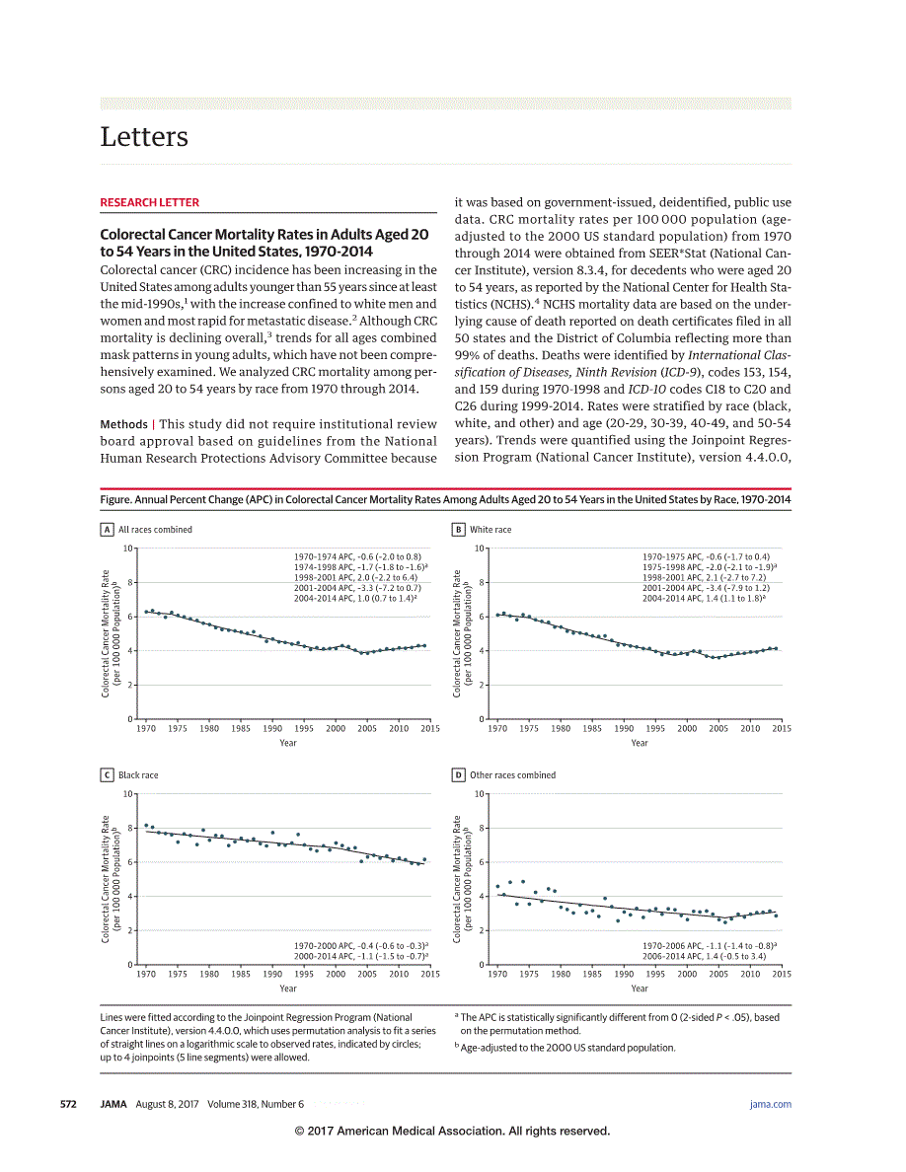
Rising Risk of Colon Cancer in Young Patients
JAMA. 2017;318(6):572-574

Slide 25
Rising Risk of Colon Cancer in Young Patients
Low threshold for reacting to symptoms
-Blood in stool
-Abdominal pain
-Change in bowel habits
-Narrowing of stools
Digital Rectal Exam
Possible change in screening guidelines

Slide 26
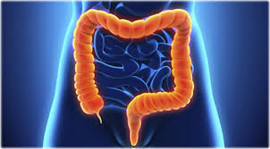
Colon Cancer Awareness Month
Don’t let your : become a ;
Get screened!

Slide 27

, and how you check it
npr.org

