Slide 1
Medical Education in the 21st Century
March 30, 2019

Slide 2
Jed Gonzalo, M.D. ‘02
April Troy, M.D., MPH, FAAP ’02
Clark Veet, M.D. ‘10
Ralph Riviello, M.D. MS, FACEP ‘90
Kelly McGuire, D.O. ’05
There are no financial disclosures for any of today’s panelists.

Slide 3
Big Trends in U.S. Undergraduate Medical Education
Jed Gonzalo MD MSc
Associate Professor of Medicine and Public Health Sciences
Associate Dean for Health Systems Education
Penn State College of Medicine

Slide 4
Objectives
Upon completion of this session, participants will be able to:
Identify several high-level trends in U.S. undergraduate medical education

Slide 5

The Woman in the Mirror by Frank Huyler
A Story
Huyler, F. The woman in the mirror: humanities in medicine. Acad Med 2013

Slide 6

and the Process of Education
Traditional Approach
CAD
ACS
STENT
MEDICATION
WELLNESS
Alternative Approach
ACS
STENT
Value
Quality/patient safety
Teams
Clinical informatics
IP collaboration
CAD
Need for Medication
Population Health
Social Determinants of Health
Medication Failure
Homelessness
Poverty
Psych Problems
Substance Use
Leadership
Advocacy
Health Economics
Health Policy
Cristancho, et al. From problem solving to problem definition: scrutinizing the complex nature of clinical practice. Persp in Med Ed 2016
Gonzalo JD, et al. Med Students as Systems Ethnographers. Acad Emergency Medicine Education and Training 2017
Gruppen, Irby, Durning, Maggio, Van Schaik. Macy Foundation Conference on the Clinical Learning Environment 2018
Simpson D, K Marcdante, KH Souza, A Anderson, E Holmboe. Job Roles of the 2025 Medical Educator. JGME 2018
Gonzalo JD, A Chang, D Wolpaw. New Educators for HSS Competencies: Implications for US Medical School Faculty. Acad Med 2018
Notes:
Applying a technical fix to a complex problem.
Bereiter and Scardamalia - expertise in terms of progressive problem solving
“Adaptive expertise” - Maria Mylopoulus. Glenn Regher, Carol Anne Moulton
It’s not what you know, sometimes it’s what is the question
Progressive problem solving (scardamalia)
Routine expertise, or classic expertise, and adaptive expertise
Educational expertise is not the solution
It’s recognizing disruption

Slide 7
and the Process of Education
3rd-Pillar of Medical Education – Health Systems Science
Higher-Order Competencies
Process over Content
Clinical Learning Environments
Learner-Faculty Relationships
“New” Educators
Hirsh DA, et al. “Continuity” as an organizing principle for clinical education reform. N Engl J Med 2007
Gruppen, Irby, Durning, Maggio, Van Schaik. Macy Foundation Conference on the Clinical Learning Environment 2018
Hunderfund, Gonzalo, Moriates, et al. Role Modeling and Regional Health Care Intensity. Acad Med. 2017
Hunderfund, Gonzalo, Moriates, et al. Value-Added Activities in Medical Education: Factors Influencing Engagement. Acad Med 2018
Gonzalo JD, A Chang, D Wolpaw. New Educators for HSS Competencies: Implications for US Medical School Faculty. Acad Med 2018
Notes:
Process over Content
Lawnmower vs focusing on habits of mind and thinking and problem solving
Higher-Order Competencies
HSS/Systems Thinking; Reflection-in/on-action; Self-directed learning; Adaptive expertise
Faculty-Student Relationships
Coaching; Longitudinal; Relational
Clinical Learning Environment
This type of learning requires social construction, in a robust learning environment
Experiences as a starting point (UP model)
Shifting Diversity
Clinical experiences (and earlier); Evaluation (and assessments); Educators; Admissions
Caring
Caring needs a canvas, it needs more than just the habit of heart (yes, this is important, but there’s more)

Slide 8
Changes in Clinical Undergraduate Medical Education
April Troy, M.D., MPH, FAAP, ‘02
Assistant Clinical Professor Geisinger Commonwealth School of Medicine
Pediatrician- Pediatrics of Northeastern Pennsylvania

Slide 9
Longitudinal Clinical Programs
98 LCPs in 69 medical schools (137 LCME accredited US medical schools)
  52% in the core clinical year
  50% clinic attachments
  26.5% Longitudinal Integrated Clerkship
  20.4% patient attachments
  About ½ of the programs are mandatory in the curriculum and ½ are optional or focus on a subset of students.

Slide 10
Longitudinal Integrated Clerkship
Students spend at least 6 months rotating through clinical clerkships (1/2-1 full day per week).
Allows for longitudinal continuity of care
Allows for longitudinal relationships between preceptors and students

Slide 11
Medical Student Evaluation
Need to prepare students for the demands on medicine in the 21st century.
Need to evaluate students to be prepared to provide unsupervised care
Criteria for evaluation at individual medical schools may not reflect skills needed to progress to residency.
Evaluations may be difficult to interpret what qualifies for each grade level.

Slide 12
Medical Student Clinical Evaluation: Entrustable Professional Activities
Specific tasks that one should be able to complete prior to entry into residency
Assessments based upon clinical activities and outcomes
  Broader domains of evaluation with more holistic assessments
Scales for evaluations include narrative descriptors that have more clinical meaning to evaluators.

Slide 13
EPAs
1- Gather a history and perform a physical examination
2- Prioritize a differential diagnosis following a clinical encounter
3- Recommend and interpret common diagnostic and screening tests
4- Enter and discuss orders and prescriptions
5- Document a clinical encounter in the patient record
6- Provide an oral presentation of a clinical encounter
7- Form clinical questions and retrieve evidence to advance patient care

Slide 14
EPAs
8- Give or receive a patient handover to transition care responsibility
9- Collaborate as a member of an interprofessional team
10- Recognize a patient requiring urgent or emergent care and initiate evaluation and management
11- Obtain informed consent for tests and/or procedures
12- Perform general procedures of a physician
13- Identify System failures and contribute to a culture of safety and improvement

Slide 15
References
Gheihman, G. et al. “A review of Longitudinal Clinical Programs in US Medical Schools.” Med Educ Online. 2019; 23(1): 1444900
Walters, L. et al. “Outcomes of longitudinal integrated clinical placements for students, clinicians and society” Medical Education. 2012; 46: 1028-1041
Hirsh, D.A. et al. “Time to trust: Longitudinal Integrated Clerkships and Entrustable Professional Activities”. Academic Medicine. 2014. 89(20: 201-204
Holzhausen, Y. et al. “How to define core entrustable professional activities for entry into residency.” BMC Medical Education, 2018. 18: 87
Patel, M and Baker, P. “Supervision for entrustable professional activities.” Medical Education, 2018. 52: 998-1000
AAMC. “Core Entrustable Professional Activities for Entering Residency” https://members.aamc.org/eweb/upload/Core%20EPA%20Curriculum%20Dev%20Guide.pdf

Slide 16


Graduate Medical Education in the 21st Century
Clark A. Veet, MD
General Medicine Clinical Research Fellow

Slide 17

Education Programs in Residency
Required proficiencies from the ACGME
Traditional modalities for teaching
Novel approaches to education in the 21st century

Slide 18
Education Programs in Residency
2017 ACGME Handbook, Section IV
Proficiency in medical knowledge, practice-based learning, interpersonal skills, systems-based practice, and professionalism
Resident participation in scholarly activities
Competency-based goals and objectives for each assignment
Regular formative feedback from faculty and program director
Notes:
What does the ACGME require? ACCREDITATION COUNCIL FOR Graduate MEDICAL EDUCATION (ACGME)

Slide 19

Education Programs in Residency
How is this done?
“Regularly scheduled didactic sessions”
Case exposure via clinical experience
Encouragement to “read more”
Limitations due to lack of available time and abundance of material

Slide 20
Graduate Medical Education in the 21st Century
Study resources, examinations, journals, and documentation are nearly all electronic
Less time is spent in the hospital or clinic due to duty hour changes
Movement to apply learning theory to graduate medical education
  Digital applications
  Social media

Slide 21
Asynchronous Learning Theory
Student-centered teaching method that uses resources to promote learning outside the constraints of a set time, place, or network of people
Movement toward asynchronous learning facilitated by electronic resources and mobile technology
Limitations include the departure from traditional classroom education in undergraduate medical education
Notes:
#
#
#
How is this achieved?

Slide 22
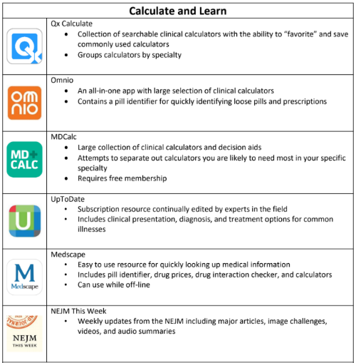
Digital Resources and Applications
Phones and tablets are ubiquitous in the clinic, on the floors, and even in the OR
Apps include point of care resources, calculators, clinical decision aids, and videos
Many require subscription or purchase
*Copy of commonly used applications and resources will be provided

Slide 23
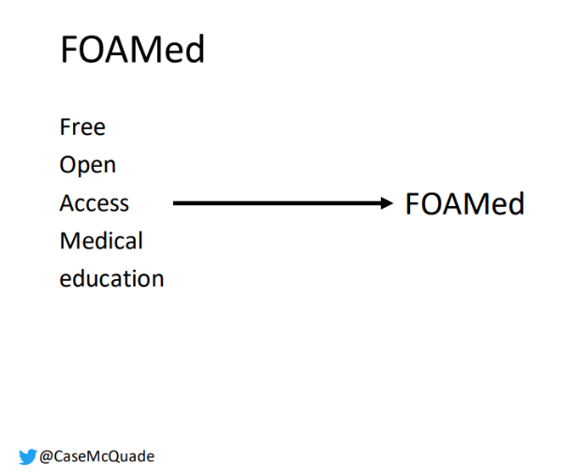
Digital Resources and Applications
Websites and tools aimed at providing medical education resources at no cost
Often interactive, problem-based, and delivered digitally
Authored by “experts” without true peer review
Notes:
An alternative to paid apps is FOAMed.

Slide 24
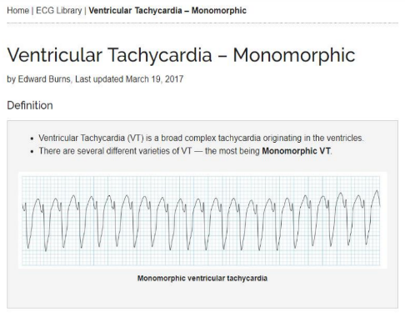
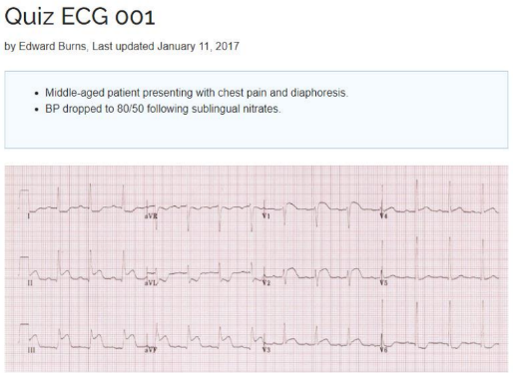
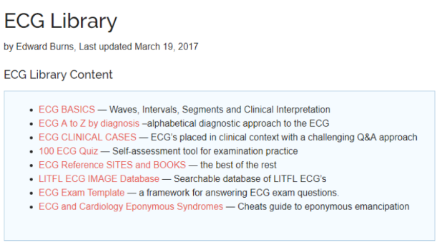
Notes:
I’ll turn our attention to one of the most used sites, LITFL.

Slide 25

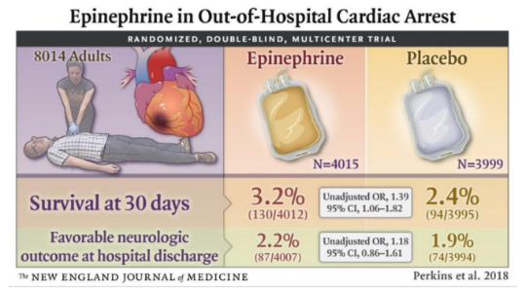
Social Media
Platforms previously used for leisure have become important ways to share ideas and obtain information
Physician Twitter profiles and “tweetorials” are valuable tools for learners
Dissemination of research via visual abstracts

Slide 26
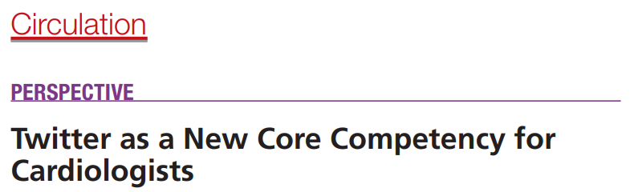

“Social networking sites are evolving into expansive sources of digital health information for both patients and providers, and the engagement of physicians and cardiologists can offer a unique element to the sharing of knowledge”
Notes:
Especially in the world of cardiology, Twitter is blossoming. The authors of this 2017 perspective in Circulation suggest that twitter is being a core competency. I have seen many debates from cardiologists on management and diagnosis, often guided by video clips of echocardiograms or catheterizations.

Slide 27
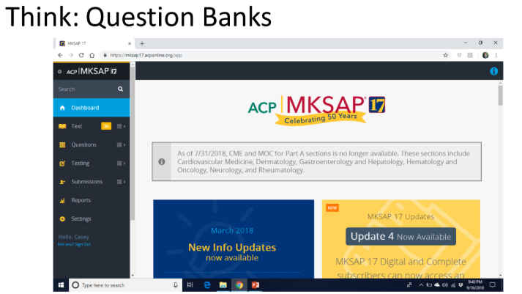
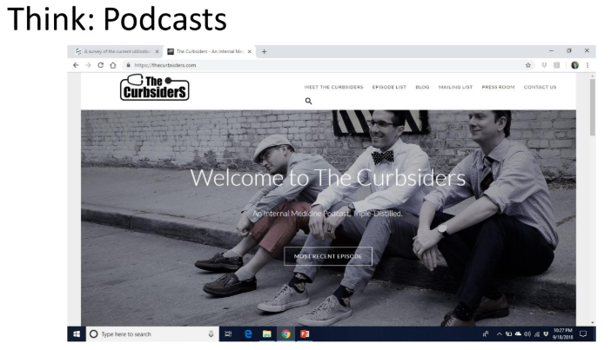
Digital Resources and Applications
Notes:
Beyond apps and social media, there are many digital question banks including the ACP’s MKSAP series which offers web and app based quizzes and testing.
There are many podcasts and videos, which can be downloaded and listened to quickly in the car or on the treadmill. One of my personal favorites is The Curbsiders which tackles common and interesting medical problems.

Slide 28
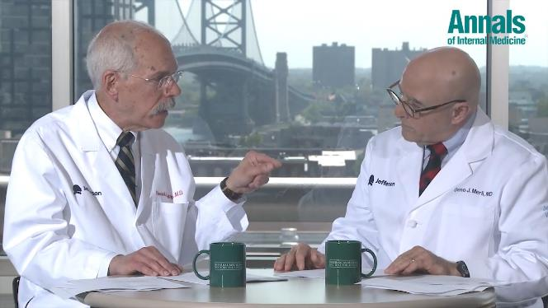

Digital Resources and Applications
Notes:
And of course, we can’t forget the great digital content from Annals. I am quite biased toward the Consult Guys, Dr. Weitz and Dr. Merli. Hailing from my medical school alma mater Thomas Jefferson, I have shared their work frequently with residents during my chief year.

Slide 29
Social Media and Learning Theory
Digital platforms can fill a void and supplement traditional residency education
Little research published on educational outcomes of asynchronous learning or social media in medical education
Cannot replace all core content but may allow for expansion or reinforcement of topics
Notes:
In summary…
#
#
#

Slide 30
References
ACGME Common Program Requirements. Feb 2017. Available at https://www.acgme.org/Portals/0/PFAssets/ProgramRequirements/CPRs_2017-07-01.pdf. Accessed: Jan 28, 2019
Alraies MC, Raza S, Ryan J. Twitter as a New Core Competency for Cardiologists. Circulation. 2018;138:1287–1289.
Life In the Fast Lane. Available at: https://lifeinthefastlane.com/ Accessed: Jan 28, 2019
Curbsiders. Available at https://thecurbsiders.com/ Accessed: Jan 28, 2019
ACP MKSAP 2018.Available at https://mksap17.acponline.org/ Accessed: Jan 28, 2019
Annals of Internal Medicine Consult Guys. Available at https://annals.org/aim/consult-guys Accesssed: Jan 28, 2019

Slide 31
Acknowledgements
Casey McQuade, MD @CaseMcQuade
Andrew Klein, MD @drewjklein
Images via Google Images and when copyrighted, used in the spirit of Fair Use to promote the progress of science and useful art.

Slide 32
Resident Evaluations
Ralph Riviello, M.D. MS, FACEP ‘90

Slide 33


Slide 34
Evaluation
Important part of medical/residency education.
Includes structured responses and comments that should provide informative and constructive feedback..
Medical Students
  Attendings
  Residents
Residents
  Attendings
  Nurses
  Peers
  Patients
  Ancillary staff
Competency-Based Medical Education

Slide 35
Evaluation Methods
Direct, real-time feedback
End of rotation evaluation
Semi-annual evaluations
Direct observation of patient interaction or procedure
  Standardized Direct Observation/Assessment Tool (SDOT)
Simulation lab
Patient survey
360-degree evaluation

Slide 36
Core Competencies
Help define the foundational skills all physicians should posses
INTERPERSONAL & COMMUNICATION SKILLS
PATIENT CARE
MEDICAL KNOWLEDGE
SYSTEMS-BASED PRACTICE
PRACTICE-BASED LEARNING & IMPROVEMENT
PROFESSIONALISM

Slide 37
Milestones
Competency-based developmental outcomes that can be progressively demonstrated by residents over their residency/fellowship.
Each competency is supported by milestones that are specific for each specialty.
Scale of “not yet assessable” to “aspirational”.
Resident can be at different levels of the scale depending on the milestone.

Slide 38
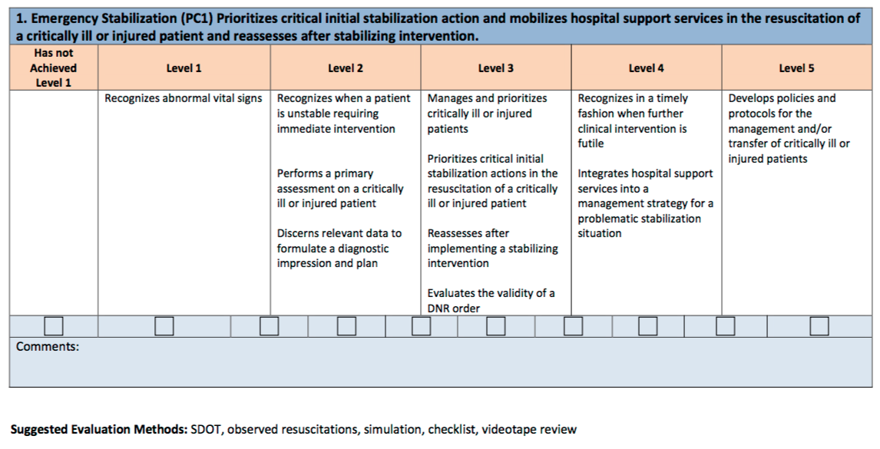

Slide 39
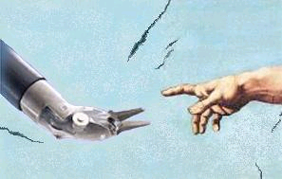
Technology in Surgery
Examples of new technology in surgical training and continuing education of practicing physicians
Kelly McGuire, D.O. ‘05

Slide 40
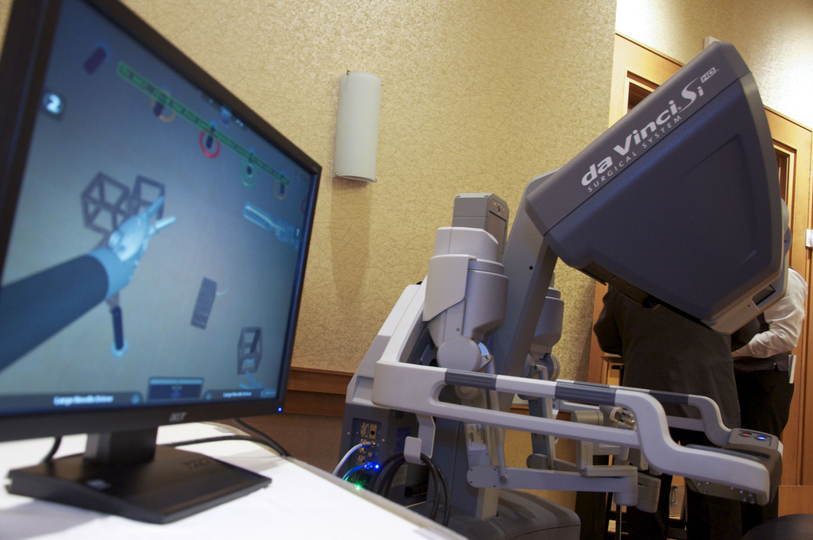
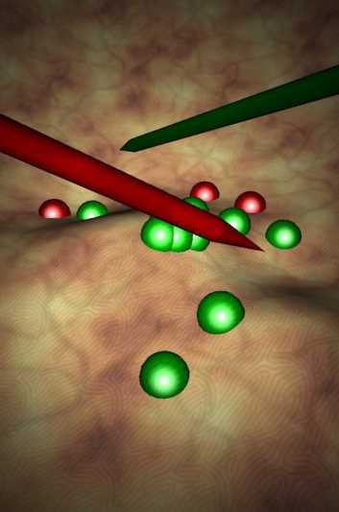
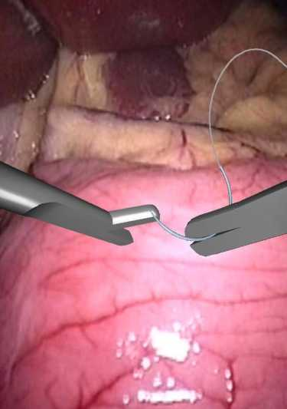
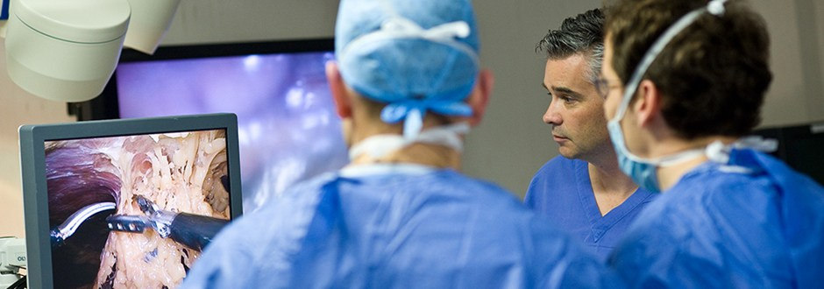
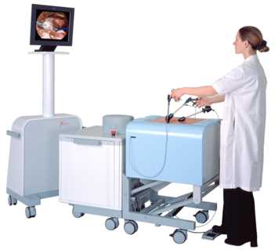
Robotics and Surgical Simulation

Slide 41
Climbing the Learning Curve
“See one, do one, teach one”
Requires entirely new skill set beyond traditional surgical and laparoscopic training
Training opportunities may be limited
Animal and cadaver labs helpful
Cases require outside proctor to determine competency
Credentialing challenges??

Slide 42
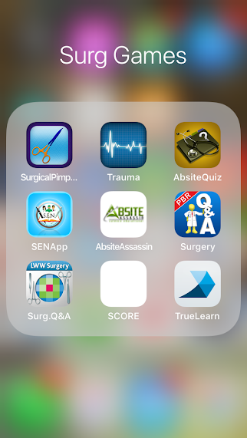
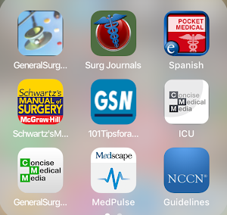
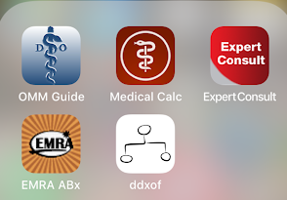
Computer and Phone Apps

Slide 43
Effects of Technological Advances in Surgical Education on Quantitative Outcomes From Residency
Programs
Journal of Surgical Education
Volume 73, Issue 5, September–October 2016, p819-830
Review of current technology for surgical education and evaluation of the effect of technological advances on ACGME Core Competencies, ABSITE scores, and ABS certification.
Conclusion:
  Most of the studies have shown a positive effect on patient care and medical knowledge
  However, the effect of simulation-based surgical training and simulation-based training on ABSITE scores and ABS certification has not been assessed

