Slide 1
Selecting Direct Oral Anticoagulants and Reversal Agents
Geno J Merli, MD, MACP, FSVM, FHM
Professor Medicine & Surgery
Sidney Kimmel Medical College
Thomas Jefferson University Hospitals

Slide 2
Disclosures
Geno J Merli, MD
Research Grant BMS-Pfizer: ADIOS study completed 12/2019 Presented ACC Meeting 3/2019

Slide 3
Topics
Atrial Fibrillation
VTE Prophylaxis Joint Replacement Surgery
Treatment of DVT/PE (Cancer & Non-Cancer)
VTE Prophylaxis Hospitalized Medically ill
DOACs Peripheral Arterial Disease
DOAC Reversal Agents

Slide 4
Atrial Fibrillation

Slide 5
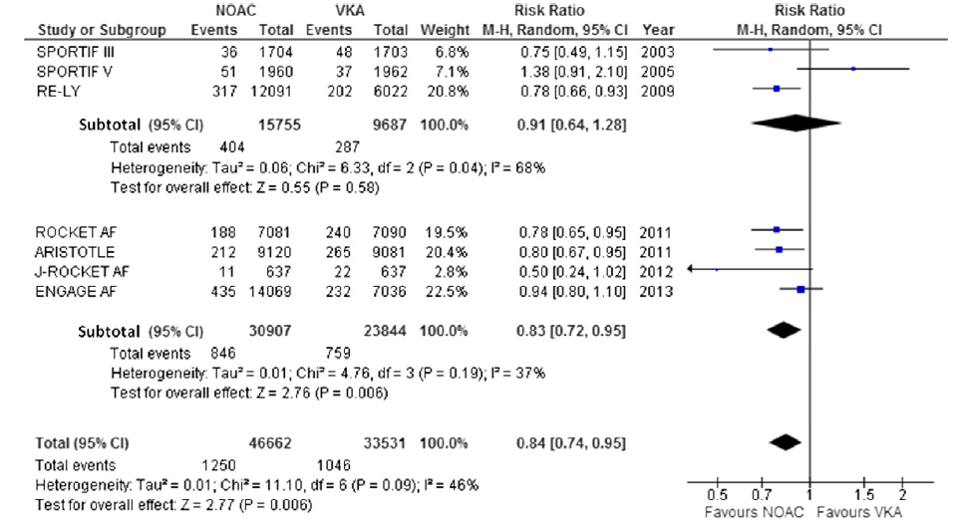
Stroke or Systemic Embolism
Target Specific Oral Anticoagulants
Favors DOAC
Providencia R et al Thromb Res 2014:134:1253-1264

Slide 6
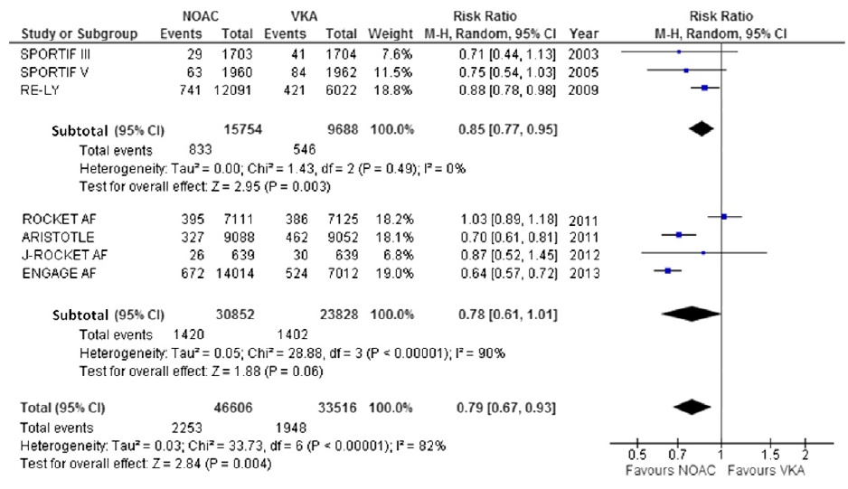
Major Bleeding
Target Specific Oral Anticoagulants
Favors DOAC
Providencia R et al Thromb Res 2014:134:1253-1264

Slide 7
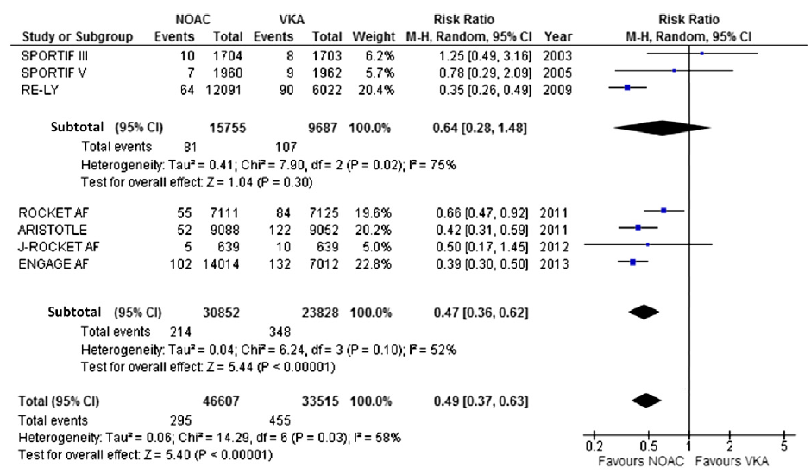
Intracranial Hemorrhage
Target Specific Oral Anticoagulants
Favors DOAC
Providencia R et al Thromb Res 2014:134:1253-1264

Slide 8
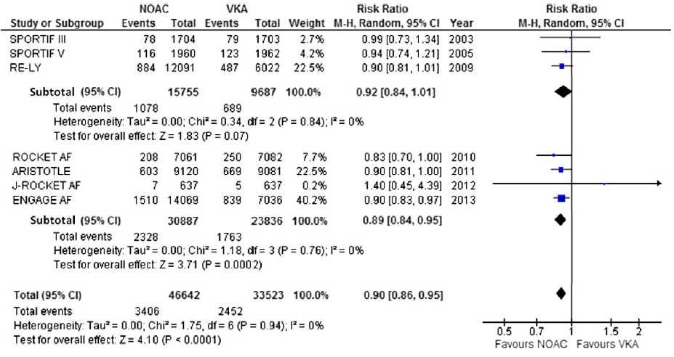
Total Mortality
Target Specific Oral Anticoagulants
Favors DOAC
Providencia R et al Thromb Res 2014:134:1253-1264

Slide 9
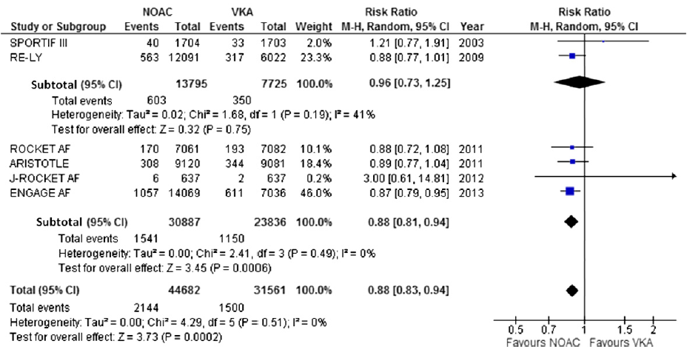
Cardiovascular Mortality
Target Specific Oral Anticoagulants
Favors DOAC
Providencia R et al Thromb Res 2014:134:1253-1264

Slide 10
DOAC vs Warfarin Afib
Summary
DOAC lower Stroke and Systemic Emboli
DOAC lower Intracranial Hemorrhage
DOAC lower Major Bleeding

Slide 11
Direct Oral Anticoagulants
Non-Valvular Afib Dosing Schedules
Agent | Atrial Fibrillation | Special Dosing
Dabigatran | 150 mg, BID | CrCl 15-30 cc/min 75 mg, BID
Apixaban | 5 mg, BID | Age > 80, BW < 60 kg, SCr > 1.5 2.5 mg, BID
Edoxaban | 60 mg, Qday | BW < 60 kg, Pgp inhibitors 30mg, Qday
Rivaroxaban | 20 mg, Qday | CrCl 15-30 cc/min 15 mg, Qday
* Do no use Edoxaban CrCl > 95 cc/min
Connolly SJ, et al NEJM 2009;361:1139-51
Patel MR, et al NEJM 2011;365:883-91
Granger CB, al NEJM 2011;365:981-92
Giugliamo RP, et al NEJM 2013;369:2093-104

Slide 12
THA & TKA Surgery

Slide 13
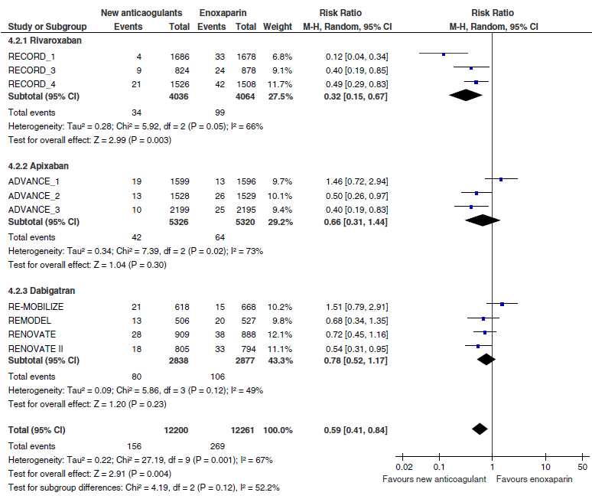
Major VTE: Prox DVT & PE
Rivaroxaban
Apixaban
Dabigatran

Slide 14
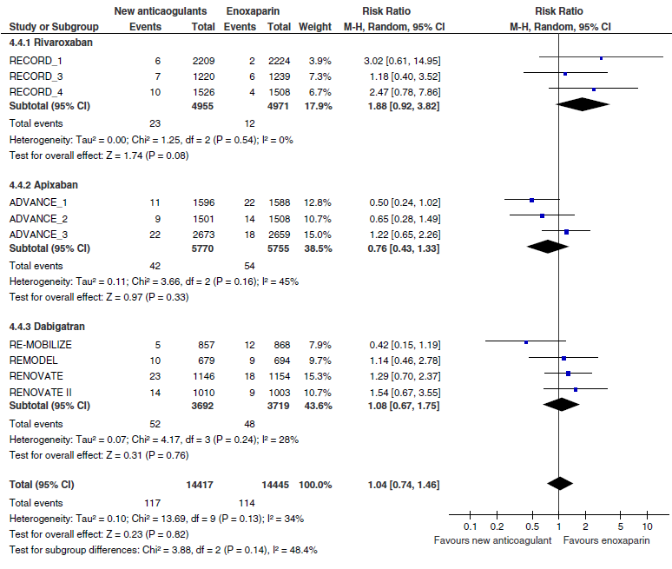
Major Bleeding
Rivaroxaban
Apixaban
Dabigatran
TSOAC
Enox

Slide 15
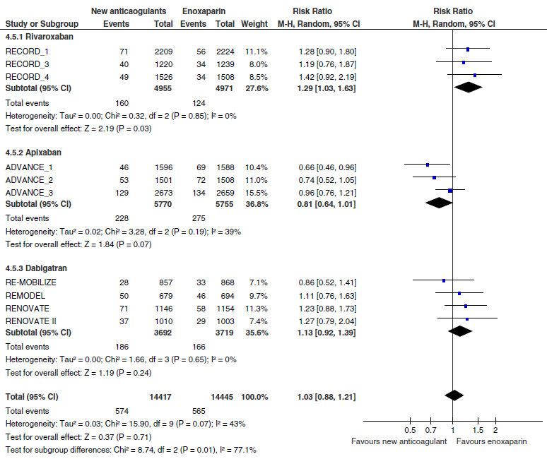
Major Bleeding & Clinical Relevant Non-Major
Rivaroxaban
Apixaban
Dabigatran

Slide 16
Direct Oral Anticoagulants
Dosing Schedules Joint Replacement
Agent | THR+TKR | Dosing Start | Duration
Dabigatran | 220 mg | 24 hrs postop | THA 35 days
Apixaban | 2.5 mg, BID | 12 to 24 hrs postop | THA 35 days TKA 12-14 days or up to 35 days
Rivaroxaban | 10 mg, Qday | 6 to 10 hrs postop or 24hrs postop | THA 35 days TKA 14 days or up to 35 days
Edoxaban | N/A | N/A | N/A
Dabigatran: Not approved for TKA in US
Edoxaban: Not approved for Ortho Joints Replacement in US

Slide 17
DOACs Treatment VTE

Slide 18
No Lead-In Therapy VTE
Study | Recurrent VTE | Major Bleeding
Einstein DVT
Rivaroxaban | 2.1% | 0.8%
Standard Rx | 3.0% | 1.2%
Einstein PE
Rivaroxaban | 2.1% | 1.1%
Standard Rx | 1.8% | 2.2%
Amplify
Apixaban | 2.3% | 0.6%
Standard Rx | 2.7% | 1.8%
Non-Inferior
Non-Inferior
Non-Inferior
HR = 0.49
P= 0.003
RR 0.31
P= < 0.001
Non-Inferior
* Major Bleeding (HR= 0.49; 95% CI, 0.31–0.79; P= 0.003)
* Major Bleeding (RR, 0.31; 95% CI, 0.17–0.55; P= < 0.001)
Einstein Investigators NEJM 2010;363:2499-2510
Einstein Investigators NEJM 2012;366:1287-1297
Agnelli G, et al NEJM 2013;369:799-808

Slide 19
Lead-In Therapy VTE
Study | Recurrent VTE | Major Bleeding
RE-COVER
Dabigatran | 2.4% | 1.8%
Standard Rx | 2.1% | 1.9%
Hokusai VTE
Edoxaban | 3.2% | 1.4%
Standard Rx | 3.5% | 1.6%
Non-Inferior
HR= 0.84
Non-Inferior
HR=0.82
Schulman S, et al NEJM 2009;361:2342-2352
The Hokusai-VTE Investigators, NEJM 2013;369:1406-1415

Slide 20
Extended VTE Prevention
Group | Recurrent VTE | Hazard Ratio | Major Bleed
Dabigatran 150mg,Q12 | 0.4% | 0.08 (0.02-0.25) | 0.3%
Placebo | 5.6% |  | 0.0%
Apix 5 mg Q12h | 1.7% | 0.2 (0.11-0.34) | 0.1%
Apix 2.5 mg Q12h | 1.7% | 0.19 (0.11-0.33) | 0.2%
Placebo | 8.8% |  | 0.5%
Riva 20mg Qday | 1.3% | 0.18 (0.09-0.39) | 0.7%
Placebo | 7.1% |  | 0.0%
Riva 20mg, Qday | 1.5% | 0.34 (0.20-0.59) | 0.5%
Riva 10mg, Qday | 1.2% | 0.26 (0.14-0.47) | 0.4%
ASA 100mg, Qday | 4.4% |  | 0.3%
Schulman S, et al NEJM 2013;368:709-71
Einstein Investigators NEJM 2010;363:2499-2510
Agnelli G, et al NEJM 2012;1-10
Weitz J, et al. NEJM 2017;376:1211

Slide 21
Acute Treatment VTE
Direct Oral Anticoagulants
15 mg, Q12hrs
21 days
Rivaroxaban
20mg, Q day
Apixaban
10mg, Q12hrs
7 days
5 mg, Q12hrs
UFH or LMWH
5-10 days
60 mg, Q day
30 mg, Qday if CrCl 15-50,
Wt < 60 kg, P-gp inhibitor
Edoxaban
Dabigatran
UFH or LMWH
5-10 days
150 mg, Q12hrs
Rosovsky & Merli, Tech Vasc Interven Rad. 2017;20:141

Slide 22
Direct Oral Anticoagulants
Acute VTE & Extended Treatment Dosing
Agent | Rx VTE | Extended VTE Rx
Dabigatran | Lead-In x 5-10 d, LMWH or UFH 150mg,BID for 3-6 months | 150 mg, BID
Apixaban | 10mg, BID 5-10 d then 5mg, BID for 3-6 months | 2.5 mg, BID
Edoxaban | Lead-In x 5-10 d, LMWH or UFH 60mg, Qday for 3-6 months | N/A
Rivaroxaban | 15mg,BID x 21 d then 20 mg, Qday for 3-6 months | 10 mg, Qday
Dabigatran: Use with extreme caution age > 75 yrs
Apixaban: Study excluded SCr > 2.5 mg/dL or CrCl < 25 ml/min
Edoxaban: Wt < 60 kg use 30mg, Qday
Rosovsky & Merli, Tech Vasc Interven Rad. 2017;20:141

Slide 23
DOAC Treatment VTE Cancer Patient

Slide 24
Thromboembolism and Cancer
VTE is the second leading cause of death in patients with known malignancy¹
Death rate from cancer is 4-fold higher if patient has concurrent VTE²
Incidence rate of VTE varies by cancer type³
Incidence rate (95% CI) of first VTE per 100 person-years by cancer type
Age | Bladder | Breast | Colon | Lung | Prostate | Uterus | Haem. | Brain | Ovary | Pancreas | Stomach
≥18 | 2.7 (2.4–3.0) | 3.2 (2.9–3.4) | 6.7 (6.3–7.2) | 10.1 (9.5–10.8) | 4.4 (4.0–4.7) | 7.0 (5.9–8.3) | 4.5 (4.1–4.8) | 12.1 (10.3–14.0) | 11.9 (10.6–13.2) | 14.6 (12.9–16.5) | 10.8 (9.5–12.3)
Khorana AA, et al. J Thromb Haemost. 2007;5(3):632-634
Timp JF, et al. Blood. 2013;122(10):1712-1723
Cohen AT et al, Thromb Haemost 2017;117:57–65
Notes:
Bullet 1: Khorana 2007 [JTH], p633, Table 1✓
Bullet 2: Timp 2013 p1718✓
Bullet 3:Gallus 1976. p1982; White 2003, p452, Table 3; Gangireddy 2007, p338, Table 2✓
Table: Cohen 2017 Table 2 p60
Bullet 4:Timp 2013 p1713; Streiff 2013 p351✓
Khorana 2007 [JTH], p633, Table 1
Gallus 1976. p1982
White 2003, p452, Table 3
Gangireddy 2007, p338, Table 2

Slide 25
Einstein PE + DVT Studies
Pooled Analysis: Active Cancer Patients
Recurrent VTE | Rivaroxaban | LMWH + Warf | HR-95% CI
Cancer | 5.1% (16/316) | 7.1% (20/281) | 0.69 (0.36-1.33)
Major Bleeding | Rivaroxaban | LMWH + Warf | HR-95 CI
Cancer | 2.8% (9/316) | 5.0% (14/278) | 0.53 (0.23-1.23)
Prins M, et al Thrombosis J 2013;11:21

Slide 26
AMPLIFY Study
Subgroup Analysis Patients Active Cancer
AMPLIFY
 | Recurrent VTE or VTE-Related Death |  | Major Bleeding
 | Apixaban | Enoxaparin/ warfarin | Apixaban | Enoxaparin/ warfarin
Active cancer and cancer history | 1.9% (5/260) | 6.3% (16/253) | 1.1% (3/271) | 3.5% (9/259)
RR (95% CI) | 0.30 (0.11, 0.82) |  | 0.32 (0.09, 1.16)
Active cancer % (n/N) | 3.7% (3/81) | 6.4% (5/78) | 2.3% (2/87) | 5.0% (4/80)
RR (95% CI) | 0.56 (0.13, 2.37) |  | 0.45 (0.08, 2.46)
Cancer history (without active cancer) | 1.1% (2/179) | 6.3% (11/175) | 0.5% (1/184) | 2.8% (5/179)
RR (95% CI) | 0.17 (0.04, 0.78) |  | 0.20 (0.02, 1.65)
No cancer, % (n/N) | 2.3% (54/2349) | 2.3% (55/2382) | 0.5% (12/2405) | 1.7% (40/2430)
RR (95% CI) | 0.99 (0.69, 1.44) |  | 0.30 (0.16, 0.58)
Interactionª | P=.07 |  | P=.83
Agnelli G, et al. J Thromb Haemost. 2015;13(12):2187
Notes:
Agnelli 2015, p2190, B

Slide 27
Subgroup Analysis of the Hokusai-VTE Trial
Post-Hoc Analysis of non-inferiority and safety
771 patients with Cancer enrolled: 378 Edoxaban and 378 LMWH+Warfarin
Primary Outcome Recurrent VTE and Major Bleeding
Raskob G et al Lancet Haematol 2016;3:e379

Slide 28
Recurrent Venous Thromboembolism
Patients with and without cancer
Subgroup Analysis Hokusai-VTE Study
Raskob G et al Lancet Haematol 2016;3:e379

Slide 29
Major Bleeding
Patients with and without cancer
Subgroup Analysis Hokusai-VTE Study
Raskob G et al Lancet Haematol 2016;3:e379

Slide 30
Open-label, noninferiority trial, randomly assigned patients with cancer
Dalteparin 200 IU/kg Qday for 5 days followed by Edoxaban 60 mg daily vs
Dalteparin 200 IU /kg Qday for 1 month followed by 150 IU/kg once daily
Treatment 6-12 months
Primary outcome was a composite of recurrent VTE or major bleeding during the 12 months after randomization, regardless of treatment duration.
Raskob G, et al. N Engl J Med. 2018;378:615

Slide 31
Hokusai Cancer Study
No. of Events (%) | Edoxaban (n=522) | Dalteparin (n=524) | Risk Difference (95% CI)
Recurrent VTE | 6.5% (34) | 10.3% (54) | −3.8 (−7.1, −0.4)
Confirmed fatal | 0 | 0
DVT only | 13 (2.5) | 30 (5.7)
Symptomatic | 22 (4.2) | 40 (7.6)
Major bleeding | 6.3% (33) | 3.2% (17) | 3.1 (0.5, 5.7)
Fatal | 0 | 2 (0.4)
Intracranial | 2 (0.4) | 4 (0.8)
Upper GI | 17 (3.3) | 3 (0.6)
Lower GI | 3 (0.6) | 3 (0.6)
Raskob G, et al. N Engl J Med. 2018;378:615

Slide 32
1. Multicenter, randomized, open-label, pilot trial in the United Kingdom, patients with active cancer who had symptomatic pulmonary embolism (PE), incidental PE, or symptomatic lower extremity proximal deep vein thrombosis (DVT) were recruited.
2. Dalteparin (200 IU/kg, daily for 1 mon., then 150 IU/kg daily for 6 months versus rivaroxaban15mg twice daily for 3 weeks, then 20 mg once daily for a total of 6 months.
3. Primary outcome VTE recurrence over 6months. Safety was assessed by major bleeding and clinically relevant non-major bleeding (CRNMB).
Young AM, et al. J Clin Oncol. 2018;36(20):2017-2023

Slide 33
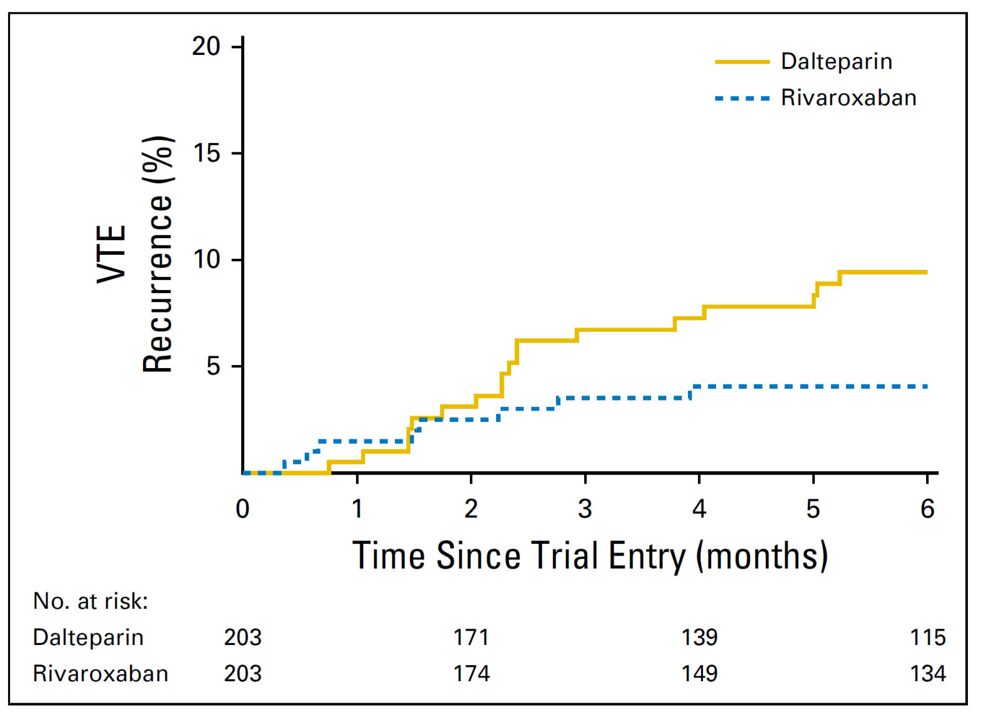
SELECT-D
Recurrent VTE
HR: 0.43 (95% CI: 0.19, 0.99)
11%
4%
Young AM, et al. J Clin Oncol. 2018;36(20):2017-2023

Slide 34
SELECT-D
Major Bleeding
6%
4%
Young AM, et al. J Clin Oncol. 2018;36(20):2017-2023

Slide 35
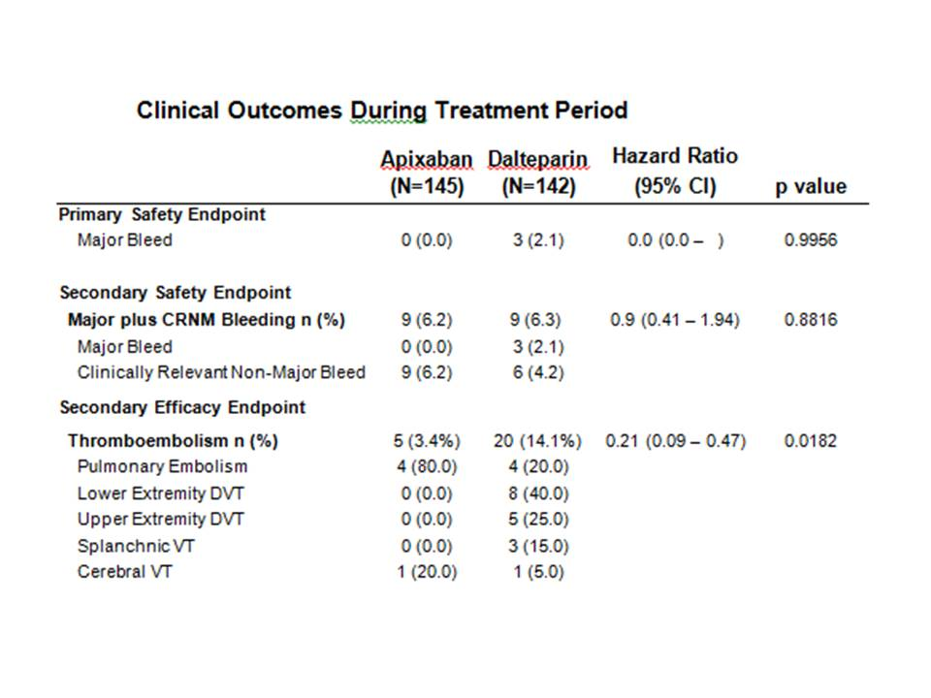
Apixaban, Dalteparin, in Active Cancer Associated Venous Thromboembolism, ADAM VTE Trial
0.0
3 (2.1%)
5(3.4%)
20 (14.1%)
McBane R et al Presented ASH 12/2/2018

Slide 36
1. Randomized, placebo-controlled, double-blind clinical trial assessing
the efficacy and safety of apixaban (2.5 mg twice daily) for thromboprophylaxis in
ambulatory patients with cancer who were at intermediate-to-high risk for VTE
(Khorana score, ≥2) and were initiating chemotherapy.
2. Primary efficacy outcome objectively documented VTE over 180 days and major bleeding
3. 574 patients randomization and 563 included in the modified intention-to-treat analysis.
Carrier M, et al N Engl J Med 2019;380:711

Slide 37
AVERT Study
Carrier M, et al N Engl J Med 2019;380:711

Slide 38
AVERT Study
Carrier M, et al N Engl J Med 2019;380:711

Slide 39
AVERT Study
Carrier M, et al N Engl J Med 2019;380:711

Slide 40
Guidelines 2015-2016
Cancer Associated Thrombosis
ASCO, 2015 (American Society of Clinical Oncology)
  LMWH recommended for initial 5–10 days of established DVT and PE treatment and for long-term secondary prophylaxis for ≥6 months
  Use of DOACs not recommended for patients with malignancy and VTE
ACCP, 2016 ( American College of Chest Physicians)
  DVT /PE and cancer: suggest LMWH over VKA (Grade 2B) or DOACs (all 2C)
  Not high bleeding risk: recommend extended anticoagulation (1B)
  High bleeding risk: No extended anticoagulant therapy over 3 months of therapy (2B)
Lyman GH, et al. J Clin Oncol. 2015;33(6):654
Kearon C, et al. Chest. 2016;149(2):315

Slide 41
Guidelines 2018
Cancer Associated Thrombosis
NCCN, 2018 Treatment Options (National Comprehensive Cancer Network)
  Monotherapy: LMWH (preferred, category 2A; dalteparin, rivaroxaban (2A); fondaparinux (2A); UFH (2B); apixaban for patients who refuse or have compelling reasons to avoid LMWH (2A)
  Combination therapy: LMWH + edoxaban (category 1); LMWH + warfarin, fondaparinux + warfarin, UFH + warfarin, UFH + edoxaban, LMWH + dabigatran, UFH + dabigatran (all category 2A)
  Minimum duration of therapy is 3 months
ISTH, 2018 Treatment Options (International Society of Thrombosis and Hemostasis)
  Cancer Patients, acute VTE diagnosis, low bleeding risk, and no drug-drug interactions with concomitant medications: edoxaban or rivaroxaban
  Cancer Patients, acute VTE diagnosis, and high bleeding risk: LMWH; edoxaban or rivaroxaban can be used if no drug-drug interactions with concomitant medications
NCCN Practice Guidelines in Oncology. version 2.2018
Khorana AA, et al. J Thromb Haemost. 2018;16(9):1891

Slide 42
Hospitalized Medically ill

Slide 43
VTE Burden
Extends Beyond Hospitalization
Among acute medically ill patients:
  Approximately 2.5% of high risk medical patients will have symptomatic VTE or VTE-related death
  More than 150,000 of the 20,000,000 acute medically ill patients each year survive their medical condition but die of VTE
  Rate symptomatic VTE doubles during the 21 days post-discharge even after 10 days of VTE prophylaxis (ADOPT)
  Fatal VTE increases 5-fold between day 10 and day 35 post-discharge even after 10 days of VTE prophylaxis (MAGELLAN)
  Hospital lengths of stay are decreasing in the US, pushing more of the burden on thromboprophylaxis into the post-acute care setting
Spyropoulos AC, et al. Chest. 2011;10:1378;10:194
Goldhaber, et al. N Engl J Med. 2011;365:2167
Cohen, et al. J Thrombolysis. 2011;4:407.

Slide 44
VTE Incidence
Hospital Admission to 3 months Follow Up
Time: Admission to VTE in Days
Spyropoulos AC, et al. Chest. 2011;10:1378

Slide 45
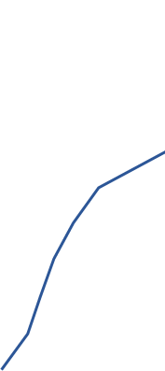
VTE Risk Persists Post-Discharge
Acute Medically iII
SYMPTOMATIC VTE
ACUTE MEDICAL PATIENTS
Real-world analysis of US hospital database (>11,000 M patients)
Greater than 2.0% symptomatic VTE event rate through 40 days
Majority of events occur after hospital discharge and standard prophylaxis
Less than 10% of patients received pharmacologic VTE prophylaxis
post-discharge
70%
2.5%
60%
2.0%
50%%
40%
1.5%
CUMULATIVE 180 DAY
PROBABILITY (%)
SYMPTOMATIC VTE
RATE (%)
30%
1.0%
20%
10%
0.5%
0
0
20
40
DAYS AFTER ADMISSION
Mean Hospital Stay
5.3 DAYS
Amin AN et al. J Hosp Med. 2012; 7(3):231-238.
Notes:
For patients hospitalized with acute medical illness, the risk of VTE persists long after discharge
Looking at cumulative VTE risk through 180 days, it is clear that VTE events occur for weeks following an acute medical illness hospitalization—despite available anticoagulant prophylaxis
Notably, hospital stays are getting shorter, and prophylaxis treatment for acute medically ill patients frequently ends at discharge
The current average hospital stay is just 5 days
Nearly 2% of the 11,000 acute medically ill patients experienced a symptomatic post-discharge VTE
In fact, 57% of all VTE events reported in this study happened after discharge

Slide 46
Extended VTE Prophylaxis In Medical ill Patients
Study (N) | Study Groups
EXCLAIM (5,963) | Enoxaparin 40mg QD x 38±4 days Enoxaparin 40mg QD x 10±4 days
ADOPT (6,528) | Apixaban 2.5mg BID x 30 days Enoxaparin 40mg QD x 10±4 days
MAGELLAN (8,101) | Rivaroxaban 10mg QD x 35±4 days Enoxaparin 40mg QD x 10±4 days
APEX (7,513) | Betrixaban 80mg QD x 35-42 days Betrixaban 40mg, QD x 35-42 days Enoxaparin 40mg, QD x 10+ 4 days
Hull RD, et al. Ann Intern Med. 2010;153:8
Goldhaber SZ, et al. N Engl J Med. 2011;365:2167
Cohen AT, et al. N Engl J Med. 2013;368:513
Cohen AT, et al. N Engl J Med 2016;375:534
Notes:
EXCLAIM- enox vs. placebo
MAGELLAN- riva vs. enox
ADOPT- apix vs. enox
LIFENOX- enox/GCS vs. placebo/GCS

Slide 47
Extended VTE Prophylaxis
Medical Patients
Net Clinical Benefit of Factor Xa Inhibitors
EXCLAIM
ADOPT
MAGELLAN
6
* p < 0.05
More VTE
*
3
*
Incidence (%)
0
0.3
0.8*
More Bleeding
3
(Major Bleeding only)
2.1
1.7
2.7
4.1*
6
(n = 5,963)
(n = 6,528)
(n = 8,101)
Hull R, et al. Ann Intern Med 2010;153:8-18
Cohen A , et al. NEJM 2013;368:513
Goldhaber S, et al. N Engl J Med 2011; 365: 2167

Slide 48
Comparison Medically ill
Extended Thromboprophylaxis
ADOPT
Apixaban
MAGELLAN
Rivaroxaban
APEX
Betrixaban
RRR* = 24.0%
VTE Events
p<0.001
8
p* = 0.006
RRR = 22.8%
p = 0.02
RRR = 12.9%
p = 0.44
4
Incidence (%)
Major Bleeding
0
p=0.04
p<0.001
p=0.55
2
Enox Apix Enox Riva Enox Betrix
Goldhaber S, et al. N Engl J Med 2011; 365: 2167
Cohen A , et al. NEJM 2013;368:513
Cohen et al. N Engl J Med. 2016; 375:534

Slide 49
MARINER Study
Spyropoulos A et al. N Engl J Med 2018;379:1118

Slide 50
VTE Prophylaxis
Hospitalized Medically ill
Agent | Dosing Schedule
Apixaban (ADOPT) | Not FDA approved: 2.5 mg, BID
Rivaroxaban (MAGELLAN) (MARINER) | Not FDA approved: 10 mg, Qday, 7.5 mg, Qday CrCl < 50 cc
Betrixaban (APEX) | 160 mg initial dose, 80mg Qday x 35-42 days CrCl >15 - < 30 cc/min, 40 mg Qday x 35-42 days
Note: UFH or LMWH current recommend prophylaxis

Slide 51
DOACs Peripheral Arterial Disease

Slide 52
Riva 2.5 mg, BID +
ASA 100 mg Qday
Riva 5 mg, BID
ASA 81 mg Qday
Anand S, et al. Lancet 2017

Slide 53
COMPASS Trial
Outcome: Cardiovascular Death, MI, Stroke
Riva + ASA 126/2492 (5%) vs ASA 174/2504 (7%)
HR (.72, 95% CI 0.57-0.90) p= .0047
Outcome: Major Amputation
Riva + ASA 32 (1%) vs ASA 60 (2%) (HR 0·54 95% CI 0·35-0·82) p=.0037
Major Bleeding
Riva 2.5 mg BID + ASA = 3%
ASA = 2%
HR 1.61, 95% CI 1.12-2.3
P= .0089
GI Bleeding
Major Bleeding
Riva 5 mg BID = 3%
ASA = 2%
HR 1.68, 95% CI 1.17-2
P= .0043
GI Bleeding
ASA = 100 mg
Anand S, et al. Lancet 2017

Slide 54
COMPASS Trial
Cumulative Incidence Primary Outcome
ASA
Riva
Riva+ASA
Anand S, et al. Lancet 2017

Slide 55
COMPASS Trial
Cumulative Incidence Major Adverse Limb Events
ASA
Riva
Riva+ASA
Anand S, et al. Lancet 2017

Slide 56
COMPASS Trial
Primary & Secondary Outcomes
Major Cardiovascular
Events
Major Adverse Limb Events
Major Amputation
Major Cardiovasular
Major Amputation
Major Bleeding
ASA
Anand S, et al. Lancet 2017

Slide 57
DOACs Peripheral Arterial Disease
Agent | Dosing Schedule
Rivaroxaban | 2.5 mg BID with ASA 81 mg

Slide 58
DOAC Reversal Agents

Slide 59
Direct Oral Anticoagulants
Key Points | Rivaxaban | Apixaban | Edoxaban | Dabigatran
Target | FXa | FXa | FXa | Factor IIa
T ½ | 7-11 h | 12 h | 9-10 h | 12-17 h
T-Max | 2-4 hrs | 3-4 hrs | 1-2 hrs | 1hr
Clearance | 30% Renal 60% Liver | 25% Renal 75% Liver | 33% Renal 60% Liver | 80% Renal

Slide 60
Major Bleed or Surgery
Intervention
Warfarin
IIa Inhibitor
DOAC
Xa Inhibitor
DOAC
4 Factor PCC
3 Factor PCC
Vitamin K
Idarucizumab
4 Factor PCC
3 Factor PCC
or
Andexanet
Goals of Intervention
Fluid Resuscitation
Provide Rescue Clotting Factors
Provide Anticoagulant Reversing Factor

Slide 61
Major Bleed or Surgery
Intervention
Warfarin
IIa Inhibitor
DOAC
Xa Inhibitor
DOAC
4 Factor PCC
3 Factor PCC
Vitamin K
Idarucizumab
4 Factor PCC
3 Factor PCC
or
Andexanet
Goals of Intervention
Fluid Resuscitation
Provide Rescue Clotting Factors
Provide Anticoagulant Reversing Factor

Slide 62
Feature | Idarucizumab
Structure | Humanized Fab Fragment
Molecular Mechanism | Non-competitive binding
Onset | Immediate
Duration Effect | 12-24 hrs
Proietti M et al Thera & Clin Risk Mgt 2018;14:1483

Slide 63
503 Patients Enrolled
301 Major Bleed and
202 Urgent Surgery or Procedure
Pollack C, et al N Engl J Med.377:431,2017

Slide 64
REVERSE-AD Study
Idarucizumab
Groups
Bleeding Type | Intracranial Hemorrhage | GI Bleed
Group A (301 pts) | 98 (33%) | 137 (46%)
Procedures | Abdomen | Trauma | Cardiac | CNS
Group B (202 pts) | 63 (31%) | 55 (27%) | 37 (18%) | 17 (8%)
Pollack C, et al N Engl J Med.377:431,2017

Slide 65
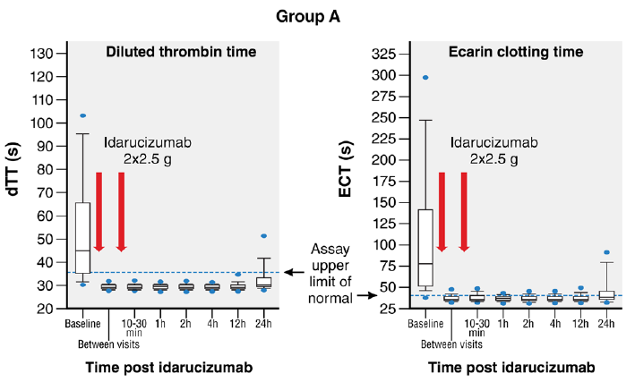
Major Bleeding
Pollack C, et al N Engl J Med. 373:511,2105
Pollack C, et al N Engl J Med.377:431,2017

Slide 66
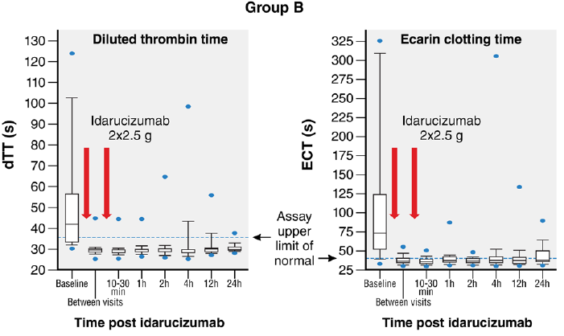
Urgent Surgery or Procedure
Pollack C, et al N Engl J Med. 373:511,2105
Pollack C, et al N Engl J Med.377:431,2017

Slide 67
Group: Urgent Surgery or Procedure
Post Indarucizumab Infusion Complications
Initiation parenteral or oral Anticoagulation
Initiation antiplatelet therapy
Pollack C, et al NEJM.2017377;431

Slide 68
Group: Major Bleeding Patients
Post Idarucizumab Infusion Complications
Initiation parenteral or oral Anticoagulation
Initiation antiplatelet therapy
Pollack C, et al NEJM.377;431, 2017

Slide 69
REVERSE-AD
Thrombotic Events
Group | 30 Day Thrombotic Events | 90 Day Thrombotic Events
Group A (301) | 14 (4.6%) | 19 (6.3%)
Group B (202) | 10 (4.9%) | 15 (7.4%)
Total (503) | 24 (4.8%) | 34 (6.8%)
Group A = Bleeding Group
Group B = Surgery/Procedure
Pollack C, et al NEJM. 2017;377:431

Slide 70
REVERSE-AD
Mortality
Group | 30 Day Mortality | 90 Day Mortality
Group A | 13.5% | 18.8%
Group B | 12.6% | 18.9%
30 Day Mortality Special Groups
16.4% Intracranial Bleed
11.1% GI Bleed
12.7 % Other Sites
Group A = Bleeding Group
Group B = Surgery/Procedure
Pollack C, et al NEJM 2017;377:431

Slide 71
Idarucizumab Dosing Schedule
Administer dose undiluted as an IV bolus either via syringe or as an infusion by hanging the vials. Infusion of each vial should take no longer than 5 to 10 minutes with the second vial of 2.5 g administered no later than 15 minutes after the end of the first 2.5 g vial.
Baseline aPTT (at presentation), repeat at 2 hours post exposure (if exposure time is known) or post-presentation (if exposure time is unknown) and every 12 hours thereafter until aPTT returns to normal.
Anti-Idarucizumab Antibodies detected 5.6%
19/28 pts positive with pre-existing antibodies that were cross reactive
Titers were low and no effect on idarucizumab activity
Pollack C, et al NEJM. 2017;377:431

Slide 72
Major Bleed or Surgery
Intervention
Warfarin
IIa Inhibitor
DOAC
Xa Inhibitor
DOAC
4 Factor PCC
3 Factor PCC
Vitamin K
Idarucizumab
4 Factor PCC
3 Factor PCC
or
Andexanet
Goals of Intervention
Fluid Resuscitation
Provide Rescue Clotting Factors
Provide Anticoagulant Reversing Factor

Slide 73
4 Factor PCC vs 3 Factor PCC
Rescue for DOACs
Factors | 4 Factor PCC | 3 Factor PCC
Factor II | 270 IU | 288
Factor VII | 150 IU | Not Detected
Factor IX | 250 IU | 250 IU
Factor X | 340 IU | 166 IU
Protein S | 210 IU | Not Detected
Protein C | 270 IU | Not Detected
Levi M, et al J Thromb Haemost. 12:1428, 2014

Slide 74
4 Factor PCC
Rivaroxaban and Prothrombin Time
Placebo
Seconds
PCC
Baseline
T=0
15 min
30 min
1 hr
2 hr
4 hr
6 hr
24 hr
Time
Rivaroxaban
20 mg bid
PCC or placebo

Slide 75
1. 35 healthy volunteers received 4 days of rivaroxaban 20 mg twice daily
2. Single 50 IU kg bolus dose 4 Factor PCC or 3 Factor PCC on Day 5
Agent | Reduction PT (sec)
Beriplex (50 IU/kg) (4 Factor PCC) | 2.5-3.5
Profilnine (50 IU/kg) (3 Factor PCC) | 0.6-1.0
Levi M, et al J Thromb Haemost. 12:1428, 2014

Slide 76
Direct Oral Anticoagulant: Rescue
Using Kcentra
Less than 12 hours from DOAC last dose
  Kcentra 50 Units/kg IV to a max of 5,000 units
  If no Kcentra then Profilnine 50 Units/kg IV to a max of 5,000 units
Greater than 12 hours from DOAC last dose
  Kcentra 25 Units/kg IV to a max of 2,500 units
  If no Kcentra then Profilnine 50 Units/kg IV to a max of 2,500 units
Jefferson Approach to Management

Slide 77
Contra-Indications Kcentra
Known anaphylactic or severe systemic reactions to Kcentra or any components in Kcentra including heparin, Factors II, VII, IX, X, Protein C and S, AT III and Human Albumin
Known HIT since Kcentra contain heparin
Clinical Evidence of DIC
Kcentra has not been studied in subjects who had a thromboembolic event, MI, DIC, CVA, TIA, ACS, PAD within the prior 3 months. Kcentra may not be suitable in patients with thromboembolic events in the prior 3 months.

Slide 78
Andexanet Alpha
Feature | Idarucizumab
Structure | Humanized variant Human FXa
Molecular Mechanism | Competitive binding FXa inhibitors
Onset | Immediate
Half Life | 5-7 hrs
Ruff C et al Circulation 2016;134:248

Slide 79
352 patient with acute major bleeding
227 patient (64%) ICH
90 patients (26%) GI Bleeding
Connelly S, et al NEJM 2019

Slide 80
ANNEXA-4 Study
Apixaban
Connelly S, et al NEJM 2019

Slide 81
ANNEXA-4 Study
Rivaroxaban
Connelly S, et al NEJM 2019

Slide 82
ANNEXA-4 Study
Remember to use VTE Prophylaxis Postop
Low titers of anti-andexanet antibodies may develop after administration. None of these antibodies have been found to be neutralizing and none have been found to be cross-reactive with factor X or factor Xa to date.
Connelly S, et al NEJM 2019

Slide 83
Jeff Criteria Andexanet Use
Inclusion Criteria
Restricted to life threatening, salvageable apixaban or rivaroxaban associated CNS bleeding (intracranial or intraspinal)
No history of prior exposure to andexanet
No sepsis or septic shock
Last dose of apixaban / rivaroxaban was administered < 24 hours ago
Patient must have undergone a head CT or MRI scan demonstrating evidence of new or expanding intracranial bleeding
Exclusion Criteria
Glasgow coma score < 7
Intracerebral hematoma volume >60 cc as assessed by the CT volumetric formula ABC/2 (see below*)
For subdural hematomas: maximum thickness >10 mm and midline shift >5 mm
For subarachnoid hematomas, any evidence of hydrocephalus
Infra-tentorial ICH location
Epidural hematomas
Intraventricular extension of hemorrhage
Known Modified Rankin Score of >4 prior to ICH
ABC/2 Formula: A is the greatest hemorrhage diameter by CT, B is the diameter 90° to A, and C is the approximate number of CT slices with hemorrhage multiplied by the slice thickness.

Slide 84
Andexanet Dosing Regimens
Dose | Initial IV Bolus | Follow-On IV Infusion
Low Dose | 400 mg at a target rate of 30 mg/min | 4 mg/min for up to 120 minutes
High Dose | 800 mg at a target rate of 30 mg/min | 8 mg/min for up to 120 minutes
Dose Based on Rivaroxaban or Apixaban
FXa Inhibitor | FXa Inhibitor Last Dose | < 8 hours or Unknown time since last dose of FXa inhibitor | > 8 hours since last dose of FXa inhibitor
Rivaroxaban | < 10 mg | Low Dose | Low Dose
 | > 10 mg or unknown | High Dose
Apixaban | < 5 mg | Low Dose
 | > 5 mg or Unknown | High Dose
Low titers of anti-andexanet antibodies may develop after administration. None of these antibodies have been found to be neutralizing and none have been found to be cross-reactive with factor X or factor Xa to date.

Slide 85
Andexanet Update
Plant in Spain now manufacturing “Generation Two” supply
200 mg vials to replace 100 mg vials by June 2019
Purchasing from Portola open to all hospitals
Availability expanded to select wholesalers, inc. McKesson Specialty
Portola has implemented wastage and expired product replacement program
$22,000 Low Dose and $49,500 High Dose Protocol
NTAP reimbursement from CMS unchanged: Maximum $14,062.50

Slide 86
Reversal Agents for Surgery
Warfarin and DOACs
Reversal Agent | Warfarin | Dabigatran | Apixaban, Edoxaban, Rivaroxaban
4-PCC | First Line | Second Line if Idarucizumab not available | Second Line if Andexanet not available
aPCC | Not-Indicated | Second Line If Idarucizumab and 4-PCC not available | Second Line if 4-PCC not available
FFP | Second Line If 4-PCC not available | Not Indicated | Not Indicated
Idarucizumab | Not-Indicated | First Line | Not Indicated
Andexanet | Not-Indicated | Not-Indicated | First Line

Slide 87
Bleeding Alert Activated
Major Bleeding or
Urgent Surgery/Procedure
Assess
Team Alert
H&P
Labs
Imaging
Manage
Rescue or Reversal Agent
Follow Up
Post
Rescue or Reversal
Management

Slide 88
Geno.Merli@Jefferson.Edu

Slide 89
Jefferson Warfarin Rescue
INR 2 - < 4
  Vitamin K 10 mg IV (over 10 minutes, maximum rate is 1mg/min)
  4 Factor Concentrate (Kcentra)*: 25 U/kg IV push, max dose 2500 Units at a rate of 0.12 ml/kg/min IV. If no 4 Factor Concentrate then give
  3 Factor Concentrate (Profilnine): 25 unit/kg by IV push over 2-5minutes
INR 4-6
  Vitamin K 10 mg IV (over 10 minutes, maximum rate is 1mg/min)
  4 Factor Concentrate (Kcentra)*: 35 U/kg IV push, max dose 3500 Units at a rate of 0.12 ml/kg/min. If no 4 Factor Concentrate then give
  3 Factor Concentrate (Profilnine) 50 units/kg IV push over 2-5 minutes
INR > 6
  Vitamin K 10 mg IV plus Administer
  4 Factor Concentrate (Kcentra)*: 50 U/kg IV push, max dose 5000 Units at a rate of 0.12 ml/kg/min. If no 4 Factor Concentrate then give
  3 Factor Concentrate (Profilnine) 50 units/kg IV push over 2-5 minutes
* Heparin Allergy or History of HIT give Profilnine
If no 4 Factor or 3 Factor Concentrates give FFP 10-20 ml/ kg, IV
Recheck INR 4 hours after the infusion then in 12 hours

