Slide 1
IACUC Occupational Health & Safety Programs

Slide 2
Occupational Health and Safety: Overview
Goals of a Health and Safety Program
Prevention of injuries and accidents through
Elimination
Avoidance
Control of Hazards

Slide 3
Occupational Health and Safety: Overview
Methods
Protocol Review
Risk Assessment
Standard Operating Procedures
Training
Accident/Incident Reporting and Investigation

Slide 4
Methods: Protocol Review
Risk Assessment
Standard Operating Procedures
Training
Accident/Incident Reporting and Investigation

Slide 5
Methods: Protocol Review
Risk Assessment
Standard Operating Procedures
Training
Accident/Incident Reporting and Investigation
Identify Hazards
Chemical- flammables corrosives toxins
Physical- noise  electrical radiation
Animal- zoonosis allergy infectious
Biological- rDNA infectious/pathogenic

Slide 6
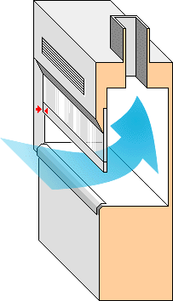
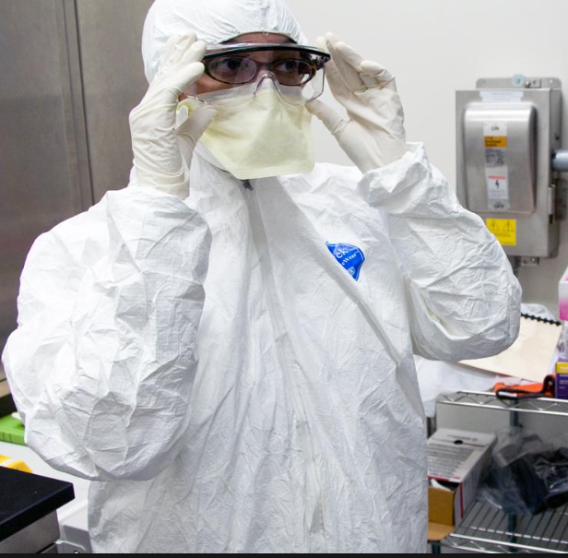
Methods: Protocol Review
Risk Assessment
Standard Operating Procedures
Training
Accident/Incident Reporting and Investigation
Designate Hazard Controls
Elimination or Substitution
Engineering/Facility Design
Administrative
Personal Protective Equipment

Slide 7
Methods: Protocol Review
Risk Assessment
Standard Operating Procedures
Training
Accident/Incident Reporting and Investigation
Topics:
Hazards/Diseases
Signs/Symptoms of Exposure
Chemical Hygiene
Biosafety
SOP’s
Waste
Occupational Hygiene
Emergency Procedures

Slide 8
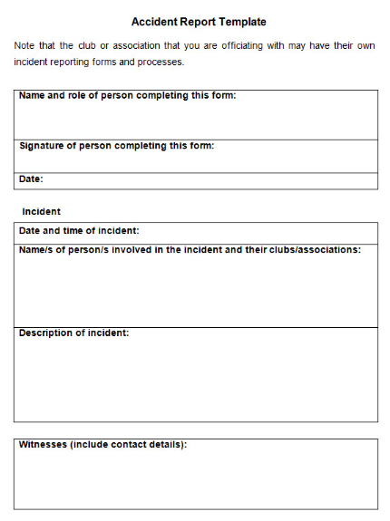
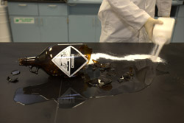
Methods: Protocol Review
Risk Assessment
Standard Operating Procedures
Training
Accident/Incident Reporting and Investigation

Slide 9
Resources
University of Scranton
Chemical Hygiene Plan
Biosafety Plan
National Research Council
Occupational Health & Safety in the Care & Use of Research Animals
U.S. Centers for Disease Control and Prevention
Biosafety in Microbiology and Biomedical Laboratories (5th Edition, 2007)

Slide 10
Contact
Health and Safety Office
x4277
x7888
University Police Department
healthandsafety@scranton.edu

