Slide 1
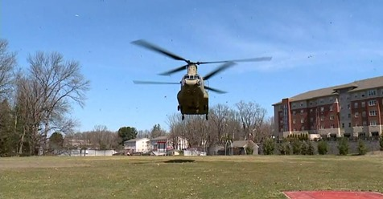
Royal Warrior Army ROTC
US Army Cadet Command partners with The University of Scranton
to recruit, educate, train and Commission leaders of Character for the
Active Army, Army Reserve and the Army National Guard.

Slide 2
The University of Scranton
Army ROTC
Class and Training opportunities
MS 138 Army Physical Fitness Training
MS 101 Concepts of Leadership
MS 111L Leadership Application Lab

Slide 3
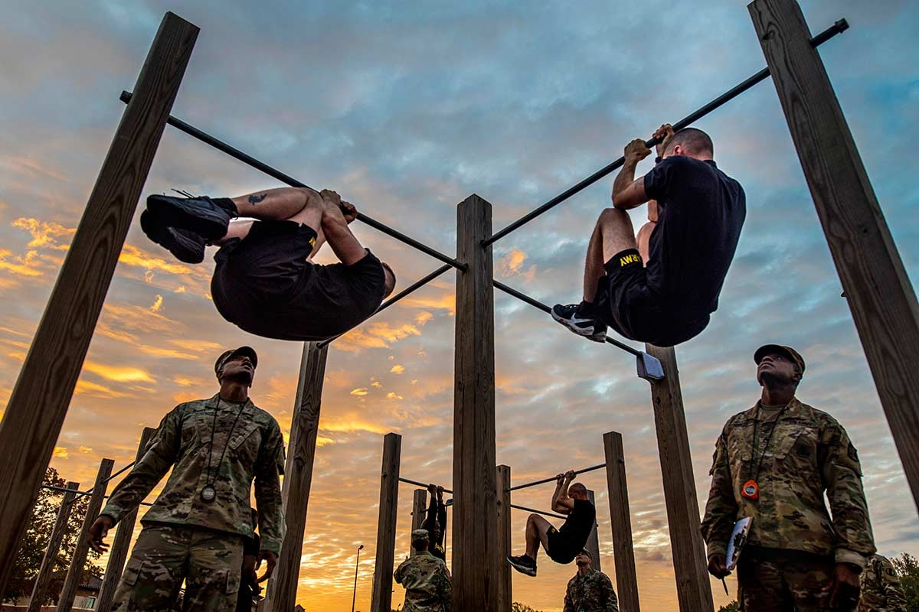
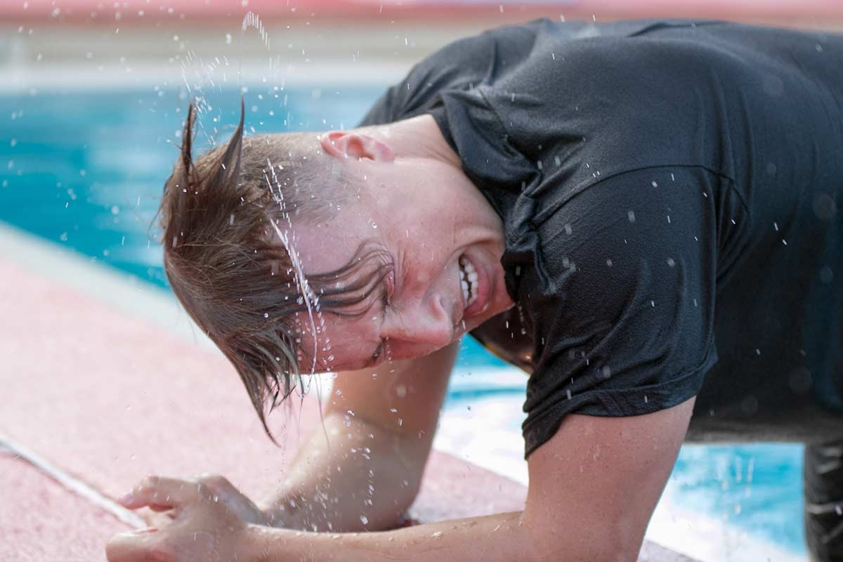
MS 138 Physical Fitness Training
Class focuses on Cross Fit, Aquatics, Ruck Marching
Cardio Endurance and competitive sports
M-W-F 6:30 AM to 7:20 AM, 1 Credit
Byron Gym, Fitzpatrick Field and locations
around campus

Slide 4
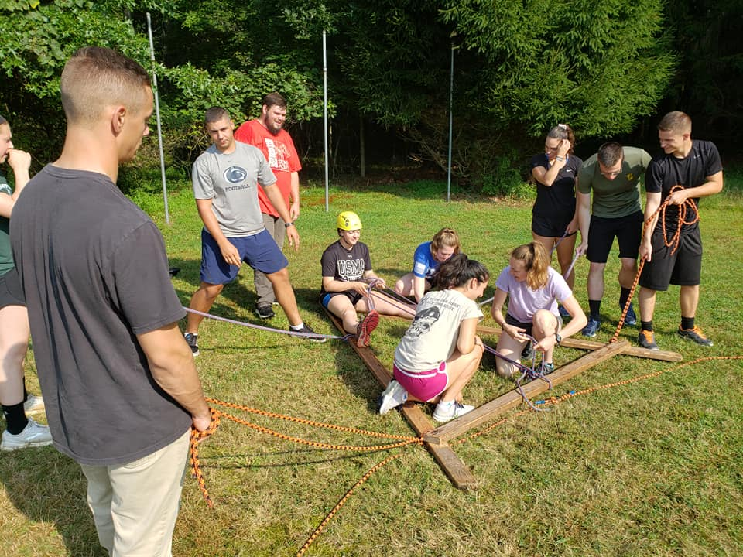
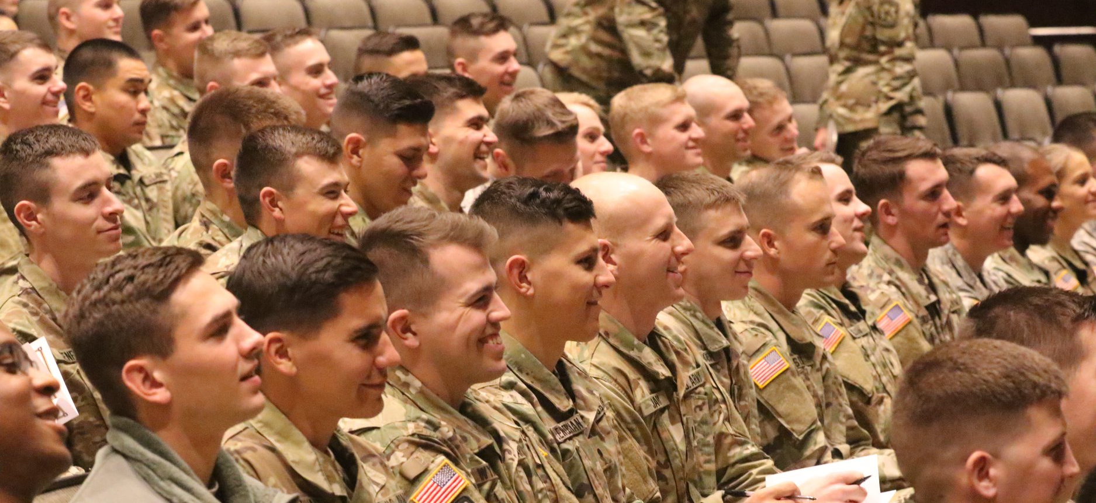
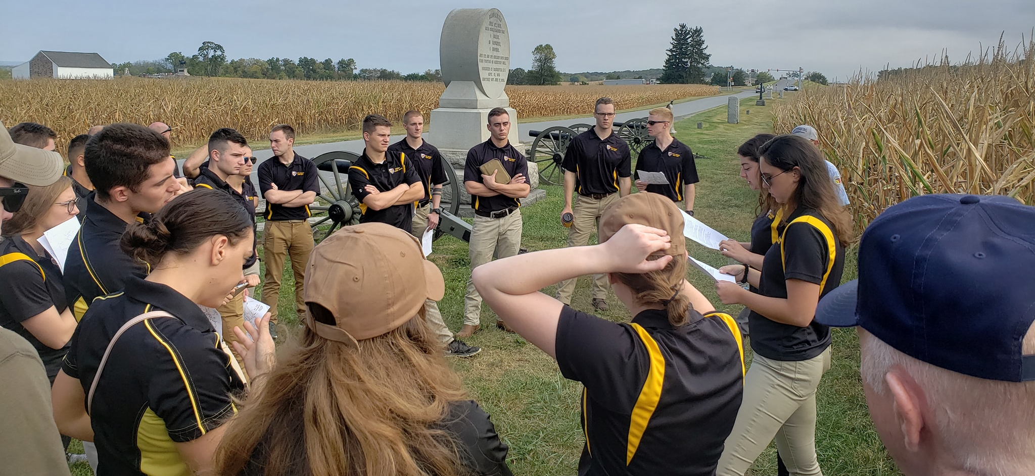
General MacArthur Leadership Presentation
Team Building Exercise
MIL 101 Concepts of Leadership
Class focuses on Military Writing and Briefing style, Leadership Theory, Military History, Mission Planning, Time Management Techniques and Team Building
MS 101A Mon 2:00 PM to 2:50 PM
Or
MS 101B Tues 10:00 AM to 10:50 AM
Cadet led historic battle Staff Ride

Slide 5
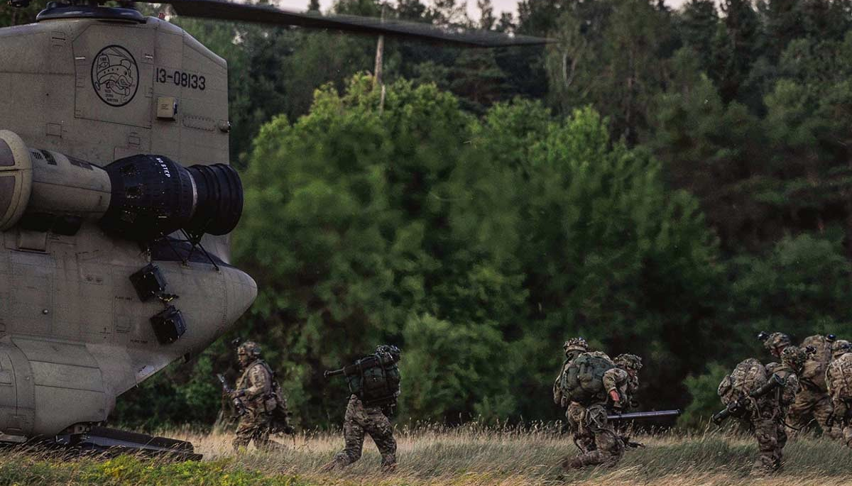
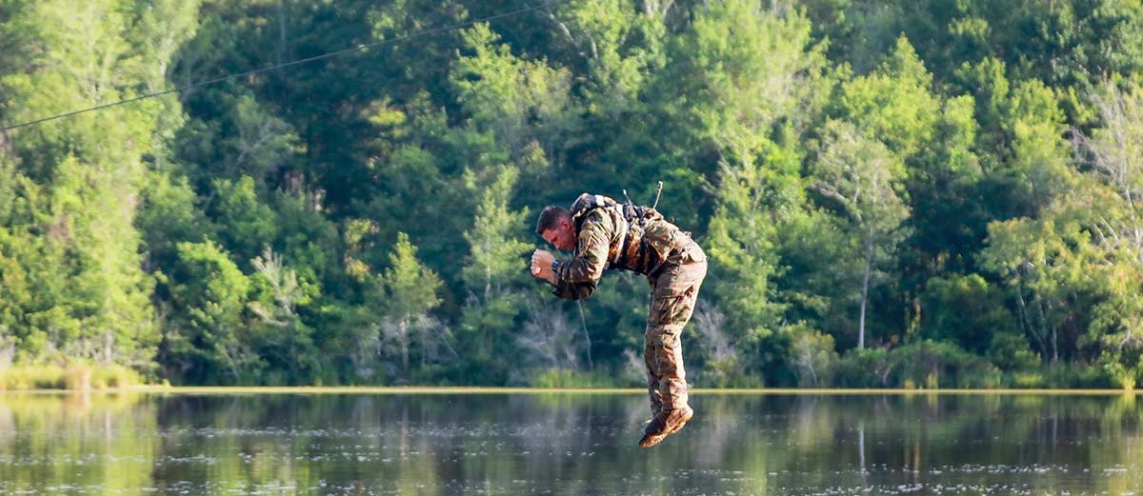
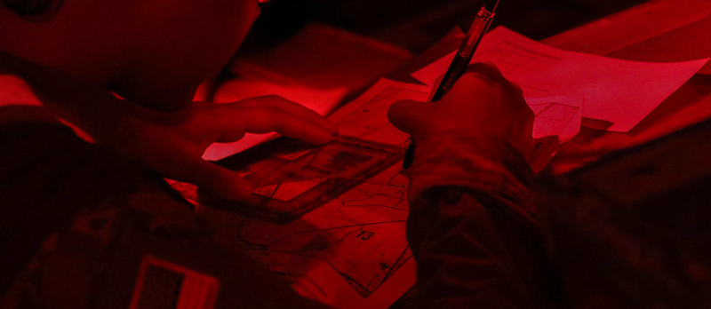
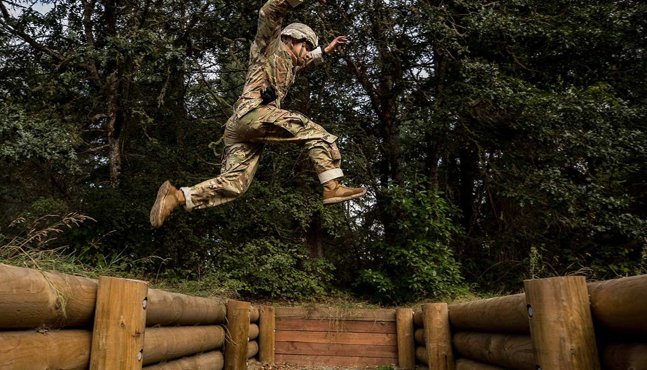
MS 101 Concepts of Leadership
Field Training Exercise
FTX focuses on Land Navigation, Leadership and physically challenging confidence events
One weekend per semester
Included in MS 101A and 101B Concepts of Leadership

Slide 6
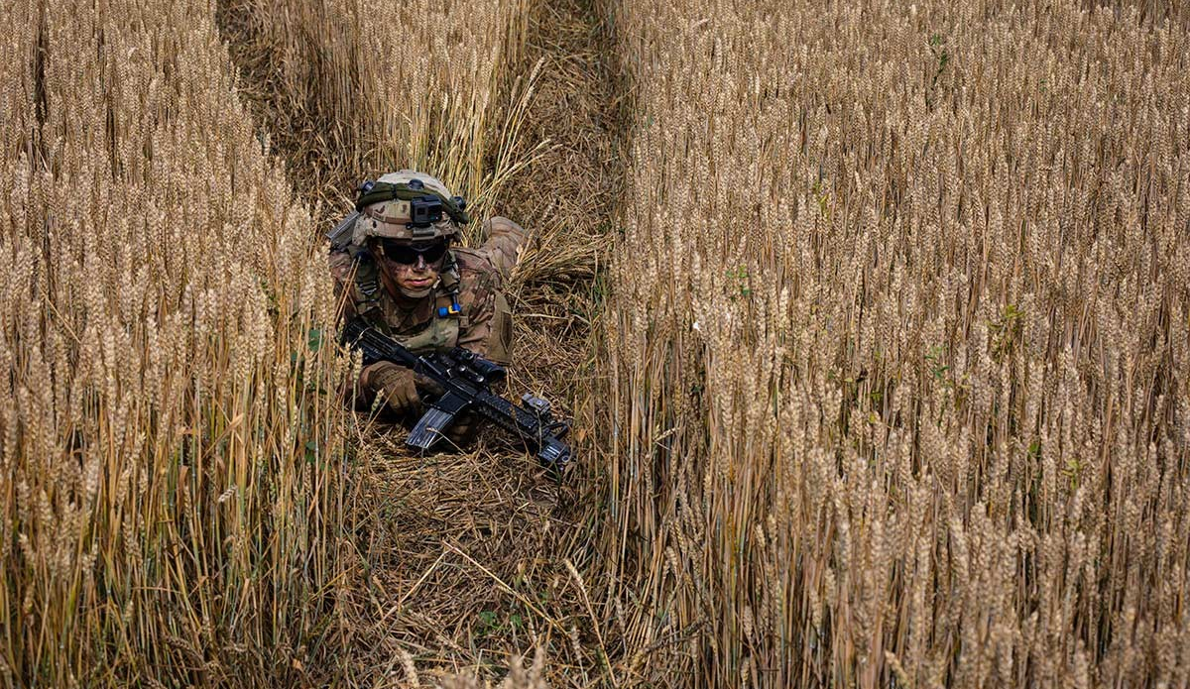
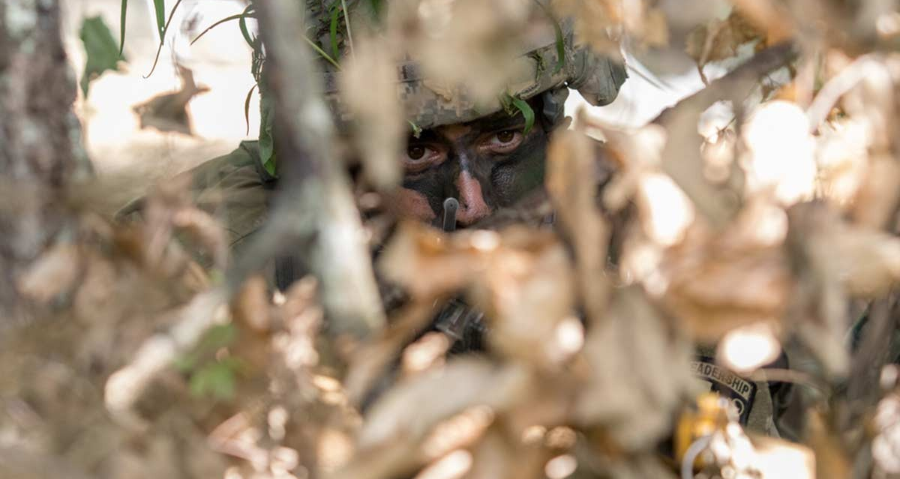
MS 111L Leadership Lab
Class focus starts off with individual
Soldier skills and progresses to small
Unit tactical and leadership skills.
Thurs – 4:30 PM to 6:30 PM, 0 Credit
Rock Hall start for most sessions
then move to locations around campus

Slide 7
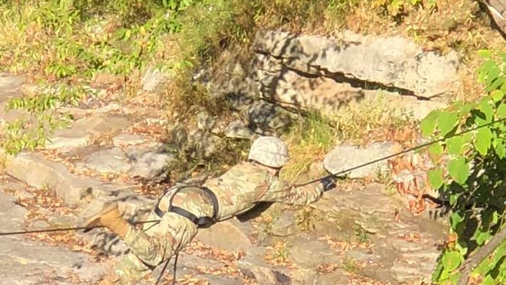
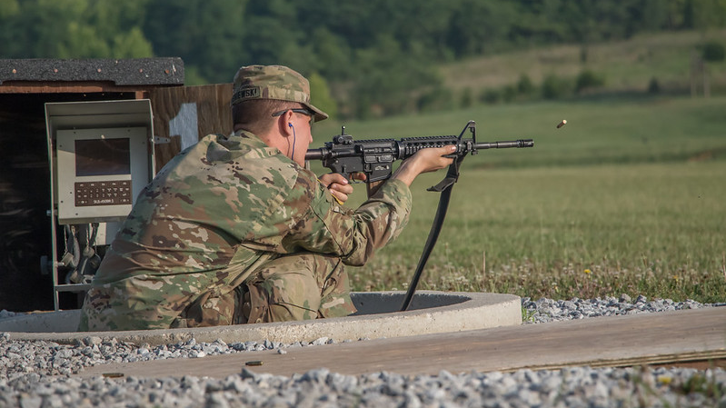
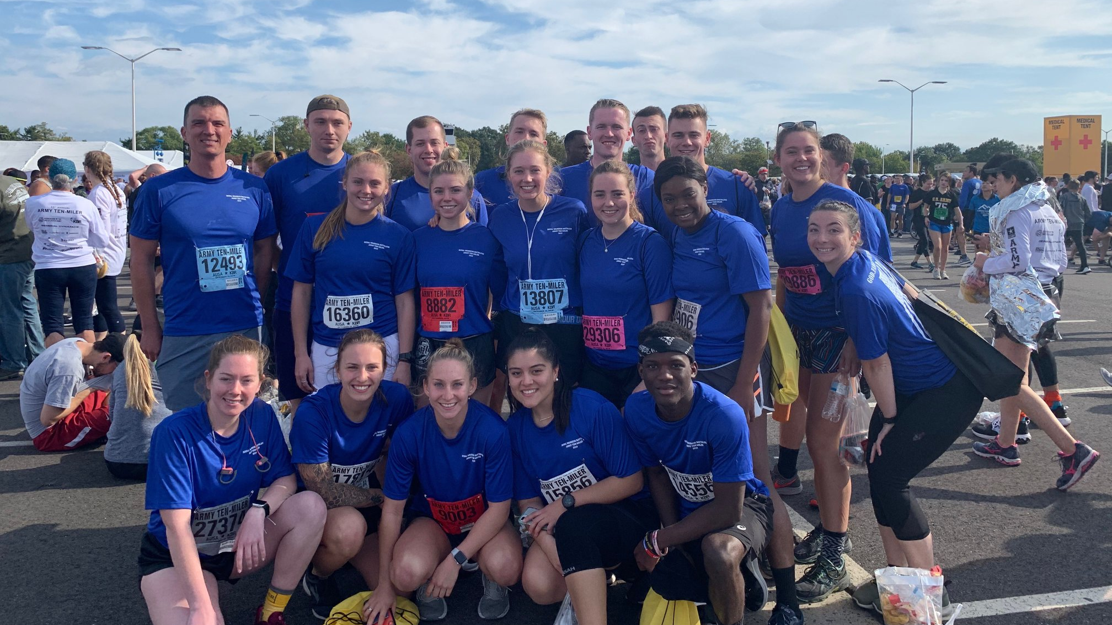
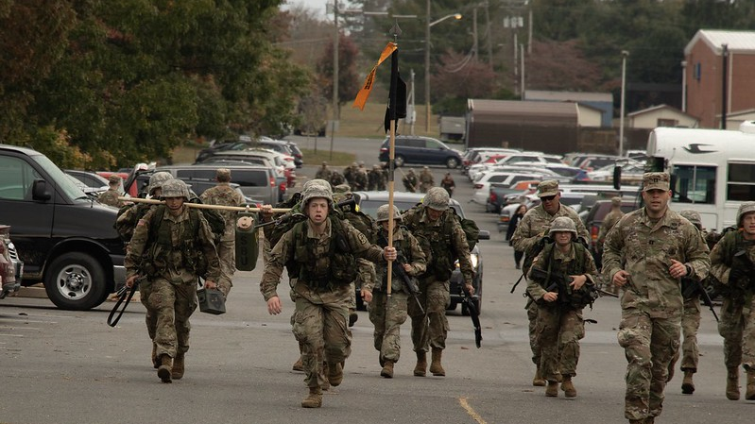
One Rope Bridge
Rifle Familiarization
Optional Weekend
Super Labs and Training Events
Army 10 Mile Team
Ranger Challenge

Slide 8
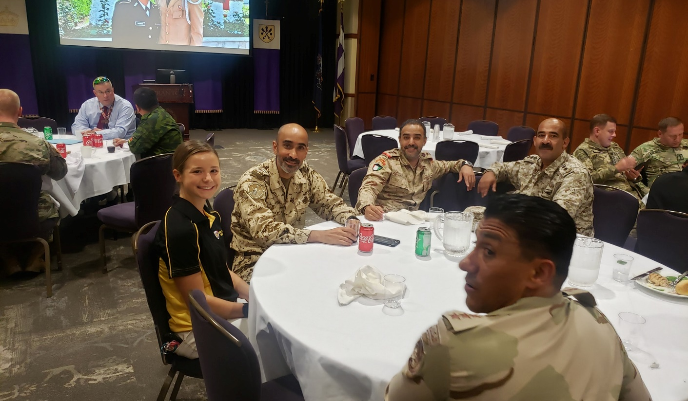
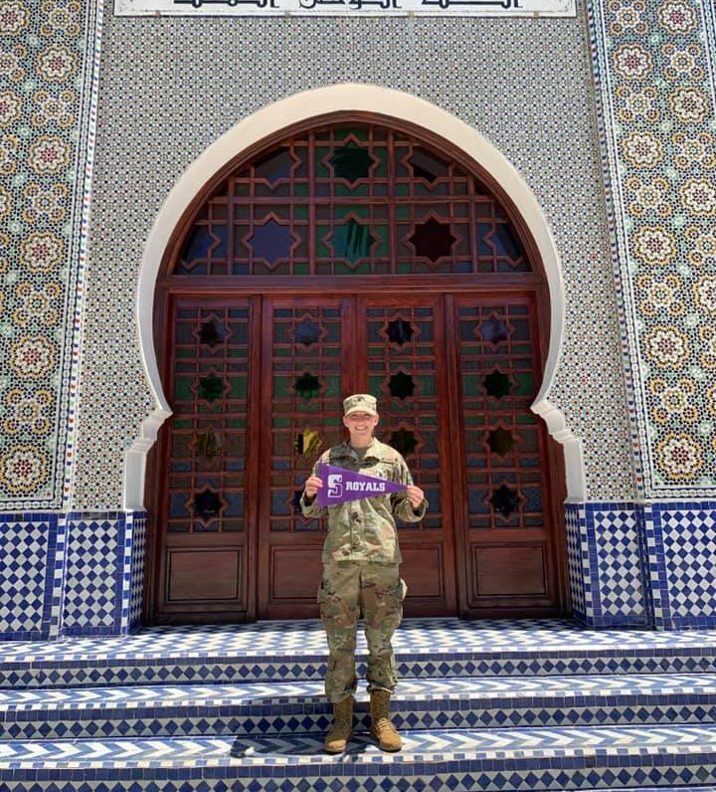
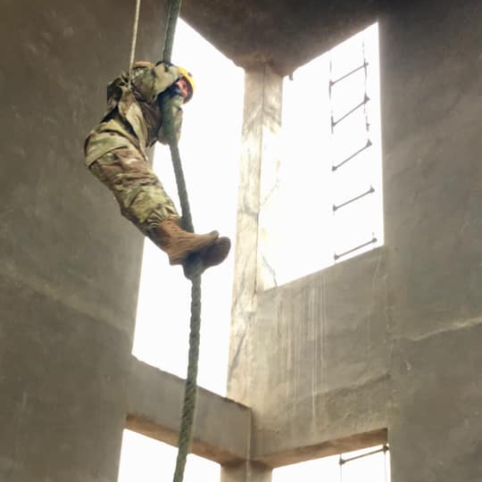
Army War College Senior International Fellows
Study Abroad Morocco
Cultural Understanding and Learning Program
Peru
Project Global Officer
Oman
You can Study Abroad and work with military officers from other countries through Army ROTC

Slide 9
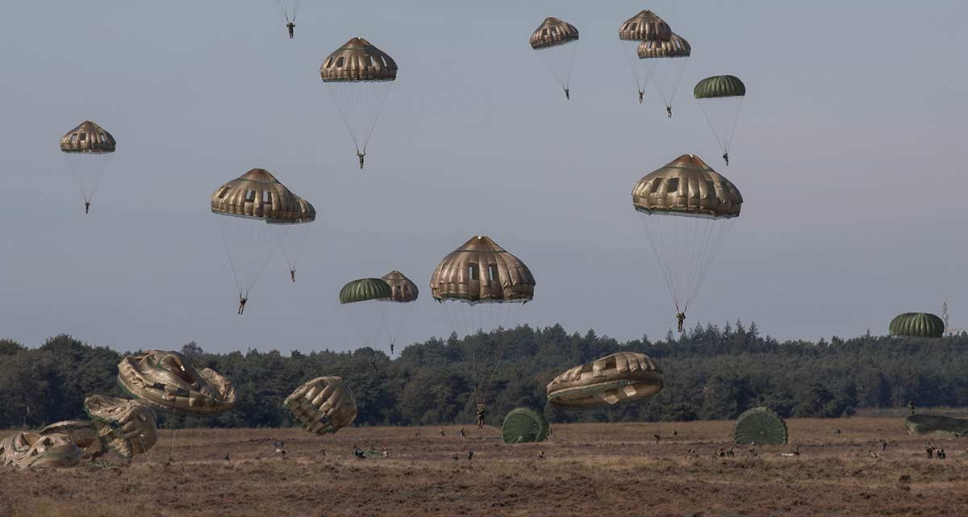
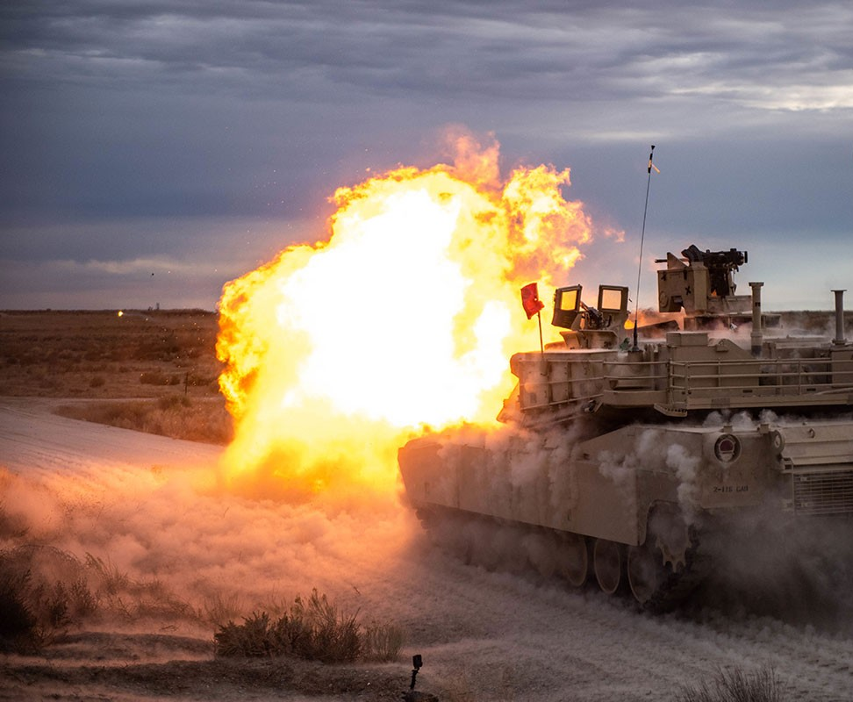
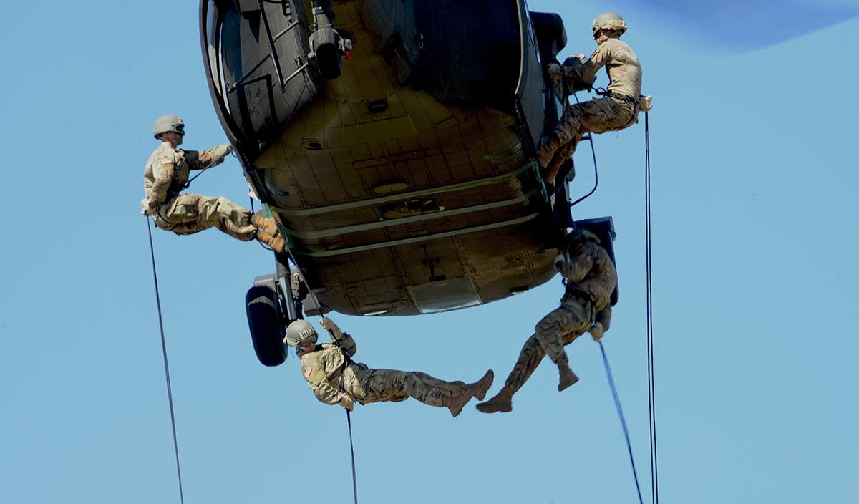
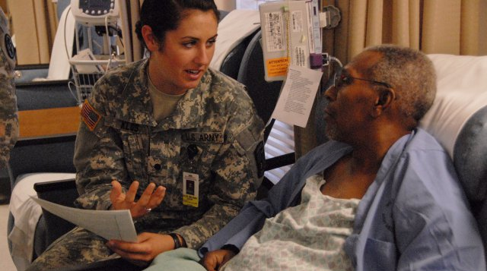
Army Airborne School
Cadet Troop Leader Training
Participate in
Army ROTC CADET
Summer Training opportunities
Nurse Summer Training Program
Army Air Assault School

Slide 10
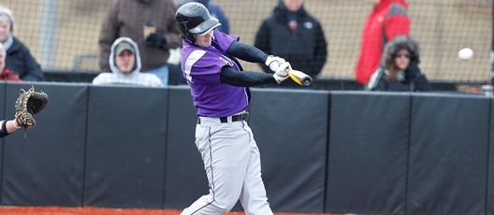
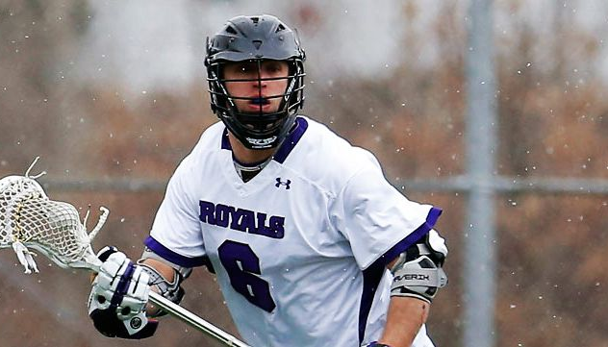
Most Army ROTC
Cadets participate in Varsity or Club level sports

Slide 11
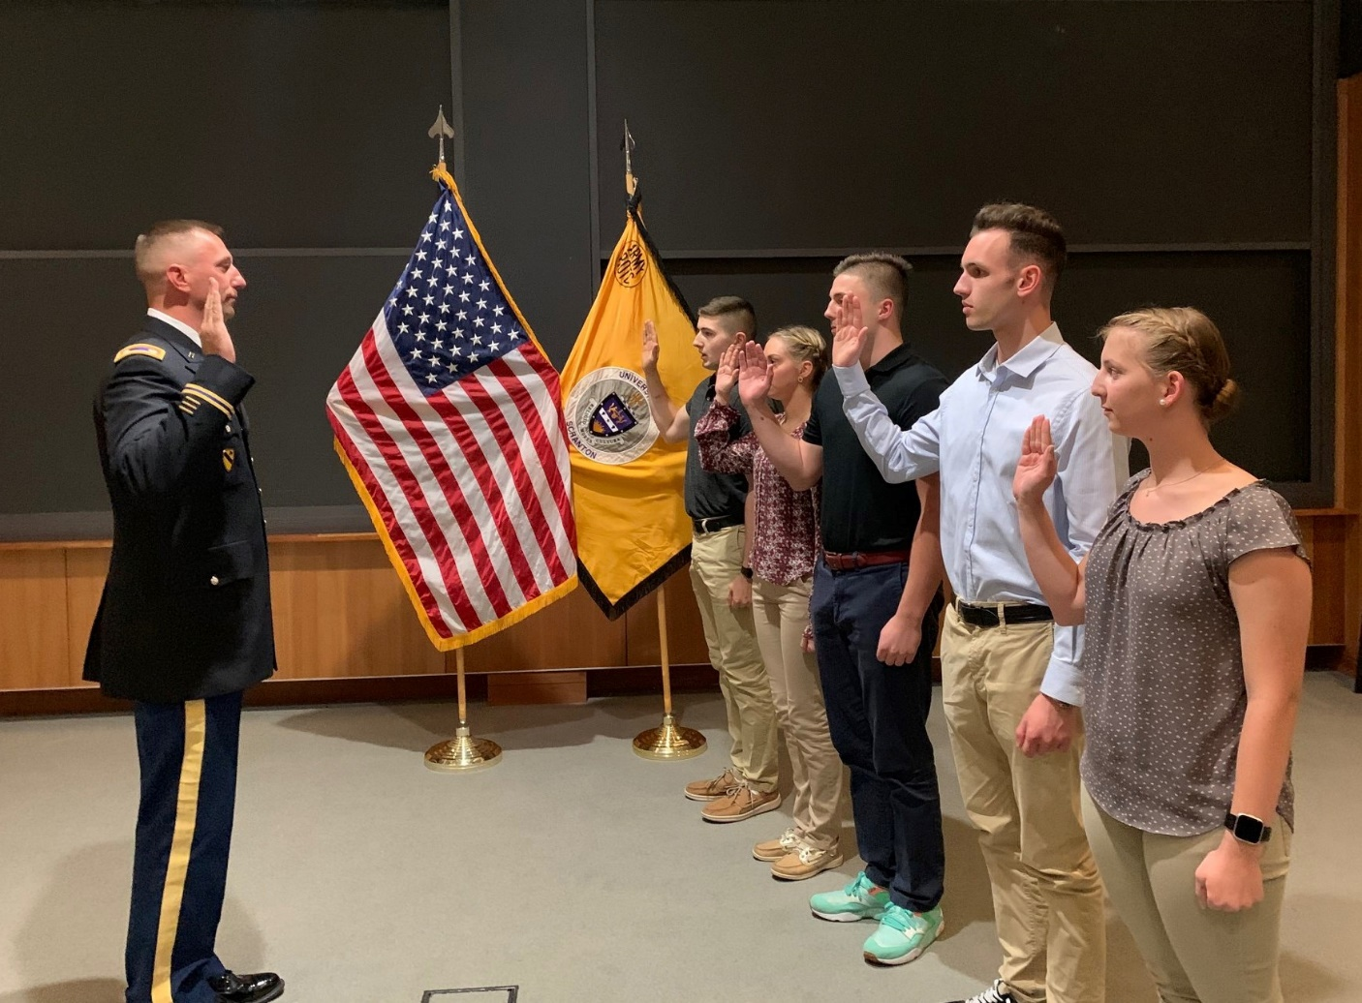
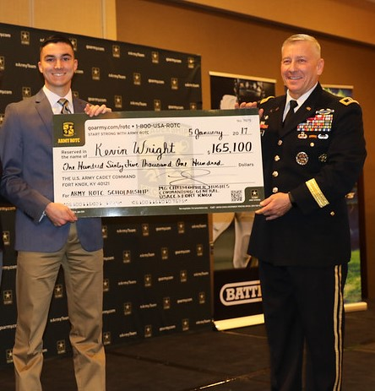
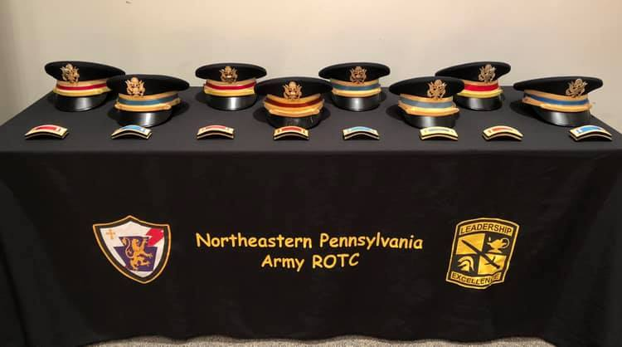
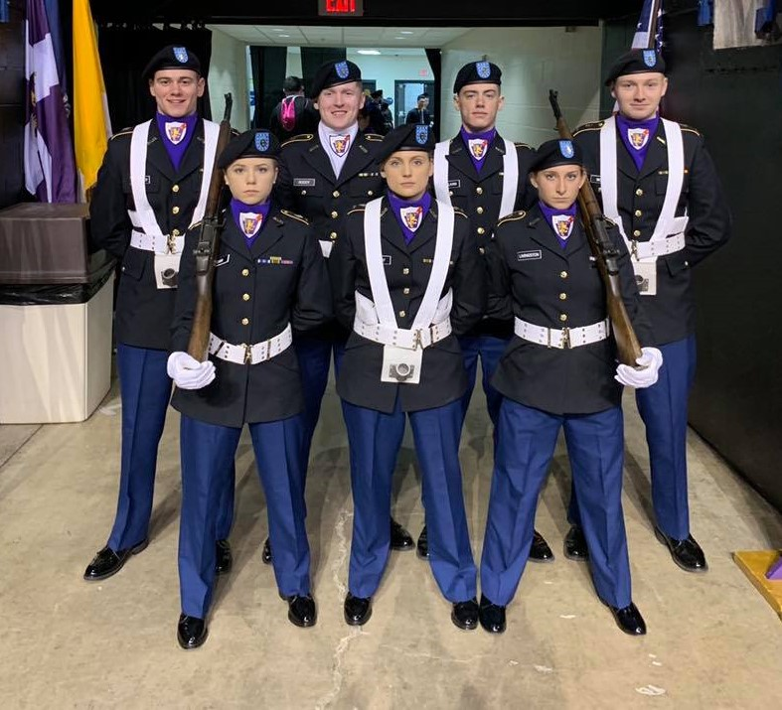
No obligation for taking the first 2 years of Army ROTC
Classes are free to all Students and all books and equipment is provided Scholarships and contracts are available to all UofS Majors
Army ROTC 2,3 and 4 year full scholarships available to qualified students
Scholarships include:
Full tuition and fees
$1200 a year book allowance
$420 a month Cadet Pay
Special Nursing, Engineering and Critical Language major scholarships
and Army Reserve and National Guard options available

Slide 12
The University of Scranton awards Full Room and Board Scholarships to all National Army ROTC Scholarship winners
and Full Room Scholarships to all
Campus Based Army ROTC Scholarship winners

Slide 13
To apply for a National Army ROTC scholarship
Visit: https://www.goarmy.com/rotc/high-school-students/four-year-scholarship.html
Application window opens for current HS Juniors 12 June each year and closes 4 February of your senior year
Steps:
Apply online
Conduct Cadet Fitness Assessment
Interview with an ROTC PMS
Complete the CBEF online
Boards convene Oct, Jan and Mar
Join the team
ROYAL WARRIORS
For questions about Army ROTC
Scholarships and Benefits, ROTC Contracts and Qualification
or future Service obligations
Contact Mr. Bill Ramsey
Army ROTC Enrollment Officer
At 978-815-4039 or herbert.ramsey@scranton.edu
To speak to a University of Scranton
Army ROTC Cadet
Contact Cadet Shannon Everton
Royal Warrior Cadet Recruiting Officer
At shannon.everton@scranton.edu
Or
Cadet Caitlin Maurer
At caitlyn.maurer@scranton.edu

Slide 14
Where to learn more about the Army and Army ROTC opportunities
Royal Warrior Army ROTC Department official page
https://www.scranton.edu/academics/cas/military-science/index.shtml
Royal Warrior Army ROTC official Face Book page
https://www.facebook.com/NEPAARMYROTC
Cadet Command Cadets in action page
https://www.flickr.com/photos/136737541@N05/
Cadet Command official leadership training site
https://futurearmyofficers.army.mil/
Cadet Special Training and Internships
https://www.cadetcommand.army.mil/cadet_internships.aspx
Cadet Command News and official information page
https://www.cadetcommand.army.mil/
Army Officer Jobs and career fields
https://www.goarmy.com/careers-and-jobs/become-an-officer.html

