Slide 1
Recreational Activities Impact on Activity and Participation in Persons with Parkinson’s Disease: A Systematic Review
Emily Gilinger SPT
Tyler Huggins SPT
Joshua Taylor SPT
Brian Gargiulo SPT
Dr. Renée Hakim, PT, PhD, Board Certified Neurologic Clinical Specialist

Slide 2
Overview
Introduction
Purpose
Methods
PRISMA
PEDro Scores
Results
Conclusion
Limitations
Future Research
Clinical Relevance
Acknowledgements

Slide 3
Introduction
Progressive neurodegenerative disease affecting motor, sensory and cognitive function²
Impact one’s independence and greatly increases risk of falls²
Second most common chronic neurodegenerative disease³
Notes:
Parkinson’s disease (PD) affects approximately 10 million people worldwide and is the second most common chronic neurodegenerative disease.1-6 Based on prolonged life expectancy and demographic changes, the estimated prevalence of PD is expected to double by 2040.1 PD is typically managed pharmacologically, with the replacement of dopamine to control motor symptoms. While motor symptoms are a primary symptom of Parkinson’s disease, non-motor symptoms, such as anxiety and depression, have been reported to have a greater impact on disability.1-4, 6 Individuals experiencing anxiety and/or depression are more likely to be found in poor social communication, adopt a sedentary lifestyle, present with increased progression of physical symptoms, and in turn increase the incidence of relapse, healthcare costs, and caregiver distress.1,2, 6 While pharmacological agents have been shown to help with non-motor symptoms, drug interactions and negative side effects are common occurrences.1,6 Adopting a complementary and alternative management approach to treating mild-to-moderate Parkinson’s disease allows patients to combat the severity, progression, and development of motor and non-motor symptoms.5 Mind-body exercises including yoga, Tai Chi, dancing, cycling, and boxing have been some of those mentioned and studied, looking at the beneficial effects on physical and psychological outcomes regarding activity and participation.1-6

Slide 4
Introduction
Typically pharmacologically managed³
Drug interactions and negative side effects are common occurrences³
Complementary or alternative approach allows patients to combat motor and non-motor symptoms³

Slide 5
Purpose
The purpose of this systematic review was to evaluate the effects of novel, recreational interventions on activity and participation in persons with mild to moderate Parkinson’s Disease (PD).

Slide 6
Methods
Search Engines:
ProQuest Nursing and Allied Health, Wiley, Science Direct, CINAHL, and PubMed/Medline
Limits:
Peer Reviewed, RCT, English language

Slide 7
Search Terms
(“Parkinson's disease” OR “Parkinson disease” OR "PD" OR “Parkinsons disease” OR “Parkinson’s”)
AND
(“mind-body exercise” OR “fitness” OR “recreational activities” OR “hobbies” OR “exercise”)
AND
(“RCT” OR “Randomized Control Trial" OR "Randomised Control Trial")

Slide 8
Definitions
Recreational activities - physical or mental activity pursued primarily for pleasure¹
Hobby - an activity done regularly in one's leisure time for pleasure¹
Leisure activities - an activity free from the demands of work or duty with a sense of unhurried ease¹

Slide 9
Definitions
Non-conventional - not part of a standard physical therapy protocol¹
Mind-body exercises - form of exercise that combines body movement, mental focus, and controlled breathing to improve strength, balance, flexibility, and overall health¹

Slide 10
Selection Criteria
Selection criteria included:
RCT design,
participants with mild to moderate PD,
and recreational activity as an intervention (defined by leisure activity or non-conventional PT treatment).

Slide 11
Outcome Measures
Unified Parkinson Disease Rating Scale (UPDRS):
Consists of the following five segments:
Mentation, Behavior, and Mood,
ADL,
Motor sections,
Modified Hoehn and Yahr Scale, and
Schwab and England ADL scale⁴
Minimal Clinical Important Difference (MCID) of -3.25 pts for meaningful improvement⁵

Slide 12
Outcome Measures
Parkinson Disease Questionnaire (PDQ-39):
Primarily used in clinical trials of therapeutics intended to benefit individuals with Parkinson’s disease
Self-report questionnaire
Assesses Parkinson’s disease-specific health related quality⁶
MCID of -4.72 pts for meaningful improvement⁷

Slide 13
PRISMA
Identification
Records identified through database searching (n = 1319)
Records after duplicates removed (n = 927)
Screening
Records screened by
title and abstract (n = 927)
Records excluded based on title or abstract (n = 853)
Eligibility
Records assessed for
eligibility (n = 74)
Records excluded, with reasons (n = 59)
Conventional PT (n = 28)
Incorrect outcome measures (n = 7)
Study design (n = 20)
Population (n = 1)
Irrelevant (n = 2)
Included
Records included (n = 15)
13

Slide 14
PEDro Scores
Author, Year | 1 | 2 | 3 | 4 | 5 | 6 | 7 | 8 | 9 | 10 | 11 | Total
Combs et al ⁸ | Y | Y | Y | Y | N | N | Y | N | Y | Y | Y | 7/10
Duncan et al ⁹ | Y | Y | N | Y | N | N | Y | N | N | Y | Y | 5/10
Foster et al ¹⁰ | Y | Y | N | Y | N | Y | N | N | Y | Y | N | 5/10
Gao et al ¹¹ | Y | Y | N | Y | N | N | Y | Y | N | Y | Y | 6/10
Hackney et al ¹² | Y | Y | N | Y | N | N | Y | N | N | Y | Y | 5/10
Ni et al ¹³ | Y | Y | N | Y | N | N | N | Y | Y | Y | Y | 7/10
Lee et al ¹⁴ | Y | Y | Y | Y | N | Y | Y | Y | Y | Y | Y | 9/10
Li et al ¹⁵ | Y | Y | N | Y | N | N | Y | Y | Y | Y | Y | 7/10
Notes:
Change table to author, PEDro score, and intervention, comments (frequency, intensity, duration)
Numbers on the top can be found in pamphlet, explain evidence total
Explain difficulty of blinding therapist and intervention

Slide 15
PEDro Scores
Author, Year | 1 | 2 | 3 | 4 | 5 | 6 | 7 | 8 | 9 | 10 | 11 | Total
Kurt et al ¹⁶ | Y | Y | Y | Y | Y | N | N | Y | Y | Y | Y | 8/10
Rios Romenets et al ¹⁷ | Y | Y | N | Y | N | N | N | Y | Y | Y | Y | 6/10
Shanahan et al ¹⁸ | Y | Y | Y | Y | N | N | Y | N | N | Y | Y | 6/10
Sharma et al ¹⁹ | Y | Y | N | Y | N | N | N | N | N | Y | N | 3/10
Van Puymbroeck et al²⁰ | Y | Y | Y | Y | Y | N | N | Y | Y | Y | Y | 8/10
Vergara-Diaz et al ²¹ | Y | Y | N | Y | N | N | Y | N | N | Y | Y | 5/10
Volpe et al ²² | Y | Y | Y | Y | N | N | Y | N | N | Y | Y | 6/10

Slide 16
Results
Samples ranged from 10-90 subjects (580 total)
Treatment parameters varied widely
Durations ranged from 8 weeks to 2 years
Frequency of application varied between 1-2 days per week and 60-90 minutes per session⁸⁻²²

Slide 17
Results
Four out of 15 studies found statistically significant improvements in PDQ scores as follows:
within group
Boxing (-4.0 pts)⁸ and
Yoga (-11.5 pts)¹³
between groups
Tai Chi (-7.65 pts)²¹,
Yoga (-16.7 pts)¹³,
Irish set dancing (-8.4 pts)²² and
Argentine Tango (-7.5 pts)¹⁷
Notes:
Note that negative value is good using UPDRS and PDQ, negative score = better score

Slide 18
Results
Seven out of 15 studies found statistically significant improvements in UPDRS scores as follows:
within groups
Waltz, Argentine Tango, and Ballroom Tango (-8.05, -21.0, -7.2 pts)^{12, 9, 17},
Turo Qi (-6.2 pts)¹⁶,
Yoga (-10.9, -10.6 pts)^{13, 19}
between groups
Irish set dancing (-7.2 pts)²²,
Turo Qi (-6.2 pts)¹⁶ and
Tai Chi (-6.4 pts)²⁰

Slide 19
Results
Subgroup meta-analyses showed improved overall mean differences (MD) for activity and/or participation as indicated by:
UPDRS scores (n=12; MD=-6.704; 95% CI [9.48, -3.92])
PDQ scores (n=6; MD=-6.066; 95% CI [-10.41, -1.71])

Slide 20
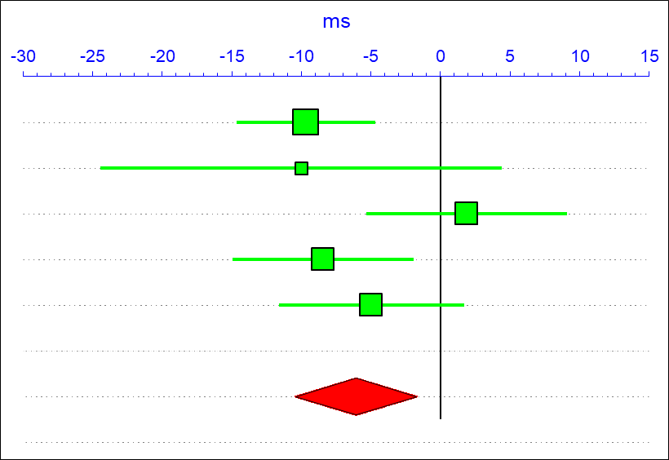
PDQ Meta-Analysis
Notes:
Explain meta-analysis
Change in score
Red is combined data – collapsed data

Slide 21
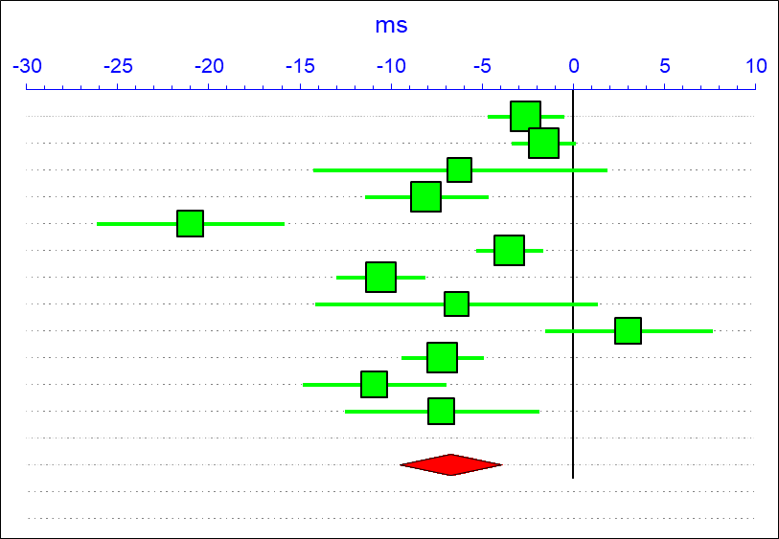
UPDRS Meta-Analysis

Slide 22
Conclusion
There is moderate to strong evidence in support of using various recreational, leisure activities to improve activity and participation levels in persons with Parkinson’s Disease.
Notes:
Through our research, we concluded that there is moderate to strong evidence in support of using various recreational, leisure activities to improve the activity and participation levels in persons with Parkinson’s Disease.

Slide 23
Limitations
Small sample sizes
Self-report outcome measures
Inadequate long-term patient follow-up
Only 4 databases used in the search
Studies varied by frequency and duration
Notes:
There were various limitations in our study that should be discussed. Studies included in our research often yielded smaller sample sizes, limiting the statistical power of the articles. Self-report outcome measures were utilized throughout various studies, which often leads to more subjective results based on the patient’s experience. Few studies did not perform long-term follow-up, defined as follow-up of more than 6 months after the conclusion of the study. While our search yielded increased studies, only 4 databases were employed for collecting data. This may have limited the amount of studies that were captured in our search, preventing us from obtaining all the pertinent data. Lastly, the studies collected in our search varied in frequency and duration, increasing the difficulty of comparing and concluding beneficial interventions.

Slide 24
Future Research
Future studies should focus on:
Optimal training parameters
Providing operationalized descriptions of interventions
Additional evidence on boxing
Notes:
Future studies should focus on determining the optimal training parameters per activity to promote long-term improvements and to provide operationalized descriptions of interventions to allow others to easily reproduce the activity. Additional research should be focused on boxing, as it is the most novel intervention regarding treatment of Parkinson’s and has little high level evidence on the topic.

Slide 25
Clinical Relevance
Outcomes were more pronounced as they were significantly associated with continuing exercise outside of the study intervention.
The most successful programs that exceeded Minimal Clinically Important Difference (MCID) values as follows:
Tai chi and yoga, alone or combined with traditional therapy, for an average of 60 minutes, 2-3 times per week over 12-24 weeks.
Notes:
Practicing clinicians should consider educating and referring patients to participate in recreational programs to promote increased activity, participation, and symptom management as part of the long-term management in persons with Parkinson’s Disease. It was also concluded that the effects of improved patient-reported outcomes in recreational interventions were more pronounced as they were significantly associated with continuing exercise outside of the study intervention.
Based on the research collected, the most successful programs included tai chi and yoga, alone or combined with traditional therapy, for an average of 60 minutes, 2-3 times per week, over a 12-24 week time period.

Slide 26
Acknowledgements
Dr. Renée Hakim, PT, PhD, NCS
Dr. Tracey Collins, PT, PhD, MBA, GCS
Ian O’Hara, MSLIS
Physical Therapy Department at The University of Scranton
28
Notes:
My colleagues and I would like to thank our research advisor, Dr. Renee Hakim, our Scientific Inquiry professor, Dr. Tracey Collins, the librarian who assisted us during our data collection, Ian O’Hara, and the rest of the Physical Therapy Department at the University of Scranton.

Slide 27
References
Caspersen CJ, Powell KE, Christenson GM. Physical activity, exercise, and physical fitness: definitions and distinctions for health-related research. Public Health Rep. 1985;100(2):126-131
Parkinson’s Disease Foundation. Statistics on Parkinson’s Disease. Accessed September 27, 2016. http://www.pdf.org/en/parkinson_statistics 2. Khallaf ME, Fayed EE.
Kowal SL, Dall TM, Chakrabarti R, Storm MV, Jain A. The current and projected economic burden of Parkinson’s disease in the United States. Mov Disord. 2013;28(3):311–8.
Movement Disorder Society-Sponsored Unified Parkinson's Disease Rating Scale Revision. Shirley Ryan AbilityLab - Formerly RIC. https://www.sralab.org/rehabilitation-measures/movement-disorder-society-sponsored-unified-parkinsons-disease-rating-scale. Accessed October 2, 2019.
Horvath K, Aschermann Z, Ács P, et al. Minimal clinically important difference on the Motor Examination part of MDS-UPDRS. Parkinsonism Relat Disord. 2015;21(12):1421-1426. doi:10.1016/j.parkreldis.2015.10.006.
Parkinson's Disease Questionnaire - 39. Shirley Ryan AbilityLab - Formerly RIC. https://www.sralab.org/rehabilitation-measures/parkinsons-disease-questionnaire-39. Accessed October 2, 2019.
Horvath K, Aschermann Z, Kovács M, et al. Minimal clinically important differences for the experiences of daily living parts of movement disorder society-sponsored unified Parkinsons disease rating scale. Mov Disord. 2017;32(5):789-793. doi:10.1002/mds.26960.
Combs SA, Diehl MD, Chrzastowski C, et al. Community-based group exercise for persons with Parkinson disease: A randomized controlled trial. Neuro Rehab. 2013;32(1):117-124. doi:10.3233/NRE-130828
Duncan RP, Earhart GM. Are the effects of community-based dance on Parkinson disease severity, balance, and functional mobility reduced with time? A 2-year prospective pilot study. J Altern Complement Med. 2014 Oct;20(10):757-63. Doi: 10.1089/acm.2012.0774.
Foster ER, Golden L, Duncan RP, Earhart GM. Community-based Argentine tango dance program is associated with increased activity participation among individuals with Parkinson’s disease. Arch Phys Med Rehab. 2013;94(2):240-249. doi:10.1016/j.apmr.2012.07.028
27

Slide 28
References
Gao Q, Leung A, Yang Y, et al. Effects of Tai Chi on balance and fall prevention in Parkinson’s disease: a randomized controlled trial. Clin Rehab. 2014;28(8):748-753. doi:10.1177/0269215514521044.
Hackney ME, Earhart GM. Effects of dance on movement control in Parkinson’s disease: a comparison of Argentine tango and American ballroom. J Rehab Med. 2009;41(6):475-481. doi:10.2340/16501977-0362
Ni M, Signorile JF, Mooney K, et al. Comparative effect of power training and high-speed yoga on motor function in older patients with Parkinson disease. Arch Phys Med Rehab. 2016;97(3):345-354.e15. doi:10.1016/j.apmr.2015.10.095
Lee H-J, Kim S-Y, Chae Y, et al. Turo (Qi Dance) Program for Parkinson’s disease patients: randomized, assessor blind, waiting-list control, partial crossover study. Explore (NY). 2018;14(3):216-223. doi:10.1016/j.explore.2017.11.002
Li F, Harmer P, Liu Y, Eckstrom E, Fitzgerald K, Stock R, Chou LS. A randomized controlled trial of patient-reported outcomes with tai chi exercise in Parkinson's disease. J Clin Mov Disord. 2014 Apr;29(4):539-45. doi: 10.1002/mds.25787
Kurt EE, Büyükturan B, Büyükturan Ö, Erdem HR, Tuncay F. Effects of Ai Chi on balance, quality of life, functional mobility, and motor impairment in patients with Parkinson’s disease. Disabil Rehabil. 2017;40(7):791-797. doi:10.1080/09638288.2016.1276972
Rios Romenets S, Anang J, Fereshtehnejad S-M, Pelletier A, Postuma R. Tango for treatment of motor and non-motor manifestations in Parkinson’s disease: A randomized control study. Complement Ther Med. 2015;23(2):175-184. doi:http://dx.doi.org/10.1016/j.ctim.2015.01.015
Shanahan J, Morris ME, Bhriain ON, Volpe D, Lynch T, Clifford AM. Dancing for Parkinson Disease: a randomized trial of Irish set dancing compared with usual care. Arch Phys Med Rehab. 2017;98(9):1744-1751. doi:10.1016/j.apmr.2017.02.017
Sharma N, Colgrove Y, , Robbins K, Wagner K. A randomized controlled pilot study of the therapeutic effects of yoga in people with Parkinson′s disease. Int J Yoga. 2015;8(1):74. doi:10.4103/0973-6131.146070.
Van Puymbroeck M, Walter A, Hawkins BL, et al. Functional improvements in Parkinson’s disease following a randomized trial of yoga. Evid Based Complement Alternat Med. 2018;2018:1-8. doi:10.1155/2018/8516351
Vergara-Diaz G, Osypiuk K, Hausdorff JM, et al. Tai Chi for reducing dual-task gait variability, a potential mediator of fall risk in Parkinson’s disease: a pilot randomized controlled trial. Glob Adv Health Med. 2018;7:216495611877538. doi:10.1177/2164956118775385.
Volpe D, Signorini M, Marchetto A, Lynch T, Morris ME. A comparison of Irish set dancing and exercises for people with Parkinson’s disease: a phase II feasibility study. BMC Geriatr. 2013;13(1). doi:10.1186/1471-2318-13-54.
28

Slide 29
Questions?
29

